Slide 1
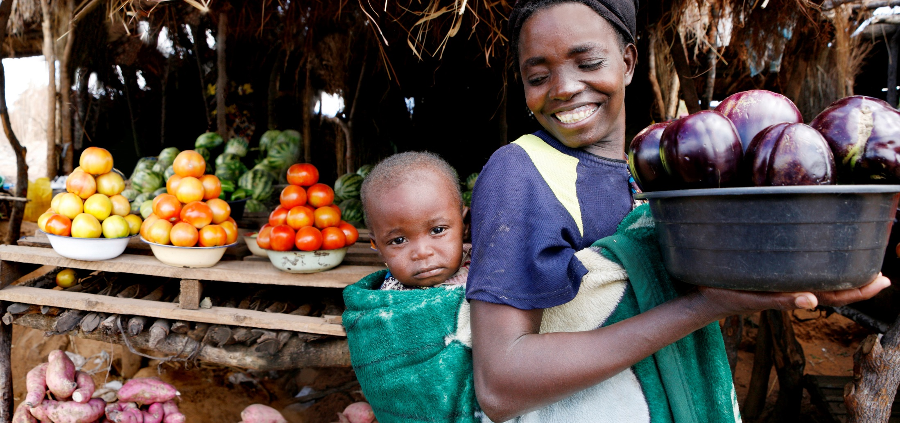
Nutrition as the Entry Point to Strengthening Health Systems
Tim Quick, Tina Lloren, Alice Nkoroi, Aimee Rurangwa, Alejandro Soto

Slide 2
NACS: A Systems Approach to Integrating Nutrition Assessment, Counseling & Support linking Clinic & Community Services
Clinical Mgmt
Treatment & management of acute & chronic infections & non-communicable disease (NCDs)
Community
Community Services:
Nutrition screening & referral to clinics
Nutrition & dietary counseling
WASH
Economic strengthening, livelihood & food security support
Assessment:
Anthropometric,
Biochemical,
Clinical,
Dietary,
Food Security
Support:
Food by Prescription: therapeutic/ supplementary (TSF) MN supplements
Community referrals
Clinic
Counseling:
Adherence & retention,
Diet, WASH
Maternal, Infant & young child feeding

Slide 3
Establish Programs from Site Level - Up, Not National Level - Down: Proof of Principle based on Data
National
Provincial
District
Clinic/Community

Slide 4
NACS through QI: Team-Driven, Data-Driven
Site-level service delivery teams meet regularly
Teams prioritize services, establish indicators & set targets
Teams coached/work on data management -- how will data be captured, analyzed & reported
Teams assess baseline data relative to targets, identify problems/barriers & test changes
Teams review (month-by-month) change data & determine what to institutionalize & what new changes to test
Team share learning across sites

Slide 5
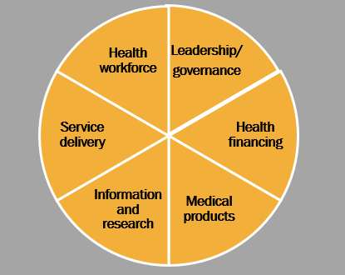
WHO Health Systems Strengthening Framework: 6 Building Blocks

Slide 6
Using Nutrition as an Entry Point to Strengthening Health Systems
Bangladesh
Cote d’Ivoire
DR Congo
Ethiopia
Ghana
Guatemala
Haiti
Indonesia
Lesotho
Madagascar
Malawi
Mozambique
Namibia
Nigeria
Tanzania
Uganda
Vietnam
Zambia

Slide 7
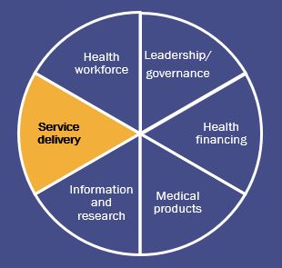
Malawi: Using QI Methods to Strengthen Service Delivery Alice Nkoroi

Slide 8
Context
In Malawi HIV and TB care and treatment services are widely scaled up.
However, nutrition interventions for vulnerable adolescent and adult PLHIV and TB clients are not as widely scaled up.
Geographic coverage of CMAM services is high.
High death rate among children with severe acute malnutrition admitted to the inpatient care, commonly associated with HIV and AIDS.
Since 2015 FANTA, has supported the MOH to roll-out nutrition focused quality improvement activities in 52 health facilities.

Slide 9
The Model for Improvement

Slide 10
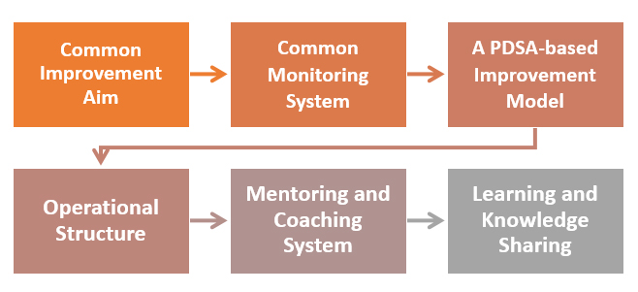
Steps in the Design of the Quality Improvement Collaborative

Slide 11
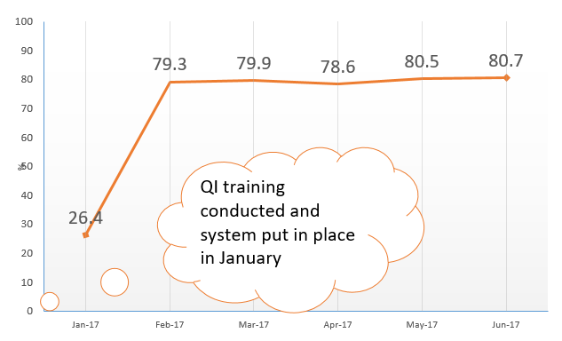
Results: Increased Number of PLHIV and TB Clients Who Receive Nutrition Assessment, Counseling, and Support

Slide 12
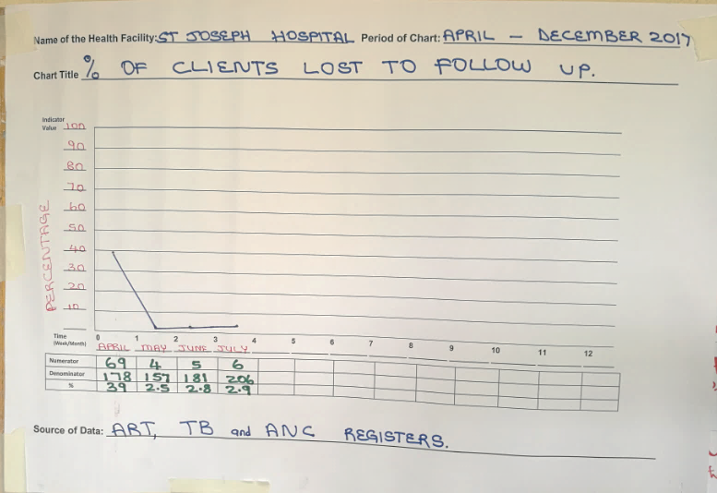
Results: Reduction in the Number of PLHIV and TB Clients Lost to Follow-up

Slide 13
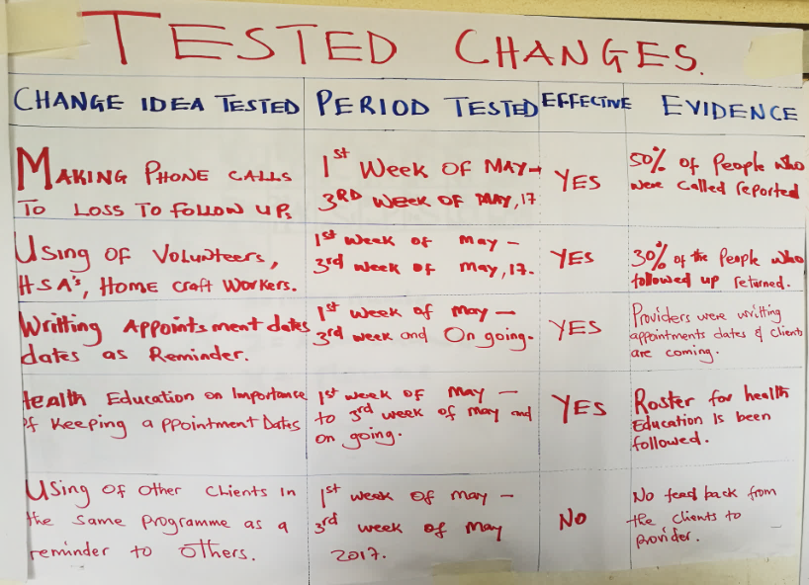
Examples of Changes Tested to Retain Clients in HIV and TB Care and Treatment

Slide 14
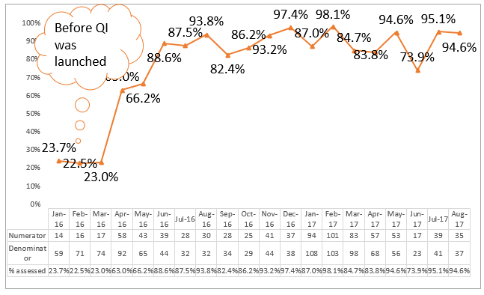
Results: Improved Initial Clinical and Nutrition Assessment of SAM Children

Slide 15
Additional Results
Better teamwork among health service providers, each provider understands their role and contribution in care and treatment.
A shift to patient-centered and competence-building mentorship and coaching.
Improved monitoring, reporting, and use of data by facility-level service providers.
Improved understanding of quality management among health care providers. The facility QI teams are applying their skills to improve other health services.

Slide 16
Key Takeaways
QI has improved nutrition outcomes and contributed to an improvement in pediatric health and HIV/AIDS outcomes (the 90:90:90 goals).
QI has improved health care providers’ performance and accountability in delivering care and treatment to patients.

Slide 17
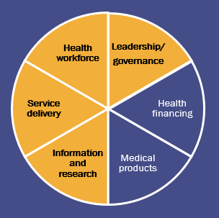
Cote d’Ivoire: Coaching and Community-Facility Linkages Aimee Rurangwa

Slide 18
Context
FANTA has provided technical assistance for the integration of nutrition care and support into HIV services since 2009.
Key activities:
Advocacy
Capacity building
Quality improvement
Referral systems
Two system approaches to nutrition programming contributed to HSS:
FANTA developed a coaching approach to improve providers’ performance.
FANTA built facility-community linkages to track ART clients between facilities, social centers, and the community.

Slide 19
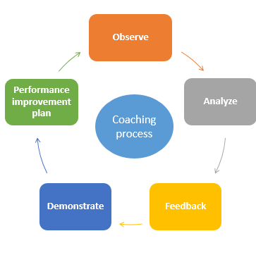
The Coaching Process
Client flow process diagram
Coaching model

Slide 20
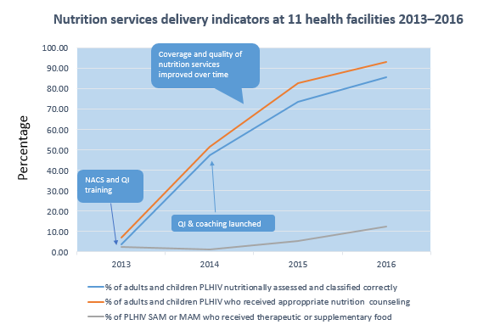
Results: Improvement of Integration and Quality of Nutrition Services Over Time

Slide 21
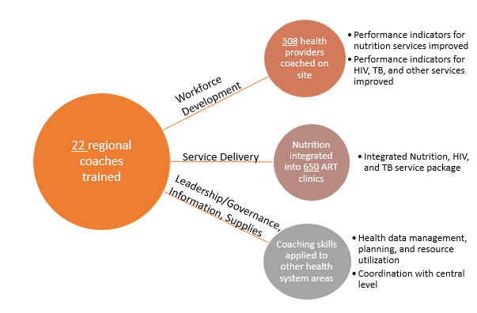
Results: Improvement in Cross-cutting Areas

Slide 22
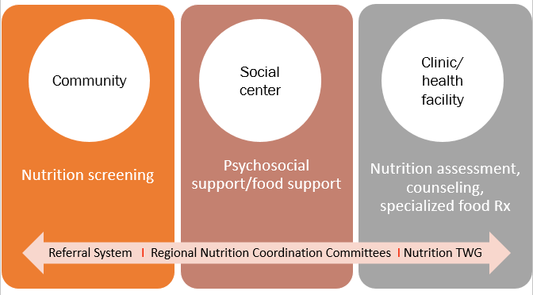
Community-Clinic Linkages for Improved Services along the Continuum of Care

Slide 23
Results: Linking More Clients to Care, Improved Retention Rate, and Reduced LTFU
Nutrition has become an essential entry point for HIV testing:
More than 50,000 clients were screened for malnutrition.
Those diagnosed severely malnourished or moderately malnourished were referred for HIV testing.
Nearly 65% of cases of SAM or MAM completed the referral for HIV testing, of which almost 80% tested HIV+.
Average adherence rate to ART increased from 59% to 76% between 2013 and 2016 (data from 11 pilot sites).
Retention in care improved from 49% in 2013 to 80% in 2016.
116 clients who were lost to follow up (LTFU) were identified and reconnected with the health system within 3 months while the referral register was being field-tested.

Slide 24
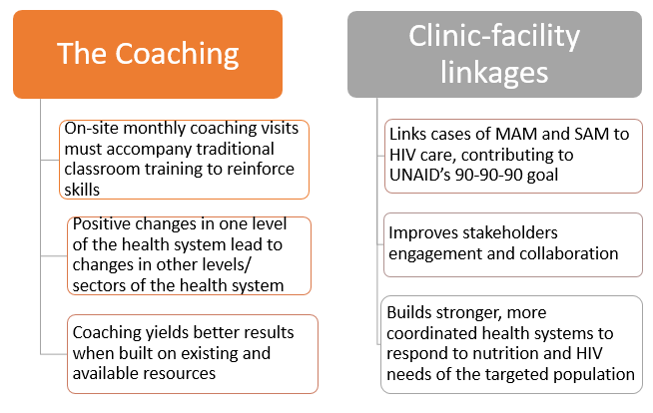
Key Takeaways

Slide 25
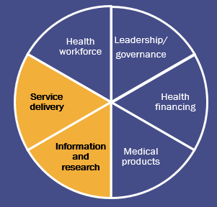
Mozambique: Strengthening Health Management Information Systems Alejandro Soto

Slide 26
Technical Assistance in Health Management Information Systems
FANTA Mozambique strengthens the health management information systems through technical assistance at:
National level with the MOH
Sub-national level with provincial and district health offices and health facilities

Slide 27
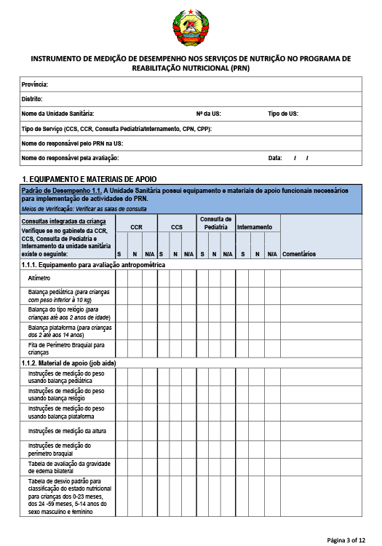
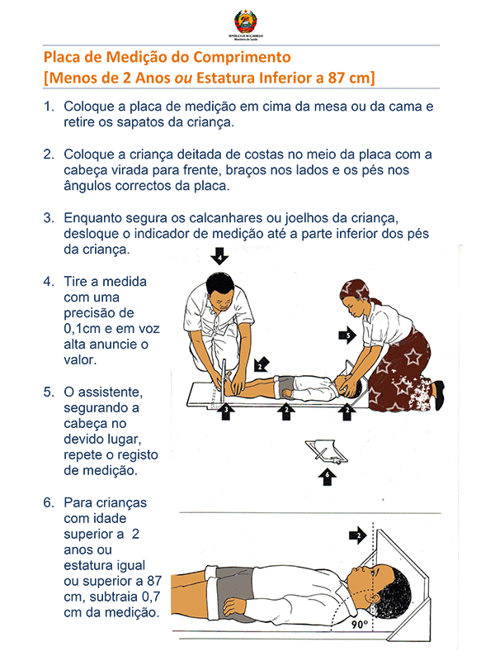
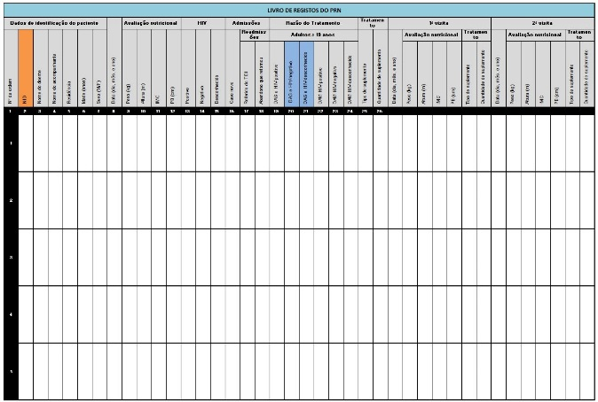
National-Level Technical Assistance
Strengthening of the national monitoring system for the Nutrition Rehabilitation Program through:
Development of tools for data management—the registry books, monitoring forms, databases

Slide 28
National-Level Technical Assistance (continued)
Strengthening of the national monitoring system for the Nutrition Rehabilitation Program through:
Training government staff and partners
Ongoing technical support to:
Install the databases
Track data submission
Analyze data

Slide 29
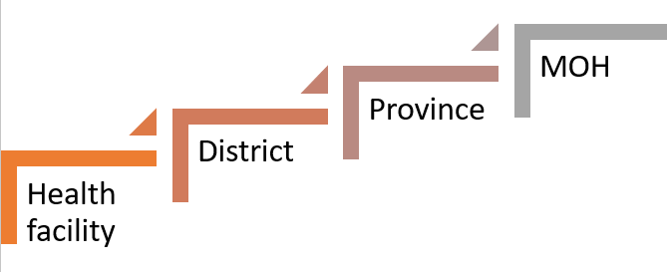
Results: MOH Receives Data from Health Sites Systematically

Slide 30
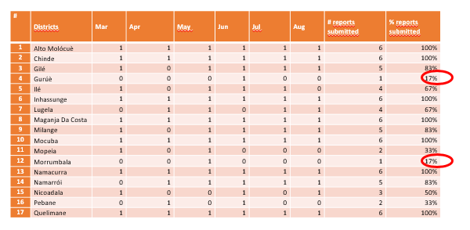
Results: MOH, Provinces, and Districts Are Able to Track Health Sites that Submit Nutrition Data

Slide 31
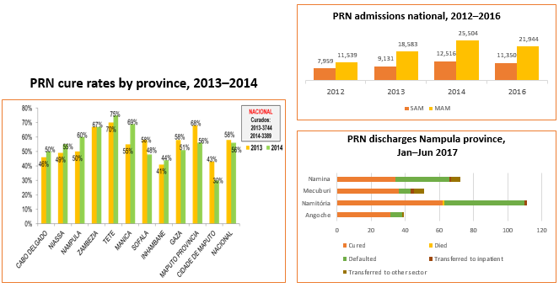
Results: MOH Produces Graphs to Analyze Nutrition Rehabilitation Program Performance in the Country

Slide 32
Sub-National Level Technical Assistance
Technical assistance on:
Completion of the registry books and aggregation of monthly data
Tracking submission of data to higher levels
Analyzing data for programmatic decision making
Data cleaning to improve quality
Data verification to track and correct diagnoses

Slide 33
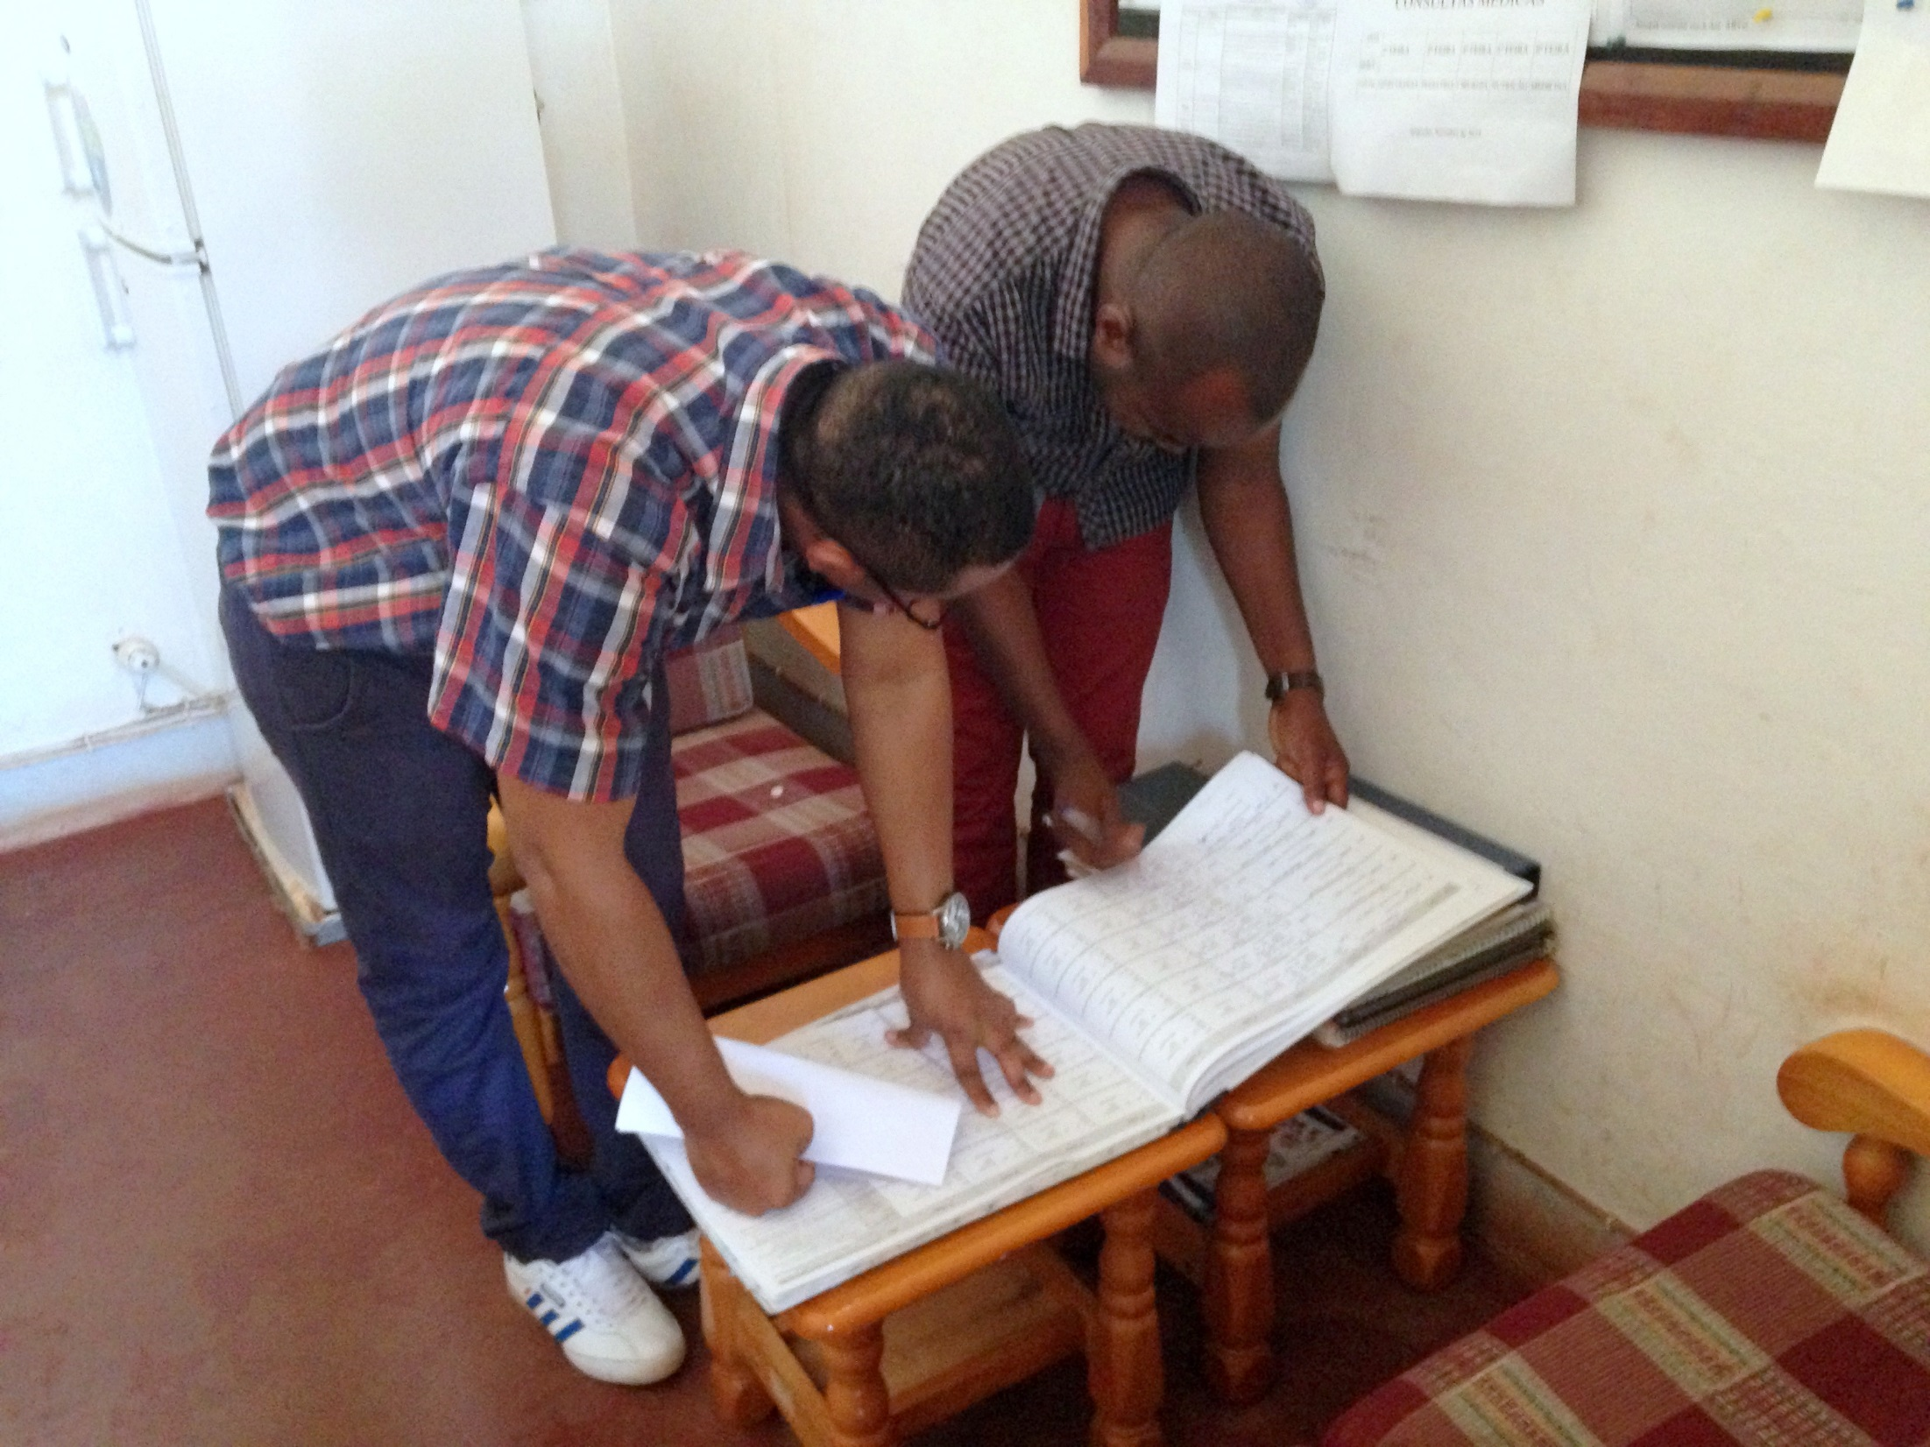

Slide 34
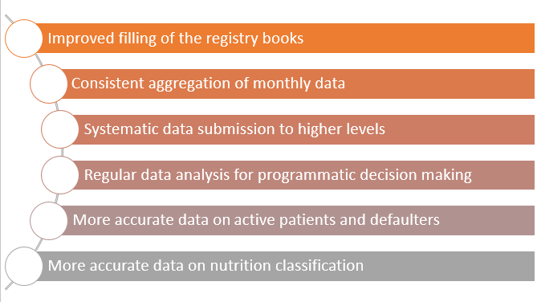
Results

Slide 35
Key Takeaways
Developing tools for the nutrition M&E system and training staff on its usage lead to the availability of data that can be analyzed to measure programs performance.
Tracking data submission at different levels brings about accountability for data completion and submission.
Improving the HMIS produces more accurate and higher quality data.

Slide 36
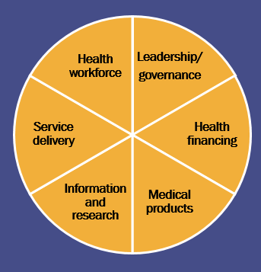
Discussion

Slide 37
This presentation is made possible by the generous support of the American people through the support of the Office of Health, Infectious Diseases and Nutrition, Bureau for Global Health, U.S. Agency for International Development (USAID), under terms of Cooperative Agreement No. AID-OAA-A-12-00005, through the Food and Nutrition Technical Assistance III Project (FANTA), managed by FHI 360. The contents are the responsibility of FHI 360 and do not necessarily reflect the views of USAID or the United States Government.

