Slide 1
Nutrition Early in Life, An Investment for the Future:
PROFILES
Advocating for a Guatemala without Chronic Malnutrition
Location, Date
This is a template. Please adjust the title, date, and logos as needed.
Notes:
This is a template. You can adjust the title and date as needed.

Slide 2
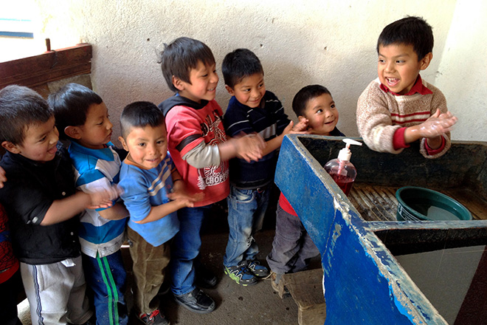
Summary
Photo Credit: Armando Marcelino Barreno Sut.
What is the malnutrition situation in Guatemala?
Why does nutrition matter?
How is Guatemala positioned in the world in terms of malnutrition?
Why invest in nutrition and why now?
What can you do to improve nutrition?
Notes:
[Refer to slide]

Slide 3
What is the malnutrition situation in Guatemala?

Slide 4
Chronic malnutrition affects almost half of children under 5 years of age
Percent
Source: MSPAS et al. 2017. ENSMI 2014-2015.
Age
Notes:
Talking Points
Chronic malnutrition begins early in life.
Nearly a third of children under 6 months of age already suffer from chronic malnutrition, which indicates that chronic malnutrition is already affecting children at birth. The percentage of children affected by chronic malnutrition continues to increase from 6 months of age until 2 years of age. At 2 years of age, the prevalence of chronic malnutrition reaches its peak and remains very high among children from 2 to 5 years of age.
The percentage of children with chronic malnutrition almost doubles between 6 and 24 months of age.
In Guatemala, chronic malnutrition is a severe public health problem, yet it often receives less attention than acute malnutrition, which is not a public health problem in the country.

Slide 5
The prevalence of low birth weight has increased and affects all economic levels
Percent
Sources: MSPAS et al. 2010. ENSMI 2008-2009; MSPAS et al. 2017. ENSMI 2014-2015.
Notes:
Talking Points
In Guatemala, low birth weight has increased since 2008 across all wealth quintiles.
Babies with low birth weight are five times more likely to die within the first month of life than normal birth weight babies (Katz et al. 2013. “Mortality risk in preterm and small-for-gestational-age infants in low-income and middle-income countries: a pooled country analysis.” The Lancet, 382(9890), 417-425.)
Additional Information
In the ENSMI 2008–2009, less than 0.5% of the more than 9,000 mothers did not have information about the birth weight of their child.
In the ENSMI 2014–2015, 94% of mothers had information about the birth weight of their child from the child’s health card or other written source of information or from the mother’s memory.

Slide 6
Anemia affects children < 5 years of age, and especially children < 1 year of age
Source: MSPAS et al. 2017. ENSMI 2014-2015.
Notes:
Talking Points
Anemia prevalence is alarming, affecting 32% of children under 5, and over 70% of children 6–11 months of age.

Slide 7
Anemia affects children < 5 years of age in all socio-economic levels
Source: MSPAS et al. 2017. ENSMI 2014-2015.
Notes:
Talking Points
As you can see, anemia affects children under 5 years of age in all socio-economic levels.
Anemia in young children increases the risk of infectious diseases. Anemia during pregnancy is associated with maternal and neonatal deaths and is a major cause of low birth weight (Black et al. 2013. “Maternal and child undernutrition and overweight in low-income and middle-income countries.” The Lancet. 382(9890): 427–451.)

Slide 8
Nutritional problems among women in Guatemala
Percent
Sources: MSPAS et al. 2010. ENSMI 2008–2009; MSPAS et al. 2017. ENSMI 2014–2015.
Notes:
Talking Points
Anemia among women continues to be a public health problem and obesity among women is increasing in Guatemala.
In women, the prevalence of anemia has declined in recent years, but it remains a public health problem. Anemia in pregnant women increases the risk of maternal and neonatal mortality.
A quarter of women of reproductive age are less than 145 cm tall. Low height in women is related to a high risk of complications in pregnancy.
Over half of women 15-49 years of age in Guatemala are overweight or obese. Overweight and obesity contribute to increased risk of noncommunicable diseases such as diabetes, hypertension, and cardiovascular disease. These are among the leading causes of death and illness in adults in Guatemala, according to Ministry of Health records.
In 39% of households with children with chronic malnutrition there is also an overweight or obese mother, demonstrating the double burden of underweight and obesity in the country (ENSMI 2014-2015, p.292.)
In addition, a mother may have anemia or other nutrient deficiencies at the same time that she is overweight or obese. Overweight / obesity does not mean "well nourished".

Slide 9
Why does nutrition matter?

Slide 10
Malnutrition: Impact on health
More illnesses like diarrhea and pneumonia
Up to 45% of deaths among children < 5 years of age
More chronic diseases in adulthood --like cardiovascular diseases
Notes:
Talking Points
Malnutrition is the underlying cause of up to 45% of child deaths in Guatemala.
Children with malnutrition are more likely to suffer and die from childhood illnesses, such as diarrhea and pneumonia, and are more likely to develop chronic diseases such as cardiovascular diseases in adulthood.

Slide 11
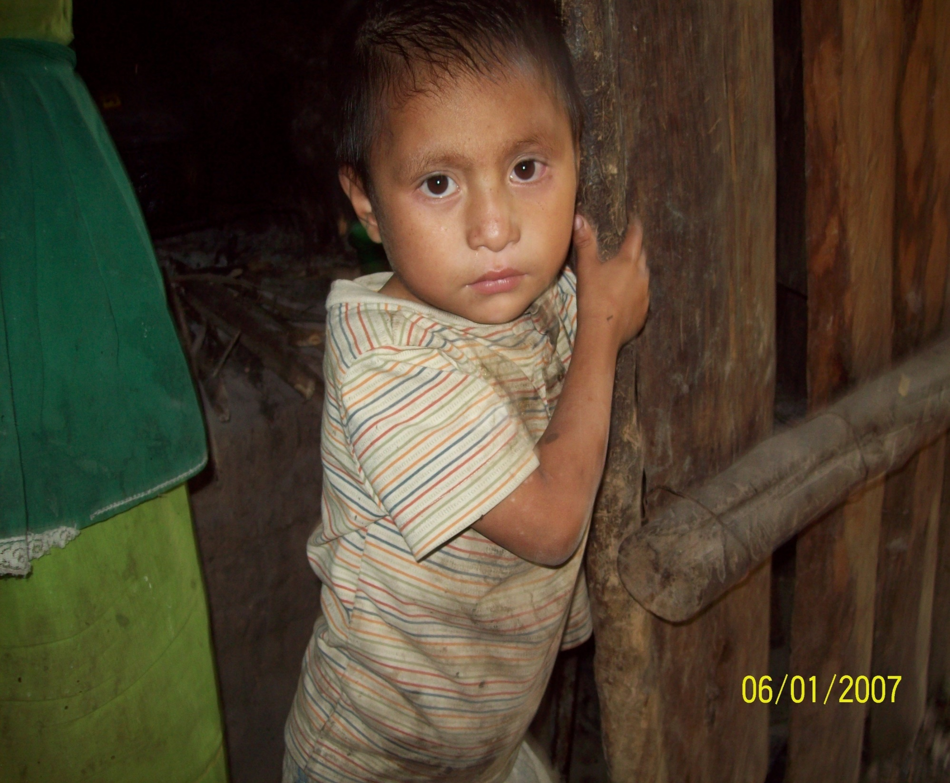
By 2026, with no change in nutrition,
more than
38,000
LIVES WILL BE LOST due to stunting among children < 5 years of age
Notes:
Talking Points
By 2026, with no change in nutrition, more than 38,000 children in Guatemala will die related to stunting alone.

Slide 12
By 2026, more than 30,000 children will die from causes related to low birth weight in Guatemala.
This is the same as losing the number of children who could fit in the national stadium.
Notes:
Talking Points
If there is no change or improvement in low birth weight in Guatemala, by 2026, 30,542 children will die from causes directly related to low birth weight. This is equal to losing the number of children who would fit in the National Doroteo Guamuch Flores Stadium.

Slide 13
By 2026, more than 70,000 children under 2 years of age will die from causes related to inadequate breastfeeding practices in Guatemala.
SCHOOL
Nearly 200 children each day for a year
Notes:
Talking Points
The practices of exclusive breastfeeding and continued breastfeeding are inadequate in Guatemala.
If breastfeeding practices do not change or improve by 2026, more than 70,000 children under 2 years of age will lose their lives.
It would be like losing nearly a school full of 200 children each day for a year.
80% of these deaths occur in the first 6 months of life.
Additional Information
According to the ENSMI 2014–2015, the prevalence of exclusive breastfeeding among children under 6 months of age is 53.1%

Slide 14
Malnutrition: Impact on education
Poor school performance
Poor cognitive capacity
Increased grade repetition in school
Increased risk of dropping out of school
Notes:
Talking Points
Children who are stunted learn to sit, stand, and walk later; have poorer cognitive function; perform worse in school; are more likely to repeat grades; miss more days of school due to illness; and are more likely to drop out of school than well-nourished children.

Slide 15
Human capital losses in learning related to chronic malnutrition: 2017–2026
Equivalent school years of learning lost
What does 33 million equivalent school years of learning lost mean?
Children with chronic malnutrition on average achieve fewer years of learning than well-nourished children.
33
millions of years
Notes:
Talking Points
If chronic malnutrition is NOT REDUCED, 33 million school years of learning will be lost in the next 10 years in Guatemala. (1 school year = 180 days according to the Ministry of Education, MINEDUC).
This has great consequences, including reduced future income and lost productivity.
Conversely, if stunting IS reduced over the time period, 3.6 million equivalent school years of learning will be gained.
These gains in learning ability mean that children who are 2 years of age in 2026 will gain an average of 1.7 equivalent school years of learning by around 12 years of age.
This gain in learning ability can be transformative for children because they would be able to learn at a higher and more advanced level both in school, outside of school, and in future years.

Slide 16
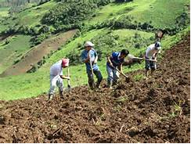
By 2026, without additional efforts to improve nutrition, losses in economic productivity in Guatemala will exceed
Q146,207 million
(US$19,437 million)
related to stunting alone.
Notes:
Talking Points
Malnutrition weakens Guatemala's economic productivity. Iron deficiency anemia and stunting reduce labor productivity, which affects agricultural and industrial production and delays national development.
Stunting in children in Guatemala is also associated with lower wages in the future during adulthood.
As an adult, an undernourished child will earn less than his/her healthy counterpart.
Productivity losses from chronic malnutrition include losses that would result from no change or improvement related to chronic malnutrition and no change or improvement in low birth weight.

Slide 17
How is Guatemala positioned in the world in terms of malnutrition?

Slide 18
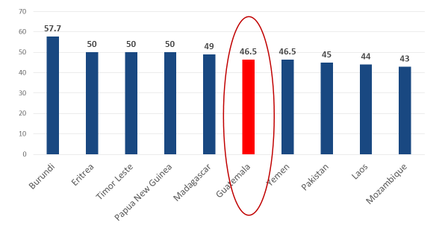
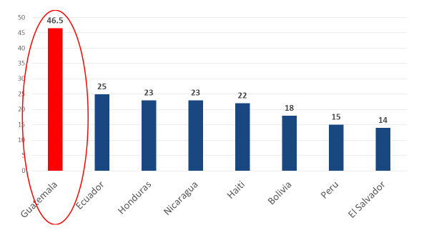
Guatemala ranks 6th in the world for chronic malnutrition
Guatemala has the highest prevalence of chronic malnutrition in the Americas
Source: UNICEF. 2016. The State of the World’s Children 2016 Statistical Tables. Available at: http://data.unicef.org/resources/state-worlds-children-2016-statistical-tables/
Notes:
Talking Points
Guatemala ranks sixth in the world for chronic malnutrition and it has the highest prevalence of chronic malnutrition in the Western Hemisphere.
Nearly half of the children under 5 in Guatemala are chronically malnourished, a higher percentage than is found on average in Africa, Asia, and Latin America and the Caribbean. The percentage rises to 53% in rural areas and to 58% among indigenous populations.

Slide 19
Why invest in nutrition and why now?

Slide 20
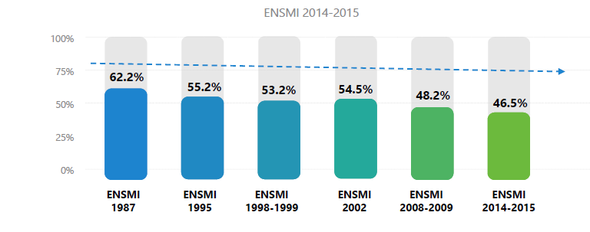
Chronic malnutrition has decreased only 0.5 percentage points per year in the last 3 decades
ENSMI 2014–2015
1987 1995 1998–1999 2002 2008–2009 2014–2015
Source: MSPAS et al. 2017. ENSMI 2014-2015.
Notes:
Talking Points
Guatemala is a signatory to the Sustainable Development Goals (SDGs), which aim to eliminate malnutrition by the year 2030.
At the current level of decline, it will take 100 years (instead of 13) to eradicate chronic malnutrition in Guatemala.
Can we wait that long? Investment in nutrition is essential to achieve greater advances in health and economic growth and to achieve Guatemala’s commitments to the SDGs and the World Health Assembly 2025 targets.
Additional Information
Objectives of the World Health Assembly include, by 2025:
40% reduction in the number of children under 5 years of age with chronic malnutrition
50% reduction in anemia in women of childbearing age
30% reduction in low birth-weight births

Slide 21
Benefits of improved nutrition during the life course
Decreased morbidity and mortality in childhood
Improved cognitive, motor, and socio-emotional development
Improved school performance and learning capacity
Increased adult stature, lower risk of obesity and NCDs
Increased work capacity and productivity
Nutrition-specific interventions and programs
MSPAS
Optimal nutrition and development
Nutrition-sensitive programs and approaches
MAGA, MINEDUC, MIDES
Breastfeeding
Child feeding and caregiving practices
Low burden of infectious disease
Food security
Feeding and caregiving resources (household & community
Access to and use of health services, water, and sanitation
Building an enabling environment
SESAN, MINFIN, Municipalities
Knowledge and evidence
Politics and governance
Leadership, capacity, and financial resources
Social, economic, political, and environmental context
Notes:
Talking Points
The malnutrition problem is multi-causal and requires a multi-sectoral response, involving not only the implementation of nutrition-specific interventions by the Ministry of Health, but also the implementation of nutrition-sensitive programs by other sectors, such as the Ministry of Agriculture, Ministry of Education, and the Ministry of Social Development.
It also requires SESAN, the Ministry of Finance, and Municipalities to build an enabling environment that strengthens and facilitates, through policies, governance, and the social and economic context, an improvement in nutritional status for the entire population.

Slide 22
Funding gap at the national level for nutrition interventions: Projected budget versus funding needed by year (millions of quetzales)
Source: FANTA 2017. Malnutrition in Guatemala Holding our Country Back A Call to Action for Government to Invest in Nutrition.
Notes:
Talking Points
An important question is how much investment is necessary to improve the nutrition of the population in Guatemala, and what is the gap between what is now invested and what is necessary to reduce malnutrition.
In 2013–2014, FANTA, with the Ministry of Health, Ministry of Finance, and ICEFI (Central American Institute of Fiscal Studies [Instituto Centroamericano de Estudios Fiscales]), conducted a costing study on nutrition interventions.
The study covered 7 nutrition-specific interventions and 2 nutrition-sensitive interventions.
A significant gap was identified between the current budget and what is needed to provide quality health services as well as to reduce chronic malnutrition.
In Guatemala, the government invests only 2.4% of its gross domestic product (GDP) in health. This level of investment is the lowest in Latin America.
In 2013, the Government of Guatemala invested Q637.2 million in nutrition, only one third of what was required to provide nutrition services nationwide.
In 2016, only an estimated 0.15% of GDP was to be invested in nutrition, which is not enough. About 0.50% of GDP, or Q2,495 million, would be needed to implement the essential actions in nutrition with the quality and necessary coverage to improve the nutritional indicators.

Slide 23
Summary
Nutrition is central to development and necessary for Guatemala to improve several key development outcomes:
Save children’s and women’s lives
Improve child development, cognitive function, and educational outcomes
Increase economic productivity
Investment in nutrition is needed to achieve further progress toward Guatemala’s K´atun 32
Despite being a priority in the national government's plans, nutrition in Guatemala does not have sufficient funds
Notes:
[Refer to slides]

Slide 24
What can you do to improve nutrition?

Slide 25
What can you do to improve nutrition in Guatemala?
[Insert desired changes from the Guatemala Nutrition Advocacy Plan depending on the target audience of the PPT. For example:]
In the annual operational plan of your institution:
Generate the budget structure needed to allocate specific funds for nutrition
Define the budget necessary to implement interventions promoting nutrition within the framework of the ENPDC
Include goals and indicators related to nutrition within annual institutional operational planning within the “results-based management“ framework
Monitor progress toward implementing activities and make timely decisions based on results
Notes:
Talking Points
Evidence-based studies have shown that both nutrition-specific and nutrition-sensitive interventions work to prevent chronic malnutrition.
Now is the time to invest in the scale-up of high-quality actions in these areas.
[Refer to specific desired changes for each target audience in slide]

Slide 26
For more information, contact:
Analuisa Guillen Krische, Institutional Strengthening, Food Security and Nutrition Secretariat (SESAN) analuisa.guillen@sesan.gob.gt

Slide 27
This presentation is made possible by the generous support of the American people through the support of the Office of Health, Infectious Diseases and Nutrition, Bureau for Global Health, U.S. Agency for International Development (USAID), and USAID/Guatemala under terms of Cooperative Agreement No. AID-OAA-A-12-00005, through the Food and Nutrition Technical Assistance III Project (FANTA), managed by FHI 360.
The contents are the responsibility of FHI 360 and do not necessarily reflect the views of USAID or the United States Government.

