Slide 1
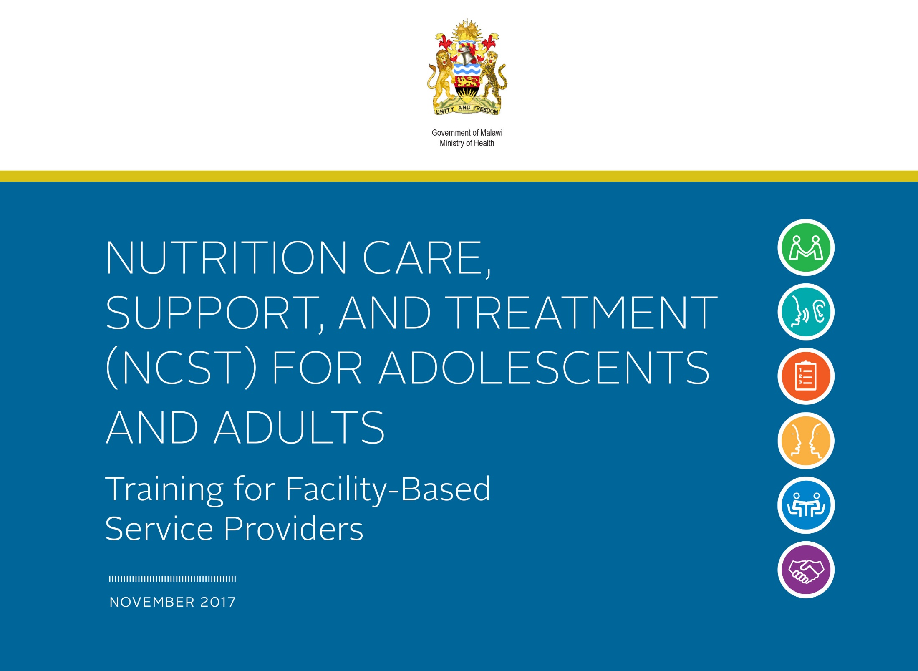

Slide 2
Introductory Session
Time: 1 hour

Slide 3
Introductory Session Learning Objectives
Discuss expectations and relate them to the course objectives
Take a pre-test to assess knowledge of NCST
Outline the required NCST competency standards

Slide 4
NCST Course Objectives
Understand the role of nutrition in the care and treatment of PLHIV and TB patients
Assess and classify the nutritional status of clients
Provide nutrition counselling to clients
Select an appropriate nutrition care plan for a client based on his/her nutritional status
Prescribe therapeutic and supplementary foods for undernourished clients
Collect information on, monitor, and report on NCST services
Manage the quality of NCST services at the facility level

Slide 5
Components of NCST
Nutrition assessment and classification
Nutrition counselling and education
Nutrition care plans and support
NCST monitoring and reporting
Managing the quality of NCST services

Slide 6
Training Methods
Lectures with slide presentations
Discussions
Group work
Role plays
Demonstrations
Written exercises
Site practice visit

Slide 7
NCST Competencies and Standards
Competence can be defined as the ability to apply knowledge and skills to produce a required nutrition outcome.
Competency standards are the range of skills that are needed to achieve a desired nutrition outcome.
Competency is a combination of knowledge, ability, and skill.
Refer to Reference 0.3 to review the required NCST competencies

Slide 8
Module 1:
Introduction to Nutrition
Time: 4 hours

Slide 9
Module 1: Learning Objectives
Explain the importance of nutrition for good health.
Describe the link between nutrition and infection.
Explain the keys to food and water safety and good hygiene.
Assist clients with dietary management of symptoms and ART side effects.
List interventions that can prevent and manage malnutrition.

Slide 10
Food and Nutrients
Food is anything eaten or drunk that provides the body with nutrients.
Nutrients are chemical substances in food that are released during digestion and provide energy and nourishment to maintain, repair, or build body tissues. Nutrients include macronutrients and micronutrients.
  Macronutrients include carbohydrates, protein, and fat (needed in large amounts).
  Micronutrients include vitamins and minerals (needed only in small amounts).

Slide 11
Malnutrition
Malnutrition occurs when energy and nutrient intake do not match dietary needs. Malnutrition can either be undernutrition or overnutrition.
  Undernutrition is the result of taking in an inadequate amount or combination of nutrients to carry out needed body functions.
  Overnutrition is the result of taking in more energy than the body needs over time.

Slide 12
Importance of Good Nutrition
Good nutrition can:
Help people feel physically and mentally strong and look healthy
Strengthen the immune system
Help people stay productive and able to do physical activities
Help prevent wasting
Improve drug adherence and effectiveness
Help manage common symptoms and drug side effects
Poor nutrition can:
Weaken the immune system
Increase vulnerability to infections
Reduce the body’s ability to recover from infections

Slide 13
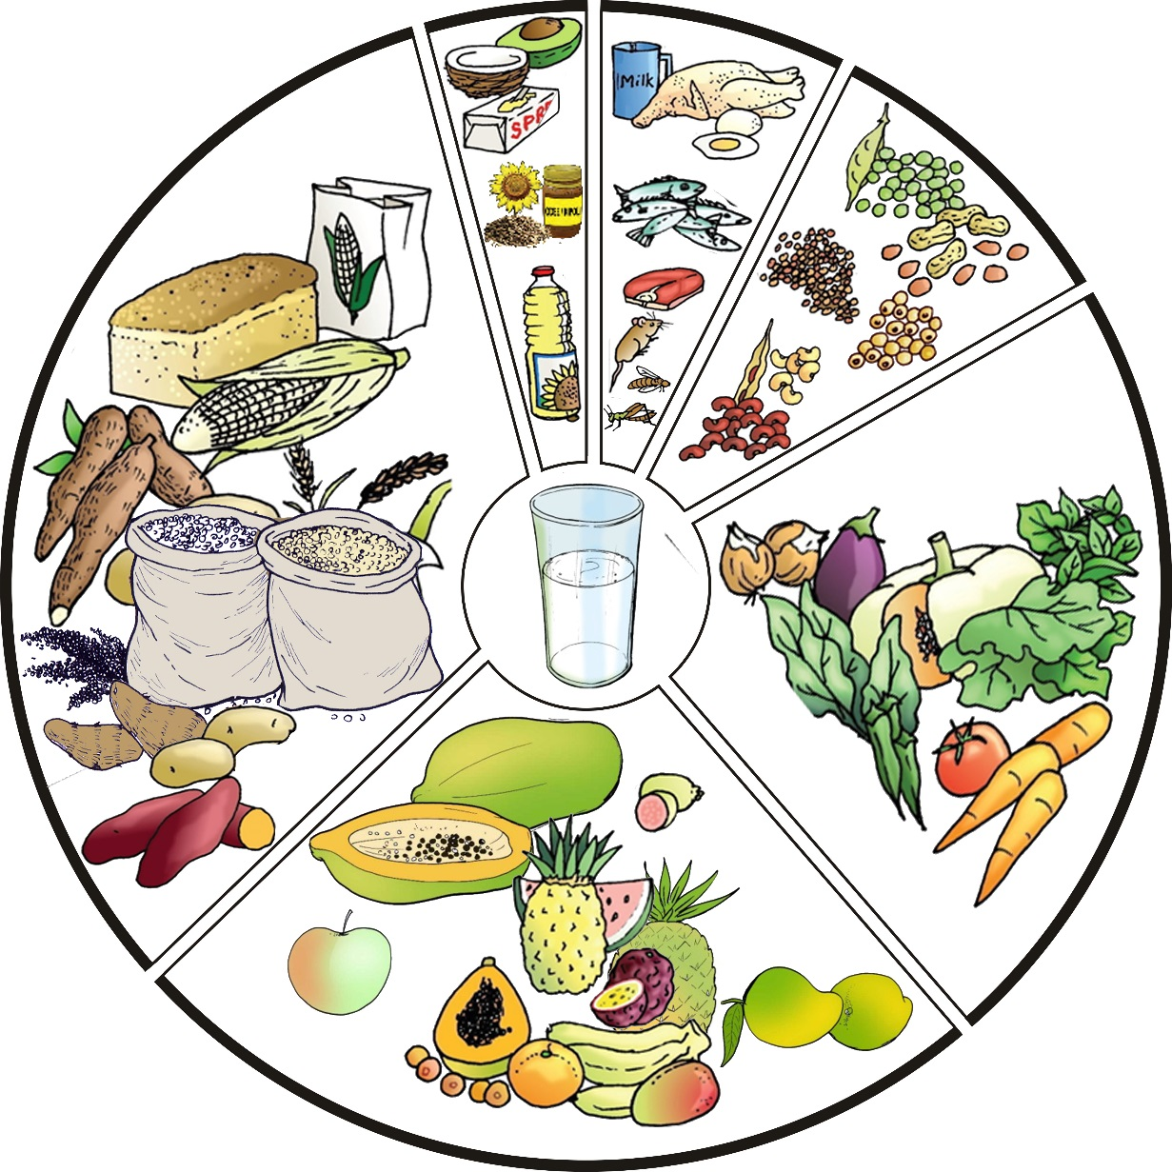
Malawi’s Six Food Groups

Slide 14
Daily Energy Requirements
Group | Kilocalories (kcal)/day
Adolescents 15–18 years | 2,800
Adults (≥ 18 years): Non-pregnant/lactating | 2,000–2,580
Pregnant/lactating women (during the first 6 months of lactation) | 2,460–2,570
Source: WHO, FAO, and United Nations University (UNU). 2001. Human Energy Requirements: Report of a Joint WHO/FAO/UNU Expert Consultation, 17–24 October, 2001. Geneva: WHO.

Slide 15
Energy Requirements during
Pregnancy and Lactation
First trimester | +85 kcal/day
Second trimester | +285 kcal/day
Third trimester | +475 kcal/day
During the first 6 months of lactation | +505 kcal/day

Slide 16
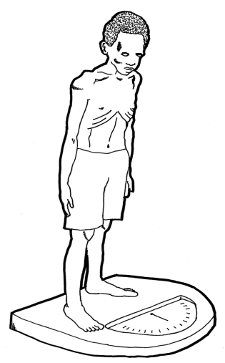
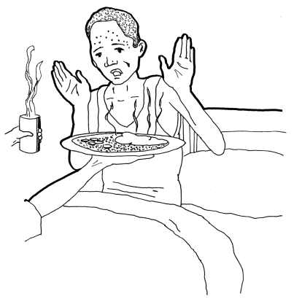
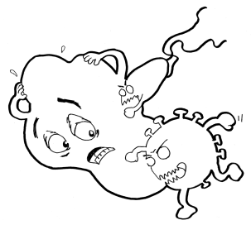
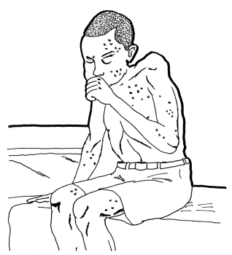
Cycle of Poor Nutrition and Infection
1. Higher energy needs because of poor nutrient absorption, symptoms, and infection
2. Weight loss, muscle wasting, and vitamin and mineral deficiency
Infection, e.g., HIV or TB
4. More chance of getting infections and faster progression to AIDS or active TB disease
  3. Immune system too weak to fight infections

Slide 17
Energy Requirements for PLHIV
HIV-infected adult in early/asymptomatic stage:
10% more energy
HIV-infected adult in late/symptomatic stage:
20% more energy
HIV-infected adolescent
  Asymptomatic: 10% more energy
  Symptomatic: 20–30% more energy
  Source: WHO. 2003. Nutrient Requirements of People Living with HIV/AIDS: Report of a Technical Consultation, Geneva, 13–15 May 2003. Geneva: WHO.

Slide 18
Nutrition and TB
TB reduces appetite and increases energy expenditure, causing wasting.
Underweight people are at risk of developing active TB.
Poor nutritional status may speed up progression from TB infection to TB disease.
Protein loss in TB patients can cause nutrient malabsorption.
Increased energy expenditure and tissue breakdown increase energy needs in people with TB.
Poor appetite makes people with TB unable to eat enough to meet their increased micronutrient needs.

Slide 19
Energy Requirements during Pregnancy
Group | Average intake (kcal) | Increased requirement during 3rd trimester (kcal) | Increased requirement for HIV (kcal) | Total needs (kcal)
Healthy | 2,000 | +475 |  | 2,475
HIV+ asymptomatic | 2,000 | +475 | +200–257 (10%) | 2,675 – 2,732
HIV+ symptomatic | 2,000 | +475 | +400–514 (20%) | 2,875 – 2,989
Notes:
19

Slide 20
Breaking the Nutrition/Infection Cycle
Good nutritional status
Stronger immune system
Nutritional needs met
Nutrition Interventions
Reduced vulnerability to infection
Notes:
20

Slide 21
Food and Water Safety and Hygiene
  Food safety: Preventing food contamination and food-borne illness through proper preparation, cooking, and storage
  Water safety: Preventing water contamination and water-borne illness through proper treatment and storage
  Hygiene: Conditions or practices that help maintain health and prevent disease, especially through cleanliness
Notes:
21

Slide 22
Food and Water Safety for PLHIV
  People who are ill are at higher risk of becoming infected if exposed to dangerous bacteria in food and water.
  When PLHIV or TB patients get sick, their illness is likely to be more severe and last longer.
  PLHIV or TB patients may have a hard time recovering from illness.
  Illness and nausea may reduce food intake and cause weight loss that is difficult to recover.
  Water- and food-borne illness can damage the mucosal lining of the gut and impair nutrient absorption.
Notes:
22

Slide 23
Interaction between Food and ART
  Poor nutrition reduces drug absorption
  ↕
  Drug side effects can reduce nutrient absorption
  Poor nutrition worsens drug side effects
  ↕
  Drug side effects reduce appetite and lead to poor nutrition

Slide 24
Nutrition Care, Support, and Treatment (NCST) Services
Nutrition assessment and classification
Nutrition counselling and education
Nutrition care plans and support
  Provision of therapeutic and/or supplementary food for severely and moderately malnourished clients
  Education on household water treatment methods and personal and household hygiene
  Micronutrient supplementation
  Referral to other facility services and economic strengthening, livelihoods, and food security support services

Slide 25
Module 2:
Nutrition Assessment and Classification
Time: 6 hours

Slide 26
Module 2: Learning Objectives
Take and interpret anthropometric measurements accurately
Conduct clinical, biochemical, and dietary assessments
Classify nutritional status correctly based on nutrition assessment

Slide 27
Importance of Nutrition Assessment
Identifies people at risk for malnutrition for early intervention or referral
Identifies malnourished clients who require intervention
Detects diet habits that increase the risk of disease
Identifies need for nutrition education and counselling
Tracks growth and weight trends
Provides information for selecting a nutrition care plan

Slide 28
Types of Nutrition Assessment
        Anthropometry
          Weight, height, mid-upper arm circumference (MUAC), BMI, and BMI-for-age
        Biochemical
          Laboratory tests
        Clinical
          Medical conditions that can affect nutritional status
          Bilateral pitting oedema
          Appetite test
        Dietary
          24-hour recall
          Usual intake

Slide 29
Anthropometry
Anthropometry is the measurement of the size, weight, and proportions of the human body. Anthropometric measurements can be used to assess the nutritional status of individuals and population groups.

Slide 30
Anthropometric Measurements
Used in NCST
        Weight
        Height
        MUAC
Some anthropometric measurements presented as indexes:
        BMI
        BMI-for-age

Slide 31
How Often Should Weight Be Measured?
    All adolescent and adult clients should be weighed as follows:
    With normal nutritional status: During the next ART, ANC, or TB visit (2–3 months)
    With moderate malnutrition: Every month
    With severe malnutrition: Every 2 weeks for the first month, thereafter every month
    With overweight and obesity: Every month

Slide 32
How Often Should Height Be Measured?
Adolescents are still growing. Their height should be taken at every visit.
Adults should have their height taken only once.

Slide 33
Body Mass Index (BMI)
BMI is a reliable indicator of body fatness and an inexpensive and simple way to measure adult malnutrition. It is used for adults 19 years and older.
WHO has established BMI cutoffs that are used to classify nutritional status.
BMI is not accurate in pregnant women or adults with oedema, whose weight gain is not linked to nutritional status. For these groups, MUAC should be used.

Slide 34
BMI Cutoff Points to Classify
Nutritional Status
BMI | Nutritional Status
< 16.0 | Severe underweight
16.0 to 18.4 | Moderate underweight
18.5 to 24.9 | Normal
25.0 to 29.9 | Overweight
≥ 30.0 | Obese
Source: WHO. 1995. Physical Status: The Use and Interpretation of Anthropometry: Report of a WHO Expert Committee. WHO Technical Report Series 854. Geneva: WHO.

Slide 35
BMI-for-Age for Adolescents
(15–18 Years)
Measure the adolescent’s weight and height.
Determine the BMI using the formula, the BMI reference table for adolescents, or a BMI wheel.
After identifying the adolescent’s BMI, use the BMI-for-age reference tables or BMI wheel to determine nutritional status.
Boys and girls have separate BMI-for-age reference tables.

Slide 36
BMI-for-Age Cutoff Points to Classify Nutritional Status
BMI-for-Age Z-Score | Nutritional Status
< -3 | Severe underweight
≥ -3 to <-2 | Moderate underweight
≥ -2 to < +1 | Normal
≥ +1 to < +2 | Overweight
≥ +2 | Obese
Source: WHO. 2007. Growth Reference Data for 5–19 Years. http://www.who.int/growthref/en/

Slide 37
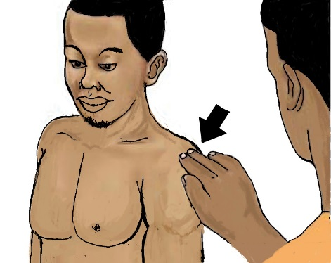
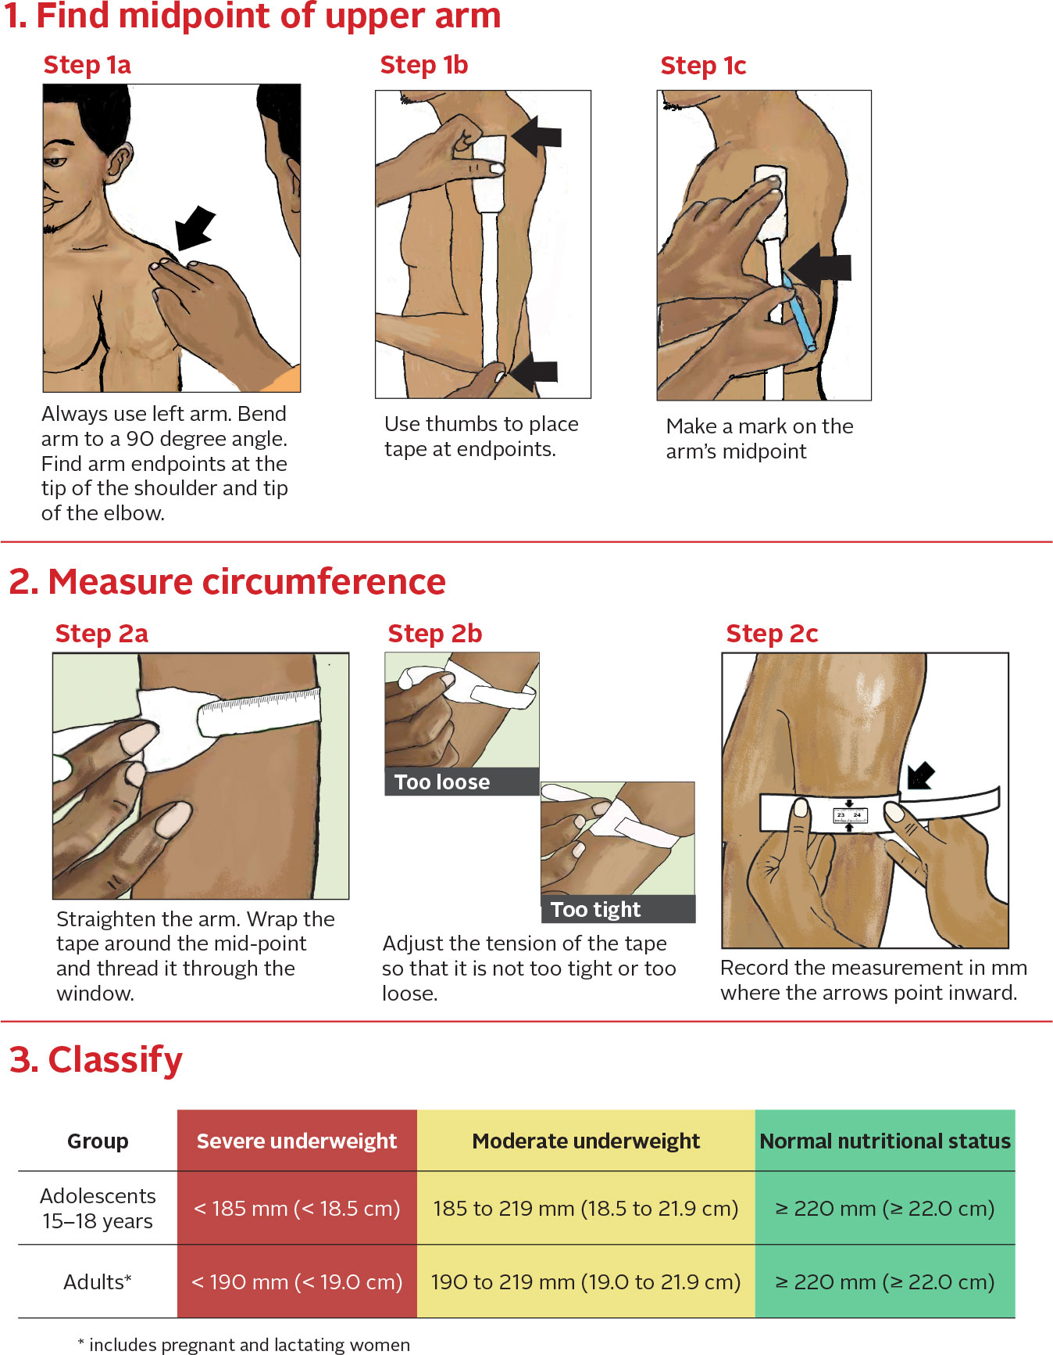
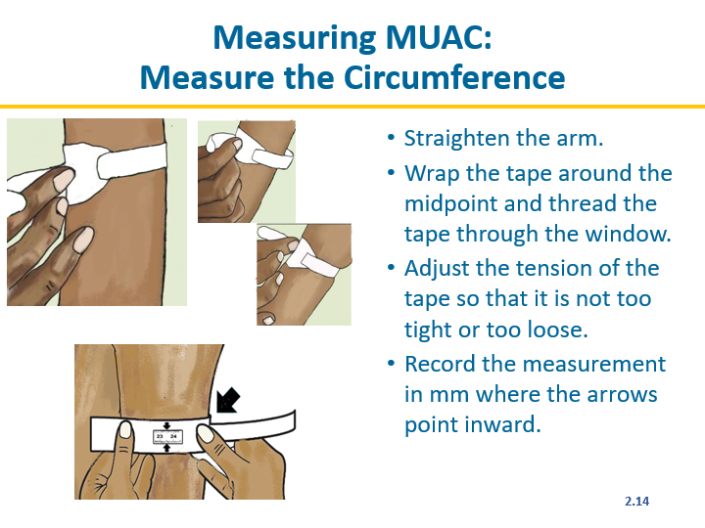
Measuring MUAC:
Find the Midpoint of Upper Arm
Always use the left arm.
Bend the left arm at a 90º angle.
Find the arm end points at the tip of the shoulder and tip of the elbow.
Use thumbs to place tape at the end points.
Fold tape so that the end points meet.
Make a mark on the arm’s midpoint, where the tape is folded.

Slide 38
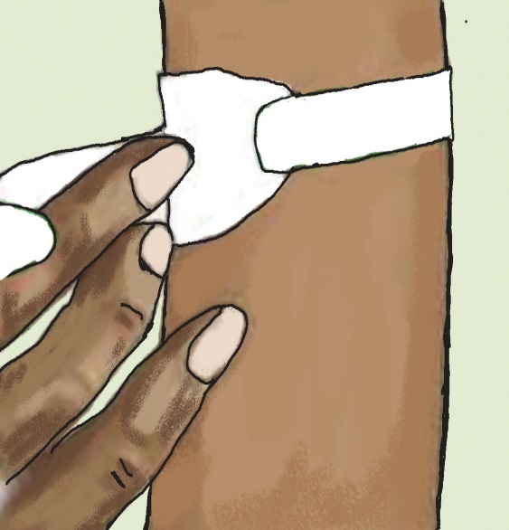
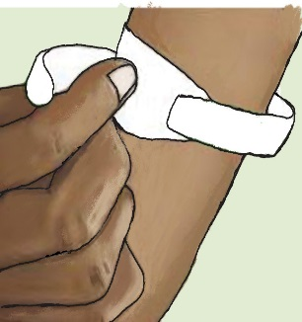
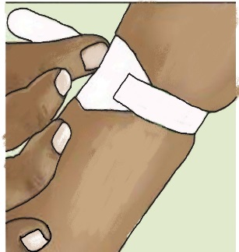
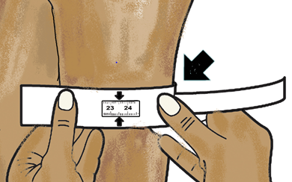
Measuring MUAC:
Measure the Circumference
Straighten the arm.
Wrap the tape around the midpoint and thread the tape through the window.
Adjust the tension of the tape so that it is not too tight or too loose.
Record the measurement in mm where the arrows point inward.

Slide 39
MUAC Cutoff Points to Classify
Nutritional Status
Group | Severe Underweight | Moderate Underweight | Normal
Adolescents 15–18 years | < 185 mm | 185 to 219 mm | ≥ 220 mm
Adults (including pregnant and lactating women up to 6 months post-partum) | < 190 mm | 190 to 219 mm | ≥ 220 mm*
* 220 to 229 mm for pregnant women and lactating women up to 6 months post-partum

Slide 40
Weight Gain During Pregnancy
Pre-pregnancy MUAC or MUAC during the first trimester | Recommended total weight gain | Minimum weight gain per month
< 220 mm | 13–18 kg | 2 kg
≥ 220 mm to 299 mm | 11–16 kg | 1 kg
≥ 300 mm | 7–11 kg | 0–0.5 kg

Slide 41
Biochemical Assessment – Blood Haemoglobin Results and Action
 | Group |  | Action
 | Non-pregnant adolescent and adult women | Pregnant women and lactating women up to 6 months post-partum
Severe anaemia | Haemoglobin concentration <7.0g/dL | Haemoglobin concentration <7.0g/dL | Provide 120 mg iron + 400 µg folic acid daily 3 months
Mild/moderate anaemia | Haemoglobin concentration 7.0–11.9 g/dL | Haemoglobin concentration 7.0–10.9 g/dL | Provide 60 mg iron + 400 µg folic acid 6 months
Normal haemoglobin levels | ≥ 12.0–15.1 g/dL | ≥ 11.0 g/dL | Counsel on consumption of iron-rich foods

Slide 42
Classifying Nutritional Status
Severe underweight with medical complications
Severe underweight without medical complications
Moderate underweight
Normal
Overweight
Obese

Slide 43
Module 3:
Nutrition Counselling and Education
Time: 18 hours
3.1

Slide 44
Learning Objectives (1)
Explain the meaning of ‘counselling’ and what makes it effective.
Describe the multiple influences on nutrition related behaviours.
Adopt a client-centred approach to counselling that helps clients take action with available resources to overcome barriers and manage their own health.

Slide 45
Learning Objectives (2)
Demonstrate communication techniques needed for effective counselling.
Use the NCST counselling flipchart to engage clients in learning and changing behaviours to achieve nutrition goals.
Help clients overcome nutrition-related challenges, maintain a healthy weight, and manage symptoms through diet.
Prepare and deliver an engaging nutrition education session.

Slide 46
How Well Are We Doing with Regards to Counselling and Education?
What is happening well in nutrition counseling?
What weaknesses do you see?
How do you rate the quality of nutrition education?
What do you think should be improved?

Slide 47
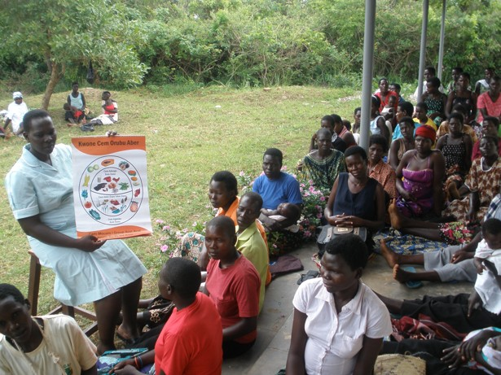

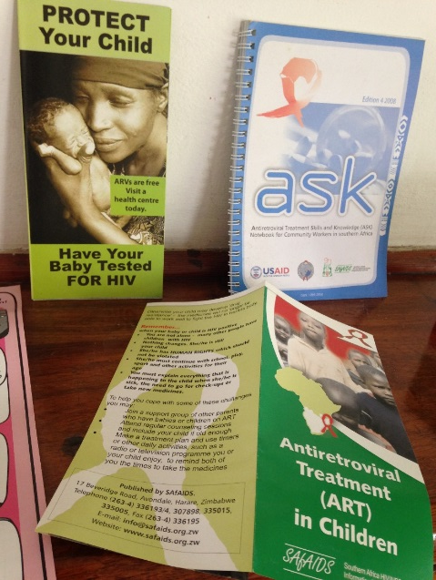
What Is COMMUNICATION?
    The meaningful exchange of information between two or more participants, by way of speech, gestures, writings, behavior, etc.

Slide 48
What Does This Mean?
The free-ion spectra emerge from a controlled spark in a rare-gas atmosphere at reduced pressure, with the spectrum of gadolinium as the circuit parameters are changed. The 3-A spectrum, where low-excitation lines of the doubly ionized fluorescence appear, manifests the spectra of unidirectional pulsed discharges.
Cold green ideas sleep fast behind the store.

Slide 49
Breast milk is best!
Will you give your baby the benefits from breastfeeding?

Slide 50

Telling Is Not Enough!
We remember:
20% of what we hear
40% of what we see
80% of what we do

Slide 51
Telling Is Not Enough Because:
What I hear, I forget.
What I see, I remember.
What I do, I understand.
Confucius

Slide 52
Communication
Education
Advice
Counselling
Information
Sometimes ‘counselling’ is here?

Slide 53
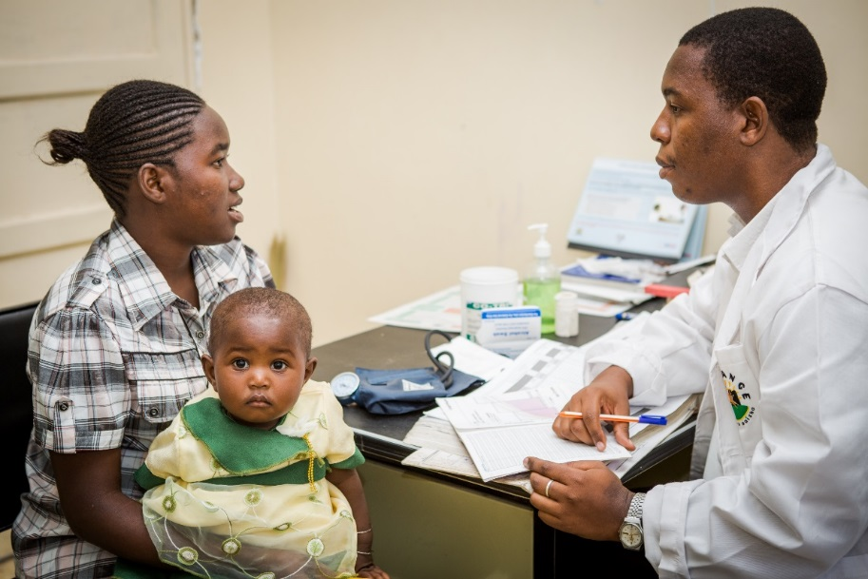
What Is Counselling?
        Counselling is an interactive, collaborative process between a client and a trained counsellor through which the client is supported to plan appropriate actions.
        Counselling:
        Is not just telling people what to do
        Involves listening more than talking
        Helps clients make informed decisions to solve a problem

Slide 54
Behaviour Change Is a Complicated Process
Enabling environment: Laws, economy, religion
Family, household, and peers
Individual
Community: Services, social norms, CBOs
Who and what influence an individual’s behaviour?
The Socio-Ecological Model of Behaviour Change

Slide 55
WHO and WHAT Influence Behaviour?
Perception of the problem and its severity
Perceived costs, benefits (expected consequences) of change
Access to resources
Health status
Family and peer pressure
Social norms, including gender roles
Culture, the media, and social status
Personal habits and preferences
Beliefs, opinions, and values
Knowledge and skills

Slide 56
Stages of Change and Your Role
Provide continuing support
Tells others about it
Praise/discuss benefits
Continues to do it
Negotiate an agreement
Tries it out
Intends to try it
Encourage
Knows about it
Provide information
Doesn’t know about it

Slide 57
Barriers to Behaviour Change
Habits: People do what is familiar and comfortable
Attitudes: Values, likes, dislikes
Feelings: Dependence/fear, etc.
Social pressure, norms
Economic costs, convenience
Cultural ideologies
Knowledge

Slide 58
Counselling Should Be:
Client-centred
Action-oriented
Context-sensitive

Slide 59
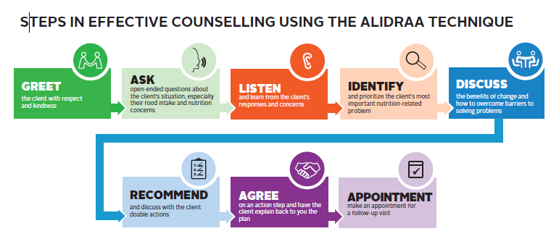
The ‘HOW’ of Nutrition Counselling

Slide 60
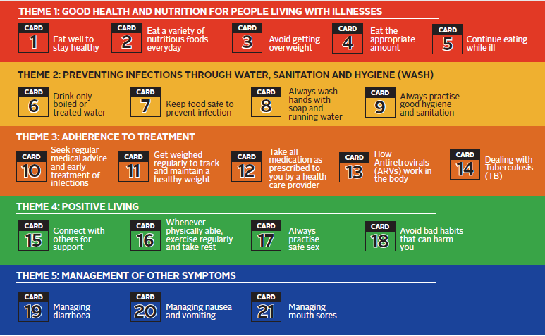
The ‘WHAT’ of Nutrition Counselling

Slide 61
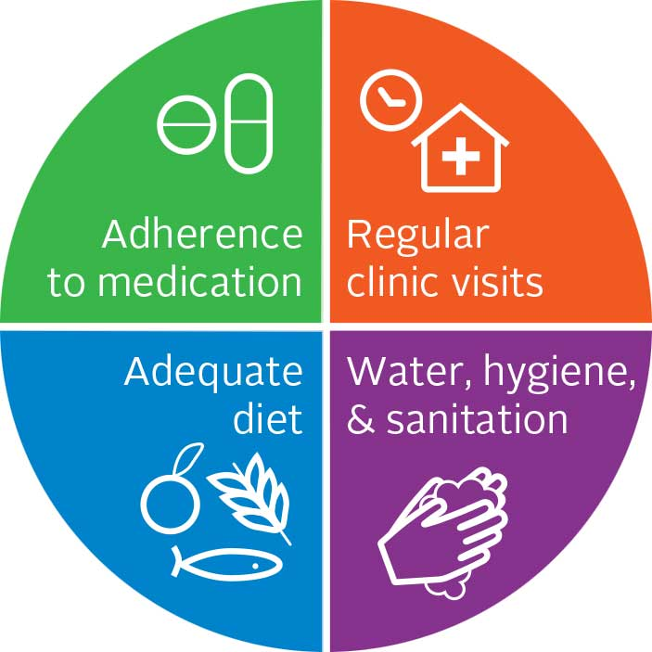
Always Address the Client’s Core Needs

Slide 62
Always Address the Client’s Core Needs:
Adequate Diet

Slide 63
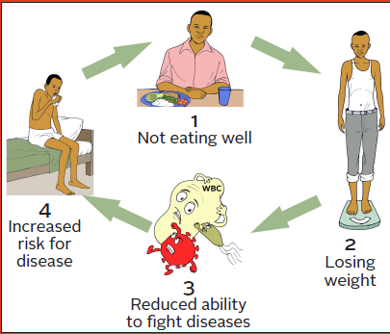

Slide 64
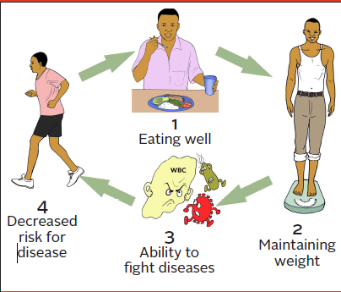

Slide 65
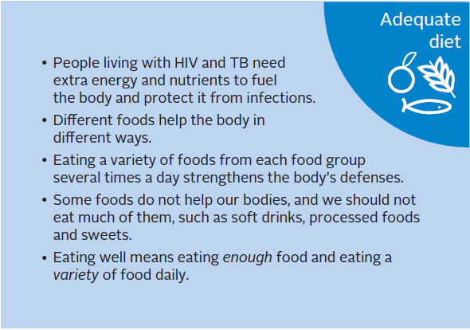

Slide 66
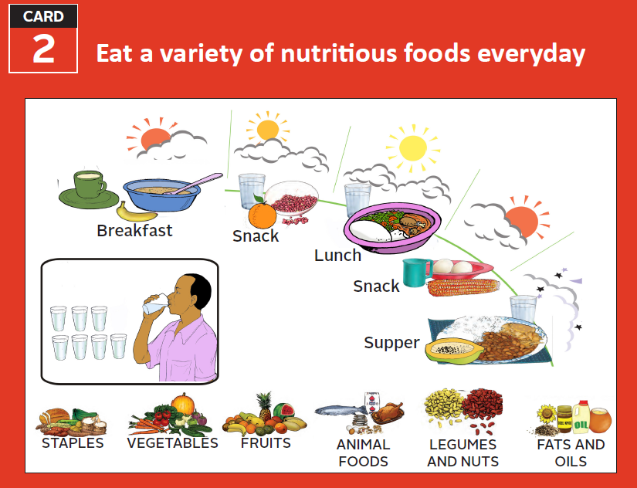

Slide 67
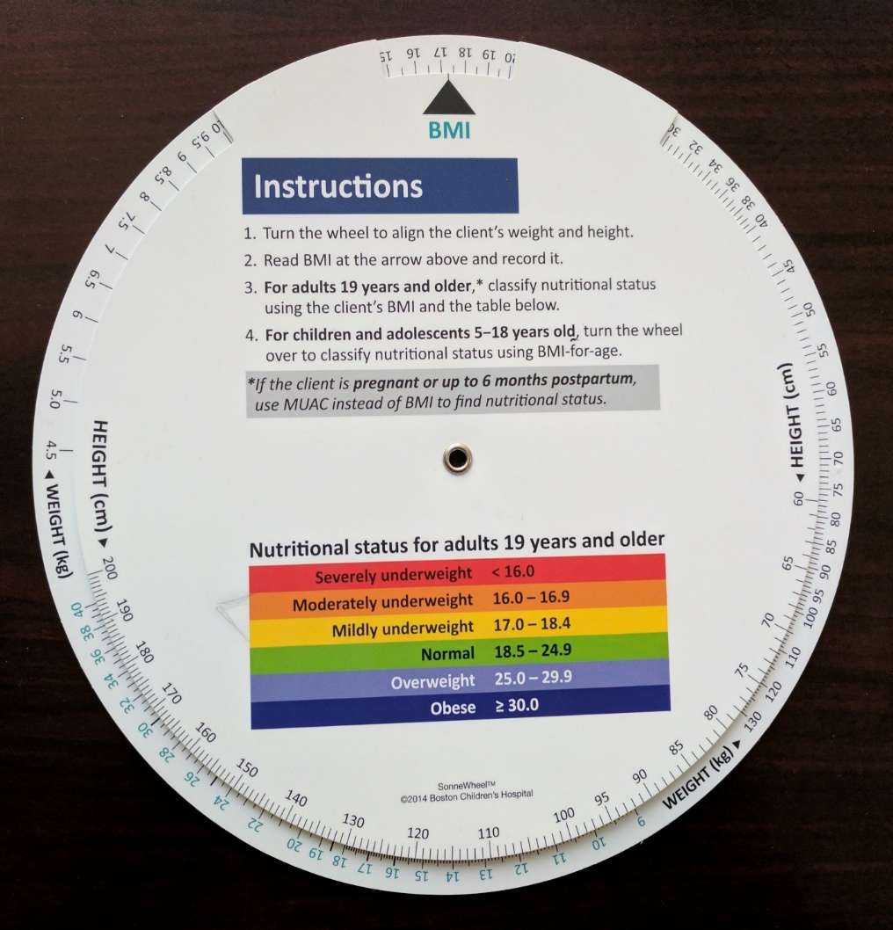
Body Mass Index (BMI) Wheel
Key tool for assessment and classification
Gateway for counselling and education
Your first ‘visual aid’

Slide 68
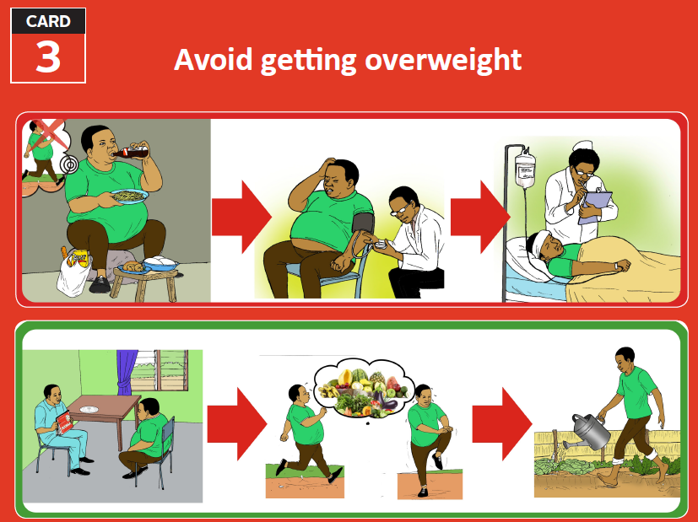

Slide 69
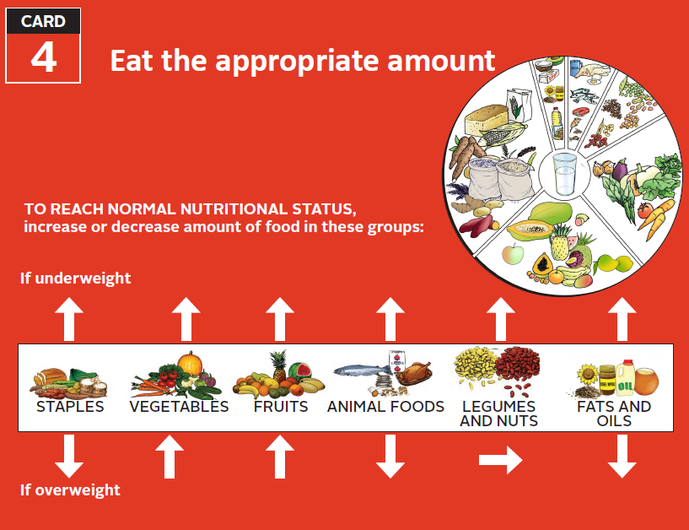

Slide 70
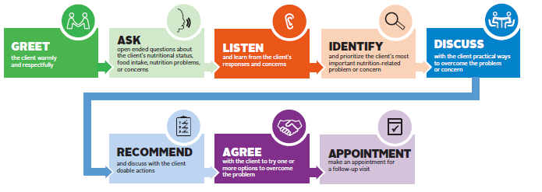
How to Conduct Effective Counselling

Slide 71
Always Address the Client’s Core Needs:
Water, Sanitation, and Hygiene (WASH)

Slide 72
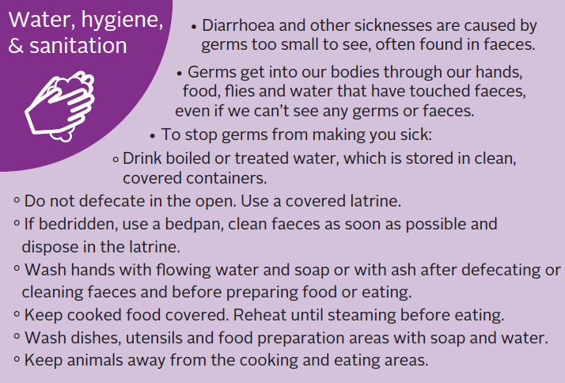

Slide 73
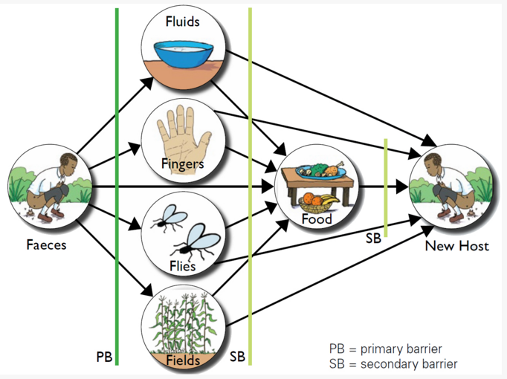
Why WASH?
3.31

Slide 74
Always Address the Client’s Core Needs: Regular Clinic Visits

Slide 75
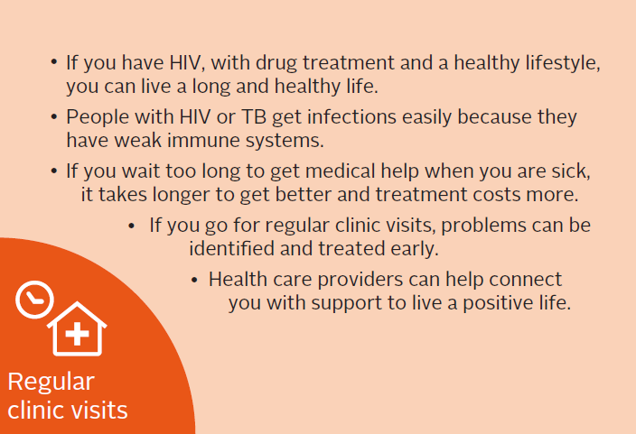

Slide 76
Always Address the Client’s Core Needs: Adherence to Medication

Slide 77
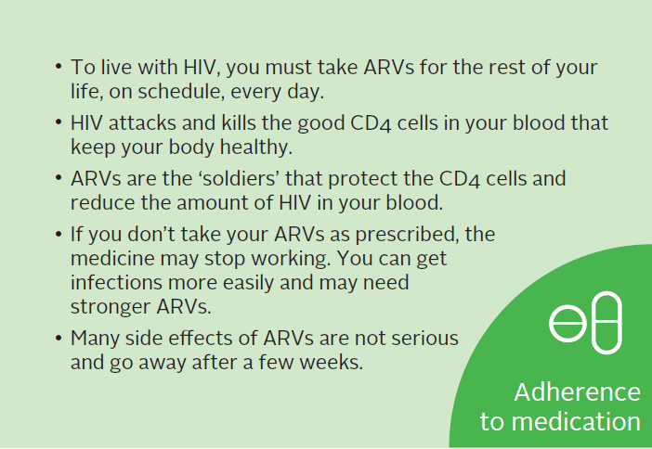

Slide 78
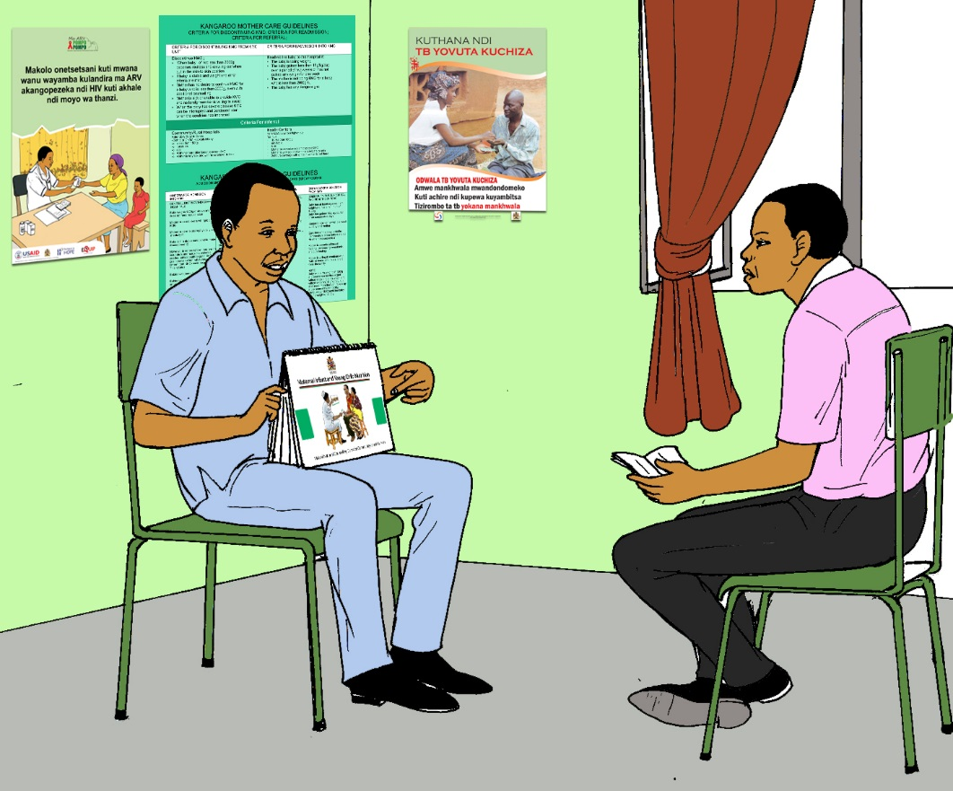
Using the New NCST Flipchart
Helps clients learn and apply messages through active, visual engagement
The flipchart is visually appealing and is used to stimulate conversation
Use the pictures and questions to get the client(s) talking
Follow ‘ORPA’ or ‘Think-Feel-Do’

Slide 79
Discuss, Recommend, and Verify the Client’s Understanding
Present a few options for addressing the priority problem and explain the benefits.
Ask about barriers and enabling factors.
Engage client in choosing the best action step given their situation; make sure it’s something s/he feels confident to do.
Verify client’s understanding of the key information (benefits) and the action plan by having him/her explain in own words.

Slide 80
Practice: Role Play―Discuss, Recommend, and Verify Understanding
REMEMBER: When using the flipchart, engage client with ‘ORPA’.
Show the client pictures relevant to the client’s situation.
Ask the client to describe what is happening the pictures.
Ask the client about common practices in his/her home/community concerning topics pictured.
Ask if the client could adopt practices shown in the pictures and have him/her explain how they would do it or why they cannot do it.
Discuss a plan for an action step that the client could do, referring to the pictures.

Slide 81
Patient Action Plan
Goal: ‘I want to have more energy, feel stronger’.
Action Plan: This week, I will walk (what) to the end of the road and back (how much) before lunch (when) three times (how many).
This week I will:
_________________________________________________ (what)
_________________________________________________ (when)
_________________________________________________ (how much/many)
This is how sure I am that I will be able to do this:
1 2 3 4 5
Not Very
Sure Sure

Slide 82
Nutrition Education with Groups
In Advance
Select a clear objective and relevant topic.
Practice to ensure that you are fully conversant in the topic.
During the Session
Use simple language.
Use various teaching techniques during the session, e.g., photographs, flipcharts, real examples, demonstrations, dramas, or songs.
Allow adequate time for clients to ask questions.
Listen carefully and engage clients to find solutions to questions and issues raised.
Present practical solutions for the local context.
Keep the session short, no more than 15 minutes.

Slide 83
Use ALIDRAA to Conduct Group Education

Slide 84
Tips to Engage Groups in Active Education
Start by asking audience questions about the topic you’re introducing, e.g.,:
  What is the best kind of diet to eat?
  How does eating a varied diet help your body?
  What happens if we eat only papa?
Use pictures to tell a story, e.g.,:
  ‘This is Gloria. She is having trouble with her medication and doesn’t know what to do. What advice would you give her’?
How do you manage challenges that can emerge in group discussion?

Slide 85
What Is High-Quality Service Delivery?
  Making sure we are doing the right things at the right time for every client every time.
  How does this apply to nutrition counselling?

Slide 86
Quality Assurance vs. Quality Improvement
Quality Assurance (QA)
Ensures that health services are meeting the required standards
Quality Improvement (QI)
The combined and continuous efforts of everyone involved in health care delivery to make the changes that will lead to better patient outcomes, system performance, and professional development

Slide 87
Quality Assurance vs. Quality Improvement

Slide 88
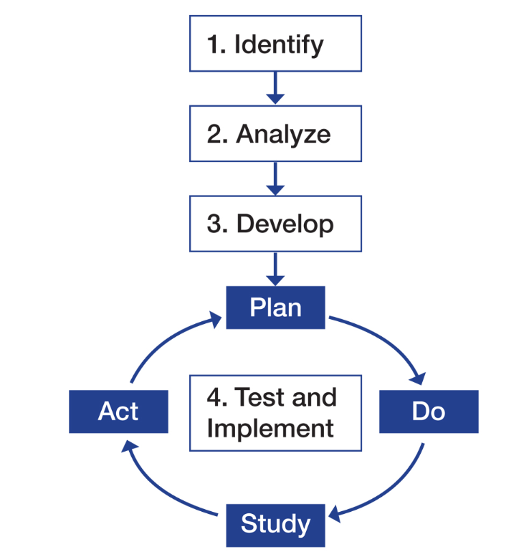
Quality Improvement Methodology
Adapted from T. Nolan et al. 1996. The Improvement Guide: A Practical Guide to Enhancing Organizational Performance

Slide 89
Quality Improvement Methodology
STEP 1. Identify the problem
Recognize a weakness in service quality or an opportunity to improve it.
Map out the process to improve.
Select the team that will solve the problem.
Have the team reach consensus on the problem.

Slide 90
Identify Problems/Areas for Improvement
Sources for identifying problems/areas for improvement:
Patient complaints
Routine patient treatment data, programme monitoring indicators, direct observation
Problem identification index
After identifying problems, prioritize the most critical ones.

Slide 91
Developing an Aim Statement
An aim statement guides teams to define their focus areas and what they want to achieve over a specific period.
A good aim statement must be SMART:
Specific–It should describe clearly and precisely who will benefit and what will be achieved.
Measurable–It should be possible to use data to determine whether the aim has been achieved, and there should be a starting point and target result to specify the scope of the goal.
It should have specific numerical goals for outcomes that are ambitious but achievable.
It should be relevant and easy to understand by others.
It should include a timeframe showing how much improvement will be achieved and by when.

Slide 92
Examples of Aim Statements
We will improve the delivery of nutrition services for HIV clients.
At Phimbi Health Centre, we will assess and categorize every client who visits the ART, PMTCT, and TB clinics using MUAC or BMI within 3 months.
At Nyungwe Health Centre, we will reduce the default rate from 12% to 0% between January 2014 and June 2014 by following up patients who miss appointments.

Slide 93
Quality Improvement Methodology
Adapted from T. Nolan et al. 1996. The Improvement Guide: A Practical Guide to Enhancing Organizational Performance

Slide 94
Quality Improvement Methodology
STEP 2. Analyse the problem
Map the process(es) that are causing the problem.
Conduct cause-and-effect analysis.
Determine the indicators that will show whether the intended improvement is achieved.
Analyse available data.
Collect additional data (as needed).

Slide 95
Process Mapping: Flow Chart
Process mapping can be useful for improving services by:
Making the steps in the process clear and understandable
Helping explain the purpose of the steps
Reducing complexity
Eliminating unnecessary steps and reducing waste
Avoiding creating extra work and the need to redo work
Helping teams understand how their work relates to the tasks of others

Slide 96
Cause-and-Effect Analysis
Is conducted to understand possible cause of the problem
Is done by asking ‘5 whys’ or by drawing a fishbone diagram

Slide 97
Fishbone Diagram
Effect
Categories for problem causes: Staff/providers, resources/equipment, processes/procedures/methods, patients, guidelines/policies/protocols

Slide 98
The QI Model
Adapted from T. Nolan et al. 1996. The Improvement Guide: A Practical Guide to Enhancing Organizational Performance

Slide 99
Quality Improvement Methodology
Step 3: Developing Changes
Develop possible changes (interventions) that may yield improvement.
Organize possible changes according to importance and practicality and select one to implement.
Discuss how the change will be implemented.
Explain what improvement is expected from the change.

Slide 100
Measuring Improvement
Measurement indicators:
Should be linked to the intended change
Help determine if the change led to improvement
Should be integrated into the health facility team’s daily routine

Slide 101
Qualities of a Good Indicator
A good indicator:
Is clear and unambiguous (teams should not be confused by what the indicator means)
Is quantifiable
Specifies the source of the data and the person responsible for collecting the data
Should be expressed as a proportion or percentage (must have a clear numerator and denominator)
Specifies the frequency with which the data should be collected

Slide 102
Testing and Implementing Changes
Adapted from T. Nolan et al. 1996. The Improvement Guide: A Practical Guide to Enhancing Organizational Performance

Slide 103
Module 4:
Nutrition Care Plans and Support
Time: 12 hours

Slide 104
Learning Objectives
Understand how to choose an appropriate nutrition care plan and support for a client based on his/her nutritional status
Describe therapeutic and supplementary food products available for adolescents and adults in Malawi and how to manage the supplies
Understand the process of referring clients from the facility to community ES/L/FS services

Slide 105
Importance of Nutrition Assessment
Identifies people at risk for malnutrition for early intervention or referral
Identifies malnourished clients who require intervention
Detects diet habits that increase the risk of disease
Identifies needs for nutrition education and counselling
Tracks growth and weight trends
Provides information for selecting a nutrition care plan

Slide 106
Types of Nutrition Assessment
        Anthropometry
          Weight, height, mid-upper arm circumference (MUAC), BMI, and BMI-for-age
        Biochemical
          Laboratory tests
        Clinical
          Medical conditions that can affect nutritional status
          Bilateral pitting oedema
          Appetite test
        Dietary
          24-hour recall
          Usual intake

Slide 107
Criteria for Normal Nutritional Status
Adolescents 15–18 years (non-pregnant and non-post-partum):
BMI-for-age: ≥ −2 to +1 OR
MUAC: 15–18 years: ≥ 220 mm (22.0 cm)
Adults ≥ 19 years (non-pregnant/non-post-partum):
BMI: 18.5 to 24.9 OR
MUAC: ≥ 220 mm (22.0 cm)
Pregnant women and lactating women up to 6 months post-partum:
MUAC: 220 to 299 mm (22.0 to 29.9 cm)
4.5

Slide 108
Criteria for Overweight and Obesity
Adolescents 15–18 years (non-pregnant and non-post-partum):
BMI-for-age: Overweight: ≥ +1 to < +2
Obese: ≥ +2
Adults ≥ 19 years (non-pregnant and non-post-partum):
BMI: Overweight: 25.0 to 29.9
Obese: ≥ 30.0
Pregnant women and lactating women up to 6 months post-partum:
MUAC: Overweight/Obese: ≥ 300 mm (30.0 cm)

Slide 109
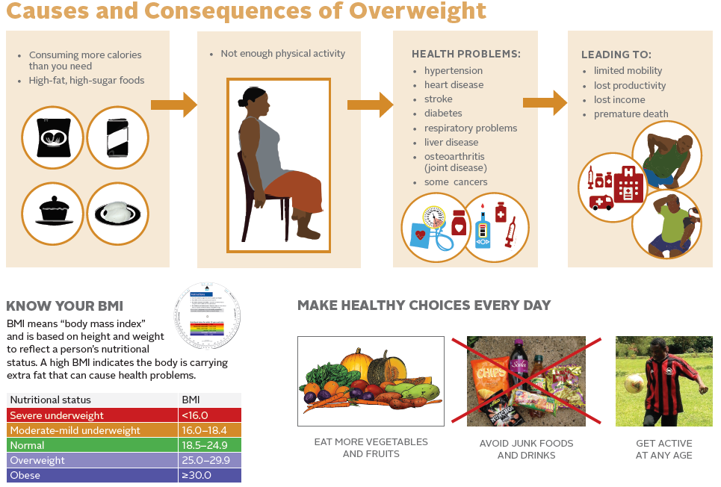

Slide 110
Criteria for Moderate Undernutrition
Adolescents 15–18 years (non-pregnant and non-post-partum):
BMI for-age: ≥ −3 to < −2 OR
MUAC: 185 mm to 219 mm (18.5 cm to 21.9 cm) OR
Unintentional weight loss of 5%–10%
Adults ≥ 19 years (non-pregnant and non-post-partum):
BMI: 16.0 to 18.4 OR
MUAC: 190 mm to 219 mm (19.0 cm to 21.9 cm)
Unintentional weight loss of 5%–10%
Pregnant women and lactating women up to 6 months post-partum:
MUAC: 190 mm to 219 mm (19.0 to 21.9 cm) OR
Weight gain: Less than 1 kg per month since the last visit
4.8

Slide 111
Criteria for Severe Undernutrition without Medical Complications
Adolescents 15–18 years (non-pregnant and non-post-partum):
BMI-for-age: < −3 OR
MUAC: < 185 mm (18.5 cm) OR
Unintentional weight loss of more than 10% OR
Presence of bilateral pitting oedema + or ++ AND Passed appetite test
Adults ≥ 19 years (non-pregnant/non-post-partum):
BMI: < 16.0 OR
MUAC: < 190 mm (19.0 cm) OR
Unintentional weight loss of more than 10%
Presence of bilateral pitting oedema + or ++ AND
Passed appetite test
Pregnant women and lactating women up to 6 months post-partum:
MUAC: < 190 mm (19.0cm) OR Any weight loss

Slide 112
Criteria for Severe Undernutrition with Medical Complications
Adolescents 15–18 years (non-pregnant and non-post-partum):
BMI-for-age: < −3 OR
MUAC: < 185 mm (18.5 cm) OR
Unintentional weight loss of more than 10% OR
Presence of bilateral pitting oedema + or ++ AND
Passed appetite test
Adults ≥ 19 years (non-pregnant/non-post-partum):
BMI: < 16.0 OR
MUAC: < 190 mm (19.0 cm) OR
Unintentional weight loss of more than 10%
Presence of bilateral pitting oedema + or ++ AND
Passed appetite test
Pregnant women and lactating women up to 6 months post-partum:
MUAC: < 190 mm (19.0 cm) OR Any weight loss

Slide 113
Therapeutic and Supplementary Food Products Used for NCST in Malawi
Therapeutic Foods
F-75
F-100
RUTF
Supplementary Foods
Fortified corn-soya blend (CSB+), also known as likuni phala
Vegetable oil
Vitameal
Nutritionally adequate (quality and quantity) home foods

Slide 114
Therapeutic and Supplementary Food Products Used for NCST in Malawi
Therapeutic Foods
F-75 and F-100 therapeutic milks are for treatment of severe undernutrition with medical complications
RUTF and CSB+ are for treatment of severe undernutrition without medical complications
Supplementary Food
CSB+ and vegetable oil for treatment of moderate undernutrition

Slide 115
How NCST Differs from Other Food Supplementation
Food aid (e.g., from the World Food Programme) aims to increase food security by giving families household food rations, largely staple foods.
NCST prescribes food to supplement the diets of PLHIV and/or TB clients with clinical malnutrition identified through routine anthropometric assessment or health status.

Slide 116
Module 5:
NCST Monitoring and Reporting
Time: 8 hours
5.1

Slide 117
Module 5: Learning Objectives
Understand how to use NCST data collection tools
Report on NCST service delivery
Understand the definition of NCST indicators
Enter NCST data in the District Health Information System–Version 2 (DHIS-2) software
Understand the principles and processes of NCST data analysis
Understand how to conduct routine data quality assessments (RDQA)

Slide 118
Importance of Monitoring and Reporting of NCST Services
Assess the effectiveness and outcome of nutrition care, support, and treatment interventions
Inform and improve the design of service delivery
Provide timely results to district and national authorities and partners
Identify successful approaches
Advocate for support, resource allocation, and expansion of activities
Monitor availability and use of therapeutic and supplementary food supplies

Slide 119
NCST Data Collection and Reporting Tools
Nutrition Care Support and Treatment (NCST) for Adolescent and Adult Register
NCST Undernourished Client Management Forms
Stock Cards
NCST Monthly Report Form

Slide 120
NCST Monthly Report Data Error Check
Data check | Answer
Total classified (normal + Moderate + Severe + overweight/obese) – Total who received nutrition assessment at contact point | Zero
Total who received health services – Total who received nutrition assessment at contact point | Greater or equal to zero
New admissions of severely undernourished – Those classified as severely undernourished | Zero

Slide 121
NCST Data Flow from Facility to National Level
MOH Central Monitoring and Evaluation Division (CMED)
Data in DHS-2
CMED provides feedback to the Zonal Health Office and central hospitals
Data aggregated at the Central Hospital
Zonal Health Office
Zonal Health Office provides feedback to the district nutritionists and HMIS officers
ANC/PMTCT
ART, Pre-ART
TB
OPD
District Health Office
Reports received and reviewed by District nutritionist or nutrition coordinator
District nutritionist/nutrition coordinator provides feedback to facilities
District Health Office
Reports received and reviewed by District nutritionist or nutrition coordinator
District nutritionist/nutrition coordinator provides feedback to facilities
Facility Level
Data aggregated by a focal person at the health facility level
NCST facility focal person provides feedback to NCST service delivery points
ANC/ PMTCT clinic
ART, Pre-ART
clinic
TB clinic
OPD

Slide 122
NCST Indicators
Nutrition Assessment: The number and proportion of adolescent and adult clients who were nutritionally assessed using anthropometric measurements (e.g., BMI or MUAC) during the reporting period
Nutrition Counselling: The number and proportion of clients who were nutritionally assessed with anthropometric measurement and also received nutrition counselling at any point during the reporting period
Provision of Therapeutic Food Support: The number and proportion of severely undernourished adolescent and adult clients who received therapeutic food at any point during the reporting period
Provision of Supplementary Food Support: The number and proportion of moderately undernourished adolescent and adult clients who received supplementary food at any point during the reporting period

Slide 123
Challenges of Data Collection
Clients may find questions intrusive.
Collecting data takes time and increases workload.
Weak data collection generates inaccurate information, which is useless for decision making.
Facilities may not receive feedback on data they submit to higher levels.
Clients may be double-counted if they are registered in different areas.

Slide 124
Addressing Data Collection Challenges
Become familiar with filling out forms by doing
it regularly.
Collect and record data as accurately as possible.
Ensure that you use the standard MOH report to record report.
Record client identification numbers on all forms.
Identify changes you can make to retain clients in treatment; this will ensure that missing information is captured.
Conduct routine data quality assessments (RDQA).

Slide 125
NCST Data Reporting Using DHIS-2
Monthly report should be entered in DHIS-2
The district nutritionist should check for inconsistencies before entry.
Why use DHIS-2?
It is easy to analyse NCST performance trends.
It helps with tracking indicators and determining need for therapeutic and supplementary food supplies.

Slide 126
Data Analysis
Refers to the process of transforming or modeling data with the goal of using the data for planning and decision making at the facility, district, or national level.
Data analysis results should be disseminated to the various levels such as communities, service providers, and managers to provide feedback on progress and outcomes.

Slide 127
Elements of a Run Chart (Time Series Chart)
Clearly defined title that includes what is being measured, where, and when
X and Y axes have clear scale and include indicator label
Tested changes are annotated
Numerator defined, including data source (e.g., NCST register)
Denominator defined, including data source (e.g., NCST register)
Numerator and denominator values shown for each month

Slide 128
Using Bar Graphs to Present Data
Can be used to present the proportion assessed and classified as:
  Severe
  Moderate
  Normal
  Overweight and obese

Slide 129
Data Quality
Data quality means that the information collected as part of the NCST monitoring and reporting system adequately represents NCST’s activities.

Slide 130
Components of Routine Data Quality Assessment (RDQA)
Part 1—Information systems assessment: Involves quantitative and qualitative assessment of the relative strengths and weaknesses of processes and systems that generate and manage NCST data
Part 2—Data verification: Involves a quantitative comparison of recounted data from source documents to reported data and a review of the completeness and availability of reports
Part 3—Plan of action development: Involves developing a joint plan of action to strengthen the processes and systems that generate and manage data to improve data quality

Slide 131
Module 6:
Managing the Quality of NCST Services
Time: 16 hours

Slide 132
Module 6: Learning Objectives
Give examples of quality assurance and quality improvement activities.
Implement a systematic process to improve the quality of NCST services at a health care facility.
Formulate an action plan for improving the quality of NCST in routine health care delivery.
Monitor quality improvement activities.

Slide 133
Quality Health Services Are:
    Safe
    Effective
    Patient-centred
    Equitable
    Efficient

Slide 134
What Is High-Quality Service Delivery?
Making sure we are doing the right things at the right time for every client every time.

Slide 135
Quality Assurance vs. Quality Improvement
Quality Assurance (QA)
Ensures that health services are meeting the required standards
Quality Improvement (QI)
The combined and continuous efforts of everyone involved in health care delivery to make changes that will lead to better patient outcomes, system performance, and professional development

Slide 136
Principles of Quality Improvement
Client focus
Focus on processes
Experimentation and use of data
Teamwork

Slide 137
Health Delivery System
Inputs/Resources
Processes
Outcomes
People
Equipment
Supplies
Infrastructure
Information
Technology
Money
What is done?
How it is done?
Health services delivered
Change in health behaviour
Change in health status
Client satisfaction

Slide 138
Experimentation and Use of Data
Solutions are tested to determine whether they produce the required improvement.
Data are used to analyze processes, identify problems, and to determine whether the changes have resulted in improvement.

Slide 139
The Model for Improvement
Adapted from T. Nolan et al. 1996. The Improvement Guide: A Practical Guide to Enhancing Organizational Performance

Slide 140
Quality Improvement Methodology
Adapted from T. Nolan et al. 1996. The Improvement Guide: A Practical Guide to Enhancing Organizational Performance

Slide 141
Quality Improvement Methodology
STEP 1. Identify the problem
Recognize a weakness in service quality or an opportunity to improve it.
Map out the process to improve.
Select the team that will solve the problem.
Have the team reach consensus on the problem.

Slide 142
Identify Problems/Areas for Improvement
Sources for identifying problems/areas for improvement:
Patient complaints
Routine patient treatment data, programme monitoring indicators, direct observation
Problem identification index
After identifying problems, prioritize the most critical ones.

Slide 143
Form a Team
Patient Arrives
Registration
Take Temperature
Doctor’s Exam
Collect Tests
Specialist’s Exam
Patient Leaves
Patient
arrives
Registration
Take
temperature
Doctor’s
Exam
Collect
Tests
Specialist’s
Exam
Patient
leaves
Patient
Receptionist
Nurse
Physician
Lab technician
Specialist
Patient
Who would be on your team?

Slide 144
Creating Effective QI Teams
Keep the team at a reasonable size (7–9 members).
Choose motivated team members who want to contribute.
Include people who have influence over their colleagues or communities.
Select people with various levels of seniority.

Slide 145
Developing an Aim Statement
An aim statement guides teams to define their focus areas and what they want to achieve over a specific period.
A good aim statement must be SMART:
Specific–It should describe clearly and precisely who will benefit and what will be achieved.
Measurable–It should be possible to use data to determine whether the aim has been achieved, and there should be a starting point and target result to specify the scope of the goal.
It should have specific numerical goals for outcomes that are ambitious but achievable.
It should be relevant and easy to understand by others.
It should include a timeframe showing how much improvement will be achieved and by when.

Slide 146
Examples of Aim Statements
We will improve the delivery of nutrition services for HIV clients.
At Phimbi Health Centre, we will assess and categorize every client who visits the ART, PMTCT, and TB clinics using MUAC or BMI within 3 months.
At Nyungwe Health Centre, we will reduce the default rate from 12% to 0% between January 2014 and June 2014 by following up patients who miss appointments.

Slide 147
Quality Improvement Methodology
Adapted from T. Nolan et al. 1996. The Improvement Guide: A Practical Guide to Enhancing Organizational Performance

Slide 148
Quality Improvement Methodology
STEP 2. Analyse the problem
Map the process(es) that are causing the problem.
Conduct cause-and-effect analysis.
Determine the indicators that will show whether the intended improvement is achieved.
Analyse available data.
Collect additional data (as needed).

Slide 149
Process Mapping: Flow Chart
Process mapping can be useful for improving services by:
Making the steps in the process clear and understandable
Helping explain the purpose of the steps
Reducing complexity
Eliminating unnecessary steps and reducing waste
Avoiding creating extra work and the need to redo work
Helping teams understand how their work relates to the tasks of others

Slide 150
Creating and Using a Flow Chart to Understand a System/Process
Decide on the beginning and end points of the process being mapped.
Identify the steps of the process.
Link the steps with arrows showing direction.
Review the flow chart to see whether the steps are in their logical order.

Slide 151
Creating a Process Flow Chart: Symbols
Beginning or end
Step
Decision
Flow lines
Unclear step

Slide 152
Creating a Process Flow Chart: Flow Lines
One flow line out of a step
Step
Two flow lines out of a decision
Must ask a yes/no question
YES
Decision
NO

Slide 153
Cause-and-Effect Analysis
Is conducted to understand possible cause of the problem
Is done by asking ‘5 whys’ or by drawing a fishbone diagram

Slide 154
Fishbone Diagram
Effect
Categories for problem causes: Staff/providers, resources/equipment, processes/procedures/methods, patients, guidelines/policies/protocols

Slide 155
Example of a Fishbone Diagram
Staff
Data collection
Staff lack skills to assess nutritional status
Bad attitude of health workers
Lack of registers to record assessments
Poor documentation
Assessing few patients on nutrition
Lack of guidelines, standards, and job aids
Patients sending guardians to collect drugs on their behalf
Lack of anthropometry equipment
Patients arriving late to receive services
Equipment
Patient

Slide 156
The QI Model
Adapted from T. Nolan et al. 1996. The Improvement Guide: A Practical Guide to Enhancing Organizational Performance

Slide 157
Quality Improvement Methodology
Step 3: Developing Changes
Develop possible changes (interventions) that may yield improvement.
Organise possible changes according to importance and practicality and select one to implement.
Discuss how the change will be implemented.
Explain what improvement is expected from the change.

Slide 158
Measuring Improvement
Measurement indicators:
Should be linked to the intended change
Help determine if the change led to improvement
Should be integrated into the health facility team’s daily routine

Slide 159
Types of Indicators
Patient arrives
Short-term result
Long-term result
Patient moves through system
Input Indicators
Process Indicators
Output
Indicators
Outcome
Indicators
# of staff trained in nutrition assessments
% compliance with assessment guidelines
Proportion of patients who received nutrition assessment
Reduction in mortality due to malnutrition
159

Slide 160
Qualities of a Good Indicator
A good indicator:
Is clear and unambiguous (teams should not be confused by what the indicator means)
Is quantifiable
Specifies the source of the data and the person responsible for collecting the data
Should be expressed as a proportion or percentage (must have a clear numerator and denominator)
Specifies the frequency with which the data should be collected

Slide 161
Example of an Indicator
Indicator: Proportion of ART, TB, ANC/PMTCT clients assessed and classified
Numerator: Number of ART, TB, ANC/PMTCT clients assessed and classified
Denominator: Total number of clients who attended the clinic (ART, TB, ANC/PMTCT)
Source: NCST registers for adolescents and adults (ART, TB, ANC/PMTCT client registers)
Person responsible: Data clerk at ART, nutrition focal persons at TB and ART
Frequency: Monthly

Slide 162
Using Data
Data are used continuously to:
Identify gaps in service
Determine whether changes led to improvement
To inform decision-making

Slide 163
Elements of a Time Series Chart
Clearly defined title that includes what is being measured, where, and when
X and Y axes have clear scale and include indicator label
Tested changes are annotated
Numerator defined, including data source (e.g., NCST register)
Denominator defined, including data source (e.g., NCST register)
Numerator and denominator values shown for each month

Slide 164
Testing and Implementing Changes
Adapted from T. Nolan et al. 1996. The Improvement Guide: A Practical Guide to Enhancing Organizational Performance

Slide 165
Testing Changes: Plan
How will the change be implemented?
Who will implement it?
Where will the change be implemented?
When will it be implemented?

Slide 166
Testing Changes: Do
Implement the plan/solution
Test BIG changes on a small scale initially and then ramp up.
Focus on learning. Negative results are an opportunity to learn, so it is ok if some changes don’t work.
Test one change at a time.
Monitor and document results. Ensure that data are complete.

Slide 167
Testing Changes: Study
Review the data and create a time series chart.
Review available qualitative data that are relevant to the quantitative data.
Ask the QI team what the results reveal.

Slide 168
Testing Changes: Act
Analysis
Did the change lead to
an improvement?
ABANDON
the change.
Develop and test
other changes.
No
Yes
Is the change significant?
MODIFY
the change
and conduct
another test.
ADOPT
the change.
Develop new
changes.
No
Yes

Slide 169
Monitoring QI Activities
Data collection tools
  NCST adolescent and adult register
  NCST client management form
Reporting tools
  NCST monthly report form
QI documentation journal
QI team maturity index

