Slide 1

Multi-Sectoral Nutrition Action Planning Training Module
Unit 1: Introduction to the Nutrition Situation in Uganda

Slide 2
Unit Purpose
Understand the multi-sectoral causes and consequences of malnutrition in Uganda and the policy and planning framework around which this training is designed.

Slide 3
Unit Objectives
Understand the types of malnutrition, their causes and consequences, and the role of all sectors in improving nutrition.
Understand the global, regional, and national nutrition policy and planning frameworks.

Slide 4
Session 1.1
Nutrition Situation Overview

Slide 5
What Is Malnutrition?
Malnutrition: People are malnourished if their diet is not balanced with their nutritional needs.
Two main categories:
  Undernutrition
    Acute malnutrition (thinness)
    Chronic malnutrition (poor growth)
    Micronutrient deficiency
  Overnutrition
    Overweight
    Obesity
Notes:
People are malnourished if their diet is not balanced with their nutritional needs.
Malnutrition: People are malnourished if their diet is not balanced with their nutritional needs. Malnutrition includes both undernutrition (stunting, wasting, underweight, and micronutrient deficiencies) and overnutrition (overweight and obesity).
Undernutrition: Undernutrition is a consequence of a deficiency in nutrient intake and/or absorption in the body. The different forms of undernutrition, which can appear alone or in combination, are acute malnutrition (bilateral pitting oedema and/or wasting), chronic malnutrition (stunting), underweight (combined form of wasting and stunting), and micronutrient deficiencies.
Underweight: A composite form of undernutrition that includes elements of stunting and wasting and is defined in children under 5 as a weight-for-age of more than 2 standard deviations below the median (<-2 SD) of the WHO Child Growth Standards. This indicator is commonly used in growth monitoring and promotion (GMP) and child health and nutrition programmes aimed at prevention and treatment of undernutrition.
Micronutrient deficiency: Inadequate intake of micronutrients (vitamins or minerals) for the body’s needs. The most common micronutrient deficiencies are: vitamin A deficiency, Iron deficiency anaemia, iodine deficiency, and zinc deficiency. This is also known as ‘hidden hunger’.
Overnutrition: Overnutrition happens when a person’s daily energy intake consistently exceeds energy requirements. If the continues over time, a person may become overweight or obese.

Slide 6
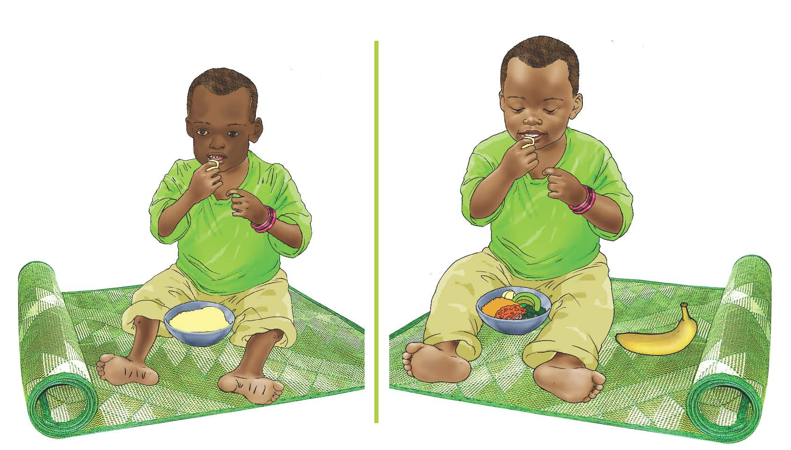
Examples of Undernutrition: Wasting
The child on the left is undernourished (wasting).
Notes:
Here we show images of some examples of undernutrition. You see an example of acute malnutrition in the form of wasting. Acute malnutrition has two categories – severe acute malnutrition (SAM), which can be treated either through inpatient care or outpatient care, depending on the severity and the presence of other medical complications – and moderate acute malnutrition (MAM), which can be treated through outpatient care and/or supplementary feeding programs (SFP).
Wasting: This occurs when an individual is very thin for his or her height. It happens when a person loses weight rapidly or a growing child does not gain adequate weight relative to their growth in height. Wasting may be caused by inadequate food intake, such as a drop in food consumption or sub-optimal infant and young child feeding practices; by disease or infection, including HIV or tuberculosis; or a combination. In children under 5 it is defined as weight-for-height of more than 2 standard deviations below the median (<-2 SD) of the WHO Child Growth Standards or MUAC under 125 mm. Wasting is one form of acute malnutrition.

Slide 7
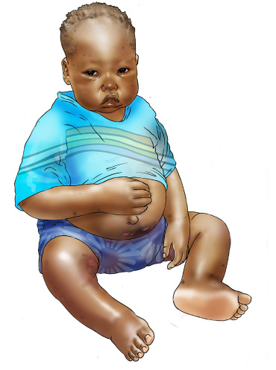
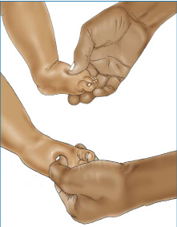
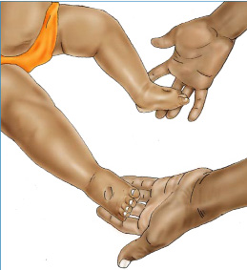
Examples of Undernutrition:
Bilateral Pitting Oedema
Previously called kwashiorkor.
Characterized by body swelling that starts from the feet/hands.
Form of severe acute malnutrition due to illness or insufficient food intake or both.
Notes:
Here we show images of some examples of undernutrition. You see an example of acute malnutrition in the form of oedema. Acute malnutrition has two categories – severe acute malnutrition (SAM), which can be treated either through inpatient care or outpatient care, depending on the severity and the presence of other medical complications – and moderate acute malnutrition (MAM), which can be treated through outpatient care and/or supplementary feeding programs (SFP).
Oedema (Bilateral pitting oedema): An excess accumulation of fluid that starts in both feet and can progress to other parts of the body. Also known as nutritional oedema or oedematous malnutrition, bilateral pitting oedema is a sign of severe acute malnutrition. It is verified when thumb pressure applied on the tops of both feet for 3 seconds leaves an indentation after the thumb is lifted.

Slide 8
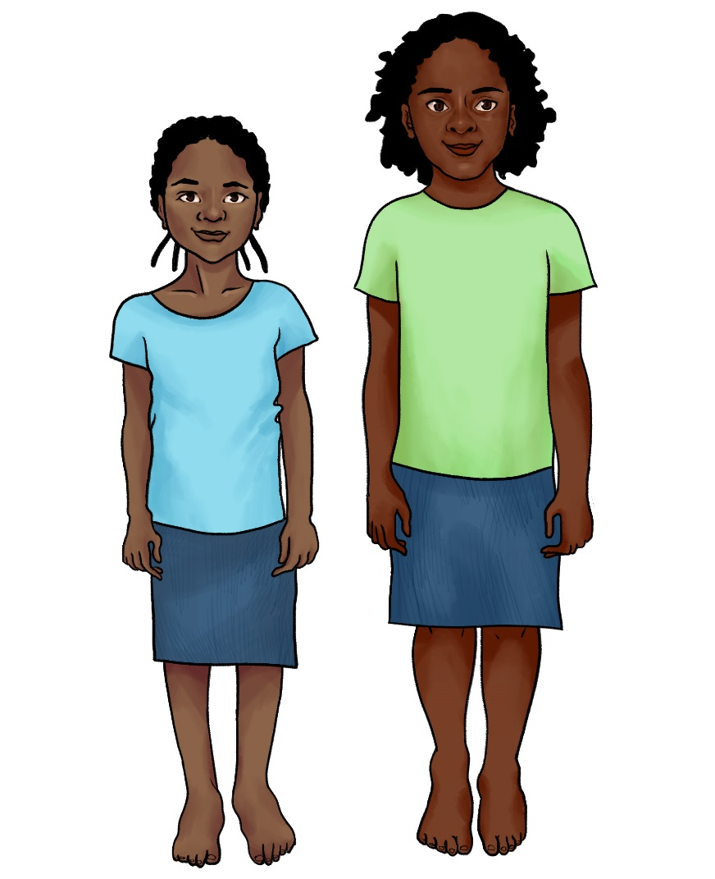
Examples of Undernutrition: Stunting
Both girls are the same age.
The girl on the left is stunted (short stature for age).
Notes:
Here we show and image some chronic malnutrition or stunting. These girls are the same age, but the girl on the left is stunted due to poor nutrition.
Stunting: Stunting, or chronic malnutrition, occurs when a child fails to grow at a healthy pace and is shorter than expected for a healthy child of the same age. Stunting develops over a long period because of long-term inadequate nutrition (including poor maternal nutrition and poor infant and young child feeding practices) and/or repeated illness or infection. Stunted children have a higher risk of death from diarrhoea, pneumonia, and measles. Stunting is associated with poor cognitive and motor development and lower school achievement. In children under 5 it is defined as a height-for-age of more than 2 standard deviations below the median (<-2 SD) of the WHO Child Growth Standards (children under 5)

Slide 9


Examples of Overnutrition
Obesity
Overweight
Notes:
Obesity: Obesity is a range of weight that is much greater than what is generally considered healthy for a given height. For adults, obesity is having a body mass index (BMI) of 30 or higher. In children under 5, obesity is a BMI-for-age more than 3 standard deviations (> +3 SD) above the median of the WHO Child Growth Standards, and in children 5–19, obesity is a BMI-for-age more than 2 standard deviations (> +2 SD) above the median of the WHO Growth Reference
Overweight: Overweight is a range of weight that exceeds what is generally considered healthy for a given height. For adults, overweight is having a BMI from 25 to 29.9. In children under 5, overweight is a BMI-for-age more than 2 standard deviations (> +2 SD) above the median of the WHO Child Growth Standards, and in children 5–19, overweight is a BMI-for-age more than 1 standard deviation (> +1 SD) above the median of the WHO Growth Reference

Slide 10
Vulnerable Groups
Children under 5 years, particularly those under 2
Pregnant and lactating women
Adolescent girls and women of reproductive age
Individuals with infectious diseases, such as HIV and TB
Notes:
These groups are those that are most vulnerable to malnutrition and nutritional problems.
Children under 5:
Children under five years are at high risk of malnutrition, particularly those under 2 because they're growing the fastest and they need adequate nutrition to grow and develop properly. Children who are malnourished are at greater risk of infections (such as diarrhoea and pneumonia), which in turn increases the risk of malnutrition. Malnourished children also have a greater risk of developing chronic diseases (such as diabetes and heart disease) in adulthood. In addition, low birth weight babies are four times more likely to die within the first month of life than other babies.
Pregnant and lactating women
Pregnancy and lactation increase a woman’s nutritional needs. Among women who are already malnourished, these increased nutritional needs present additional challenges. Women who are malnourished have a higher risk of dying from pregnancy-related causes; children born to undernourished women are more likely to be born premature and be small for gestational age/have low birth weight. This, in turn, leads to a higher risk of stunting, an increased risk of death within 1 month of birth, and future developmental challenges. In addition, overweight can increase pregnancy complications. Pregnant and lactating women are at risk, in part, due to high fertility rates. About 25 percent of births occur within 24 months of a previous birth, giving the mother little time to replenish her own body’s nutrients. Women have increased nutritional needs during pregnancy to support growth of fetus; high fertility/frequent pregnancies prevent them from rebuilding nutritional stores between pregnancies. Birth spacing also has important nutritional consequences. Children conceived less than 24 months after the birth of the next older sibling have a greater risk of dying and becoming malnourished than children born farther apart.
In addition, childbearing begins early in Uganda. Twenty-four percent of women age 15–19 are already mothers or pregnant with their first child. This has serious consequences because, relative to older mothers, adolescent girls are more likely to be malnourished and have a low birth weight baby who is more likely to become malnourished. Because of this, adolescent girls need to be the target of both family planning and nutrition interventions.
Adolescent girls and women of reproductive age
To ensure healthy pregnancy outcomes for both the mother and baby, it is important to target adolescent girls and women of reproductive age before they become pregnant. Adolescence is also a time of rapid growth and development. Girls need to be well nourished during this period to ensure they grow properly – women who are underweight and of short stature are more likely to have babies with low birth weight. Good nutrition beginning during the 1,000 days that also carries through to adolescence can help to mitigate these nutritional complications. In addition, overweight is a problem during pregnancy so it is important to educate young girls about good diet. Coupled with access to family planning and efforts to retain girls in school, this age group is a critical factor in breaking the cycle of malnutrition.
Individuals with infectious diseases
Finally, individuals with infectious diseases, such as HIV or TB, are more at risk for malnutrition due to the higher calorie and nutrient requirements as the body battles these conditions. Nutrition Assessment, Counselling, and Support (NACS) is an example of an intervention that targets these specific groups.

Slide 11
1,000 Days Window of Opportunity
PREGNANCY
270 DAYS
YEAR ONE
365 DAYS
YEAR TWO
365 DAYS
Notes:
There is a period known as the 1,000 days window of opportunity during which major gains in malnutrition prevention can be made. Here you see two of the previously mentioned target groups (pregnant women and children under 5, specifically those up to 2 years) are highlighted. This is because good nutrition in children under 5 begins with the nutritional status of the mother, as good growth and development begins at conception. If a mother is malnourished, the baby growing inside will experience poor growth and development, leading to low birth weight and poor development. The period of growth up to 2 years has been identified as a key period for growth and development, particularly as it relates to stunting – as catch up growth has been shown to be much more difficult to achieve after the age of 2.
However, achieving the benefits of the 1,000 days does not begin with pregnancy. Adolescent girls and women of reproductive age are also critical target groups as it is important for women to have a good nutritional status before becoming pregnant and to then maintain good nutrition throughout pregnancy.

Slide 12
Prevalence of Malnutrition in Uganda
LBW=low birth weight, (c)=children, (p)=pregnant women
Uganda DHS 2016 and 2011
Notes:
Malnutrition increases risk of illness, death, and harms child development and ability to perform in school. Malnourished children become adults who earn less money than their well nourished peers.
Stunting affects 29 percent of children under 5 in Uganda. Stunted children are more likely to die of infectious diseases such as diarrhoea, pneumonia, and measles (Black et al. 2013). Stunting is also associated with poor cognitive and motor development and lower school achievement (Grantham-McGregor et al. 2007; Hoddinot et al. 2008) and lower productivity in adulthood.
Underweight affects 11 percent of children under 5
Wasting affects nearly 4 percent of children under 5. Children with acute malnutrition are at higher risk of death from infectious diseases (Black et al. 2013) and require treatment based on the severity of the condition. Children with severe acute malnutrition (SAM) are at a very high risk of death, up to nine times the risk of well-nourished children (Black 2008; WHO/UNICEF 2009).
Micronutrient deficiencies are also a problem in Uganda. These are known as “hidden hunger” as a person may be eating enough food but not getting adequate nutrients from the food. Examples of micronutrient deficiencies that are prevalent in Uganda are anemia – a lack of iron, which affects 53 percent of children under 5 and 32 percent of pregnant women, and vitamin A deficiency which affects 33 percent of children under 5. Anemia leads to: increased maternal mortality (20 percent of maternal deaths); increased risk of premature and low birthweight babies; reduced cognitive development; reduces productivity. Vitamin A deficiency harms the immune system and increases risk of death from infections like measles and diarrhea; leading cause of preventable blindness.
Finally, poor nutritional status of women of reproductive age and pregnant women can lead to poor birth outcomes, including low birth weight. Babies born with low birth weights are more susceptible to diseases and nutritional problems later in life. These children then grow up to become malnourished adults, and if the children are girls, they are at high risk of also giving birth to low birth weight babies in the future – creating what is known as the intergenerational cycle of malnutrition.

Slide 13
Trends in Nutrition Status of Children Under 5 Years
Uganda DHS

Slide 14
Consequences of Malnutrition
if not Addressed
^{568,000}
lives of children under 5 will be lost related to stunting
^{Almost}
^{15,000}
women’s lives will be lost related to maternal anaemia
^{8.21}
Millions equivalent school years of learning will be lost related to stunting
^{272,000}
lives of children under 5 will be lost related to wasting
^{221,000}
lives of children under 5 will be lost related to vitamin A deficiency
^{363,000}
lives of children under 2 will be lost related to poor breastfeeding practices
^{1.1 million}
Children will be born with irreversible brain damage with a decrease in IQ related to maternal iodine deficiency
Stunting alone will result in UGX 19 trillion in economic productivity losses if these problems are not addressed by 2025.
Notes:
If nothing changes by 2025, the following consequences will be realised.

Slide 15
Malnutrition Can Affect All Households
Uganda DHS 2016
Notes:
However, malnutrition is not only a problem of low income households. There figure shows stunting and anaemia rates by wealth quintile. As you can see, rates even in the two highest wealth quintiles are still quite high. This suggests that more income at the household level does not always lead to better diet and health practices. Therefore, when planning nutrition interventions these groups and interventions targeting them should also be considered.

Slide 16
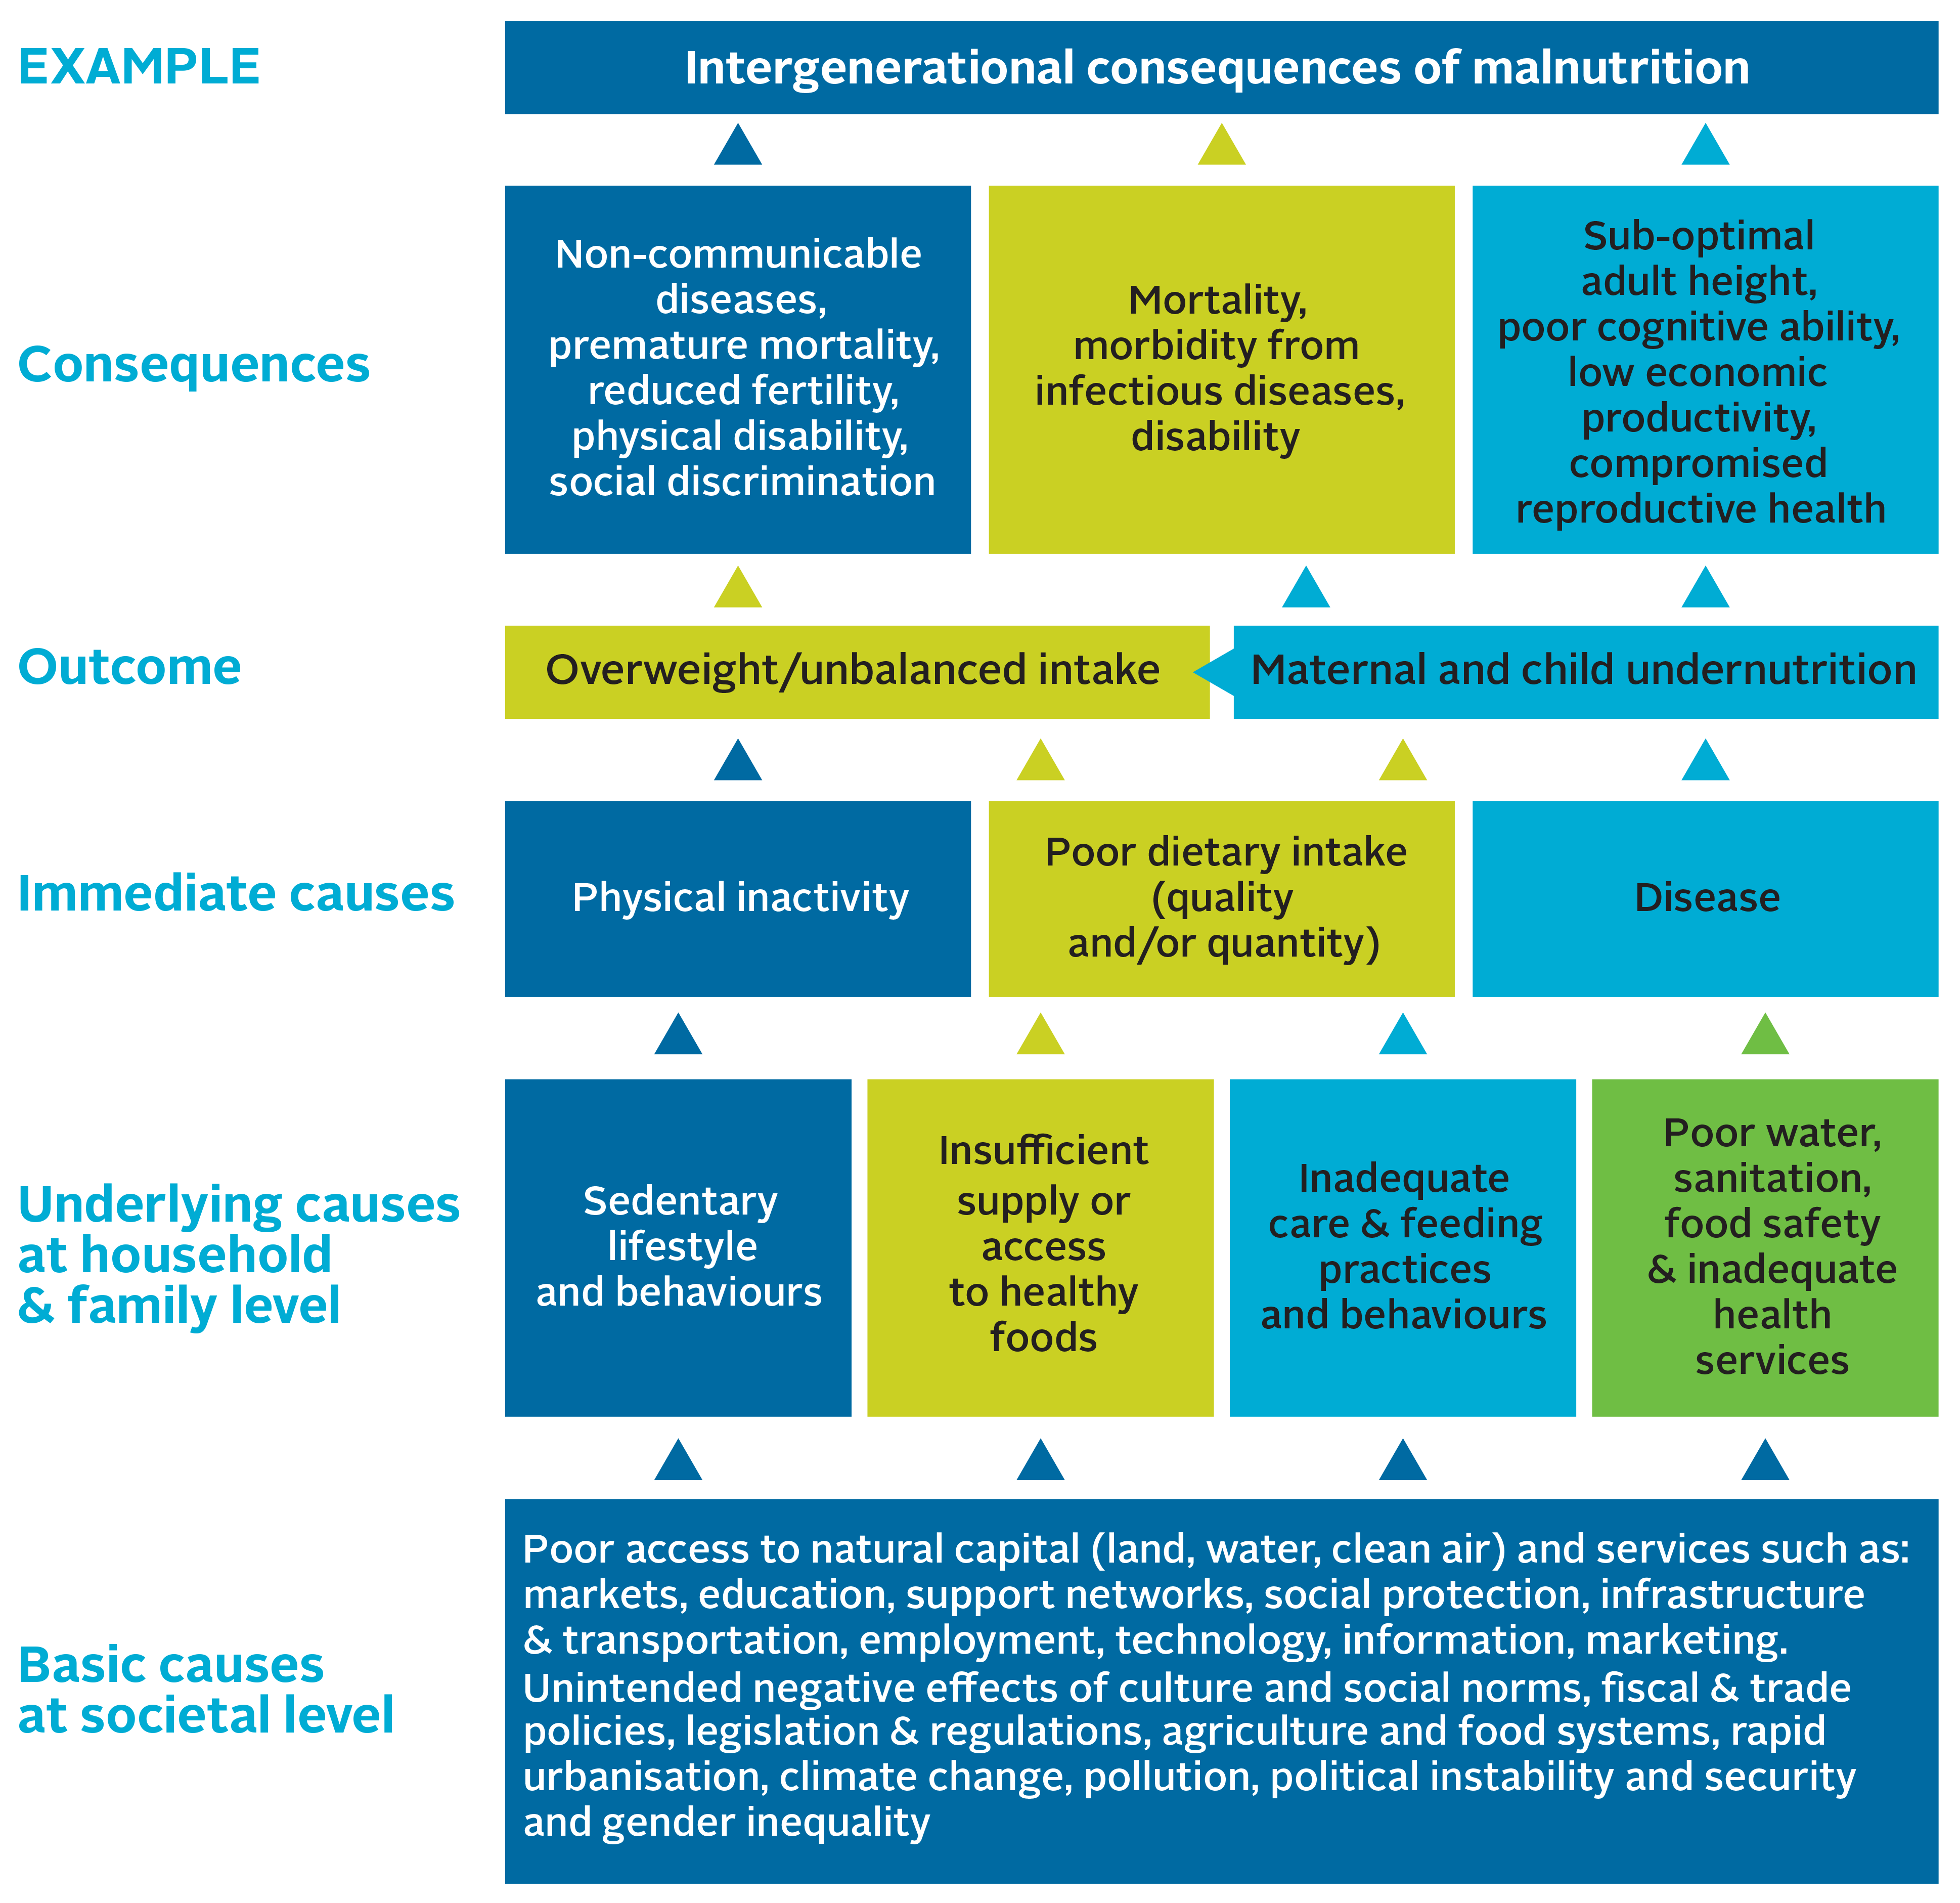
Causes of Malnutrition
Scaling Up Nutrition. 2016. Checklist on the Criteria and Characteristics of “Good” National Nutrition Plans.
Notes:
To achieve improvement in nutrition outcomes, the various causes of malnutrition must be tackled. There are three levels of causes of malnutrition: basic causes at the societal level, underlying causes at the household and family level, and immediate causes at the individual level.
Immediate causes can lead directly to malnutrition. The most obvious immediate cause is poor dietary intake. A person may not be getting enough required daily calories, or they may be consuming food that does not have the necessary micronutrients, which can lead to chronic malnutrition (stunting) and acute malnutrition (wasting) in children or specific micronutrient deficiency such as iron deficiency which contributes to anaemia in women and children. Extended and frequent illness/disease also can have an impact on the body’s ability to absorb required nutrients. An example of this is a young child who has frequent diarrhoea, which can result in acute malnutrition due to poor nutrient absorption. In addition, consumption of unhealthy foods (e.g., fatty or high calorie and nutrient poor food) and physical inactivity can also lead to malnutrition in the form of overweight or obesity, which can lead to diet-related non-communicable diseases such as diabetes and heart disease.
Immediate causes are exacerbated or caused by underlying causes of malnutrition. Inadequate dietary intake could be due to household food insecurity or poor child feeding practices, such as inadequate dietary diversity or early cessation of breastfeeding. Other inadequate care practices, such as failing to provide stimulation and other good early child development practices, can have negative impacts on cognitive development, which are further compounded by poor diet. Poor nutrition results in reduced immunity to infection, while infection results in the loss of appetite and reduces nutrient absorption, which can produce further weight loss and continued or increased levels of malnutrition. As this cycle repeats itself in a child, growth is compromised, the nutritional status worsens, and the risk of mortality continues to rise. Diseases can also be caused by poor food hygiene, (e.g., diarrhoea is often caused by exposure to faeces through poor handwashing practices). This, in turn, is linked to the environment, including issues of access to water and sanitation infrastructure. Poor water and sanitation infrastructure can contaminate food, leading to an increase in disease. Lack of access to health services, such as vaccinations, also contributes to disease. Lifestyle choices, such as sedentary behaviour, can lead to overweight and obesity, particularly if there is an imbalance in the number of calories consumed versus used. An appropriate diet based on one’s level of activity is recommended.
Finally, basic causes influence the underlying causes, and so can lead to malnutrition. At this level, all sectors are involved. Household food insecurity can be due to a lack of income, which can be the result of low levels of education, which restrict job opportunities and other income-generating opportunities. Educational disparity can lead to increases in gender-based violence, which can have an impact on a mother’s ability to properly care for her children; this may result in inadequate feeding practices or the inability to take children for health services. Educational disparity and available household resources also contribute to individuals making poor dietary choices--consuming a diet that is low in diversity, high in fat and sugar, and low in micronutrient content (e.g., soda, chips, biscuits). Political will can have an impact on the availability of services, including health, education, community development, and agricultural extension, to name a few. It also has an impact on the enabling environment for pro-nutrition policies, which can help expand service coverage and provide funding for necessary services.
As you unpack this framework, it becomes apparent that every sector has a role to play in improving nutrition.

Slide 17
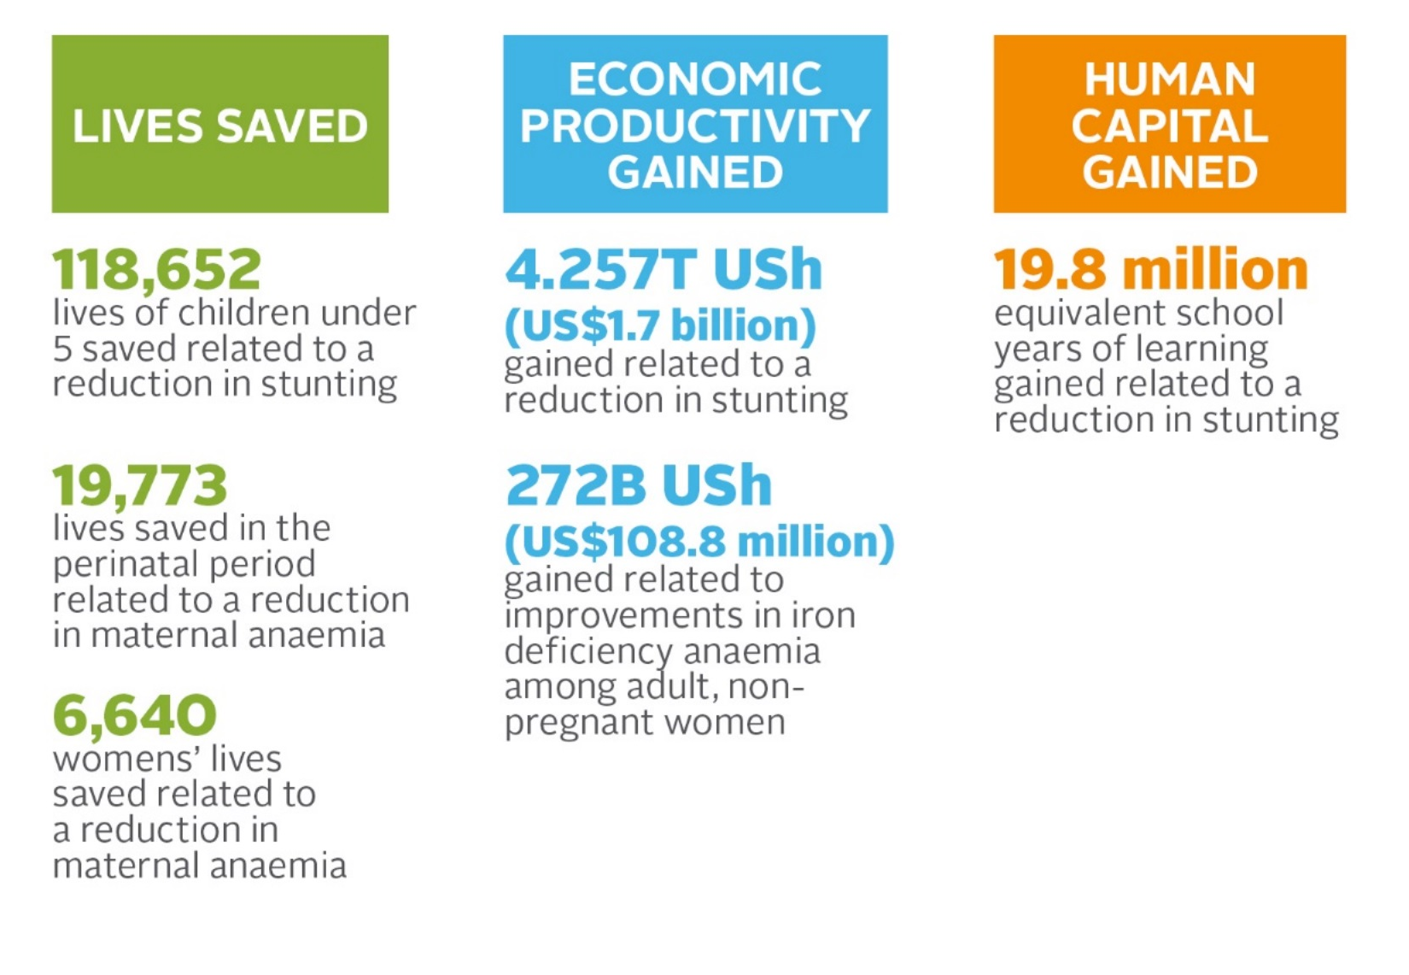
Benefits of Improving Nutrition
These benefits will be realised if nutrition is improved by 2025.
Notes:
Specifically for Uganda, if the nutrition situation is improved through interventions illustrated in the previous slide, Uganda will benefit from improved economic productivity and human capital, as well as save thousands of lives.
These figures show the benefits in economic productivity and human capital gains if even just one nutrition issue was resolved. This example shows the number of lives saved and other benefits of reducing stunting and anaemia by 2025.
In each of your sectors, you can make valuable contributions towards improving nutrition outcomes and, therefore, help the country realise these benefits.

Slide 18
Session 1.2
Uganda Nutrition Policy and Planning Frameworks
Notes:
This presentation highlights the various policy and strategic documents available in Uganda, which provide the enabling environment for planning for nutrition.

Slide 19


















Sustainable Development Goals
http://www.un.org/sustainabledevelopment/
Notes:
The Sustainable Development Goals (SDGs) have set the global development agenda the next 15 years. SDG 2 is aims to end hunger, achieve food security and improved nutrition, and promote sustainable agriculture. This includes eliminating all forms of malnutrition.

Slide 20
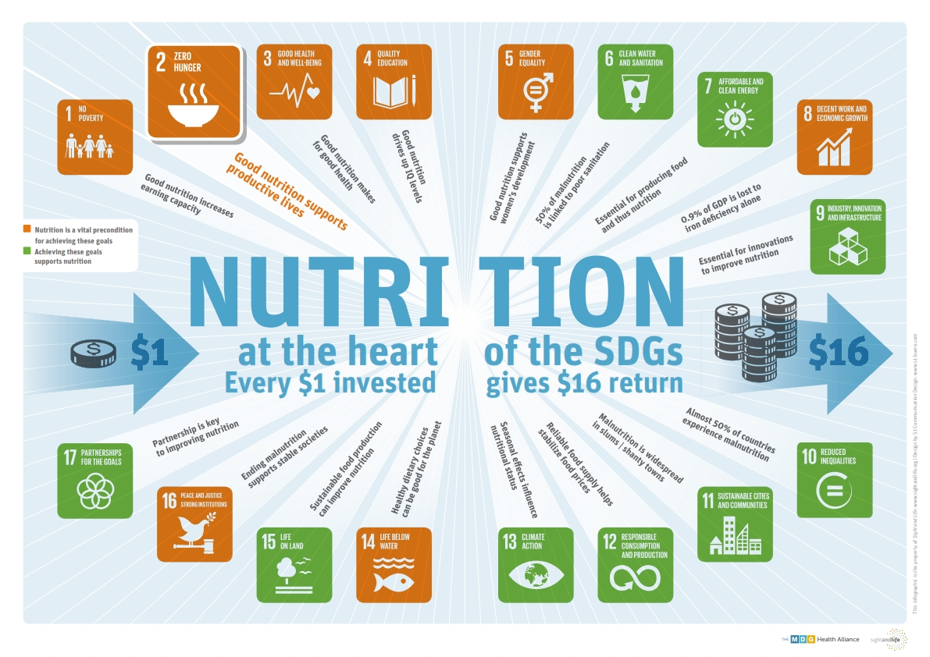
All SDGs Contribute to Improved Nutrition
Notes:
At least 12 of the 17 goals contain indicators that are highly relevant to nutrition. Without adequate and sustained investments in good nutrition, the SDGs will not be realised. This image is included in your Participant’s Handbook. You will see that the orange SDGs require good nutrition to be achieved. The achievement of the SDGs in green support support nutrition.

Slide 21

Scaling-Up Nutrition Movement
Uganda joined the SUN Movement in 2011.
The SUN Movement Strategy and Roadmap (2016–2020) envisions a world free from malnutrition in all its forms by 2030.

Slide 22
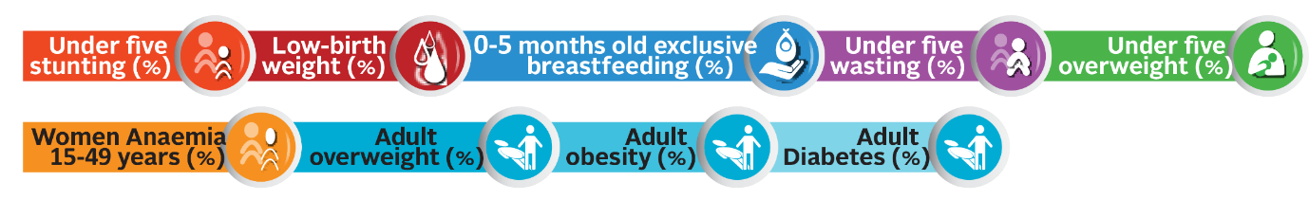
Global Nutrition Targets and Diet-Related Global NCD Targets 2025
The global nutrition targets and the global NCD (non-communicable disease) targets 2025 were endorsed by the World Health Assembly in 2012 and 2013.
SUN Countries are contributing to meeting these targets.

Slide 23
Six Pillars for Nutrition Action
Sustainable food systems for healthy diets
Aligned health systems providing universal coverage of essential nutrition actions
Review, strengthen, and promote nutrition governance and accountability
Improved Nutrition for All
Social protection and nutrition education
Enabling food and breastfeeding environments
Trade and investment for improved nutrition
Notes:
The UN Decade of Action on Nutrition has six pillars for nutrition action.
The six pillars are:
Sustainable food systems for healthy diets
Aligned health systems providing universal coverage of essential nutrition actions
Social protection and nutrition education
Trade and investment for improved nutrition
Enabling food and breastfeeding environments
Review, strengthen and promote nutrition governance and accountability
These pillars are reflected in the following national level policies and frameworks

Slide 24
Regional Frameworks
African Union’s Agenda 2063
African Union 2003 Maputo Declaration on Agriculture and Food Security
African Union 2014 Malabo Declaration on Accelerated Agricultural Growth and Transformation for Shared Prosperity and Improved Livelihoods
East African Community Agriculture and Rural Development Strategy (EAC-ARDS) 2005-2030

Slide 25
Turning Global Strategies into Local Action
Notes:
Nutrition, especially that of young children and women of reproductive age, is a priority in the Uganda Vision 2040 and is identified as a key contributor to social transformation. The Government of Uganda recognises malnutrition’s complexity and the Second National Development Plan 2015/16–2019/20 (NDP II) and the Uganda Nutrition Action Plan 2011–2016 (UNAP) provide a multi-sectoral framework to improve the nutrition situation in Uganda. Nutrition must be included and planned for as a cross-cutting issue, as mandated in the NDP II, the Local Government Development Planning Guidelines 2014, and the Sector Development Planning Guidelines 2015. These policy documents also emphasise the need to plan and coordinate nutrition programming at national, district, and community levels.
Uganda has aligned its policy frameworks and strategies to the existing global strategies such as the Millennium Development Goals, the Scaling Up Nutrition Movement, the Sustainable Development Goals (SDGs). In this way, Uganda’s national and local level objectives will make direct contributions to global nutrition goals.
This purpose of this presentation is to familiarise you with the key national level polices that provide the mandate for nutrition planning and implementation at all levels of local government, from districts to communities. It will also introduce you to the Uganda national nutrition coordination framework and your role in the nutrition planning process.

Slide 26
1995 Constitution of the Republic of Uganda
Section XXII: Food security and nutrition
The State shall:
a) Take appropriate steps to encourage people to grow and store adequate food;
b) Establish national food reserves; and
c) Encourage and promote proper nutrition through mass education and other appropriate means in order to build a healthy state.

Slide 27
Uganda Vision 2040
Vision statement:
A transformed Ugandan society from a peasant to a modern and prosperous country within 30 years.
Nutrition target:
  To reduce stunting among children under 5 from 33 percent to 0 percent by 2040.
Notes:
The goal of the Uganda Vision 2040 is to achieve “A transformed Ugandan society from a peasant to a modern and prosperous country within 30 years.” This calls for investment in human capital development. Reducing childhood stunting is one of the Vision 2040 targets, specifically to eliminate stunting among children under 5 from 33 percent to 0 by 2040. This is because, as we learned in the presentation in Session 1.1, addressing malnutrition provides a strong return on public investment – for every one thousand shillings invested, an estimated six thousand shillings worth of increased productivity will result from reduced child stunting, improved maternal health, enhanced micronutrient intake, and improved nutritional care.

Slide 28
Second National Development Plan
(NDP II) 2015/16–2018/19
Nutrition falls under NDP II Objective 3: Enhance human capital development.
Nutrition-specific target:
  Reduce child stunting in children under 5 years from 33 percent to 25 percent by 2021.
Notes:
Nutrition in the NDP II is aligned to the Sustainable Development Goal 2 on End hunger, achieve food security and improved nutrition, and promote sustainable agriculture. Nutrition targets fall under NDP II Objective 3: Enhance human capital development. This includes a target on reduction in stunting, which will improve educational attainment. General improvements in nutritional status will also help to achieve NDP Objective 3 targets of reducing, material, infant, and child mortality rates, and improvements in secondary education completion and total average years of schooling. In addition, achievements in improved safe water coverage, also an Objective 3 target, will have positive feedback effects on nutrition outcomes as well.
Nutrition-specific interventions address the immediate causes of undernutrition (e.g., inadequate dietary intake) and some of the underlying causes (e.g., feeding practices and access to food).
Nutrition-sensitive interventions address some of the underlying and basic causes of malnutrition—such as food security; adequate caregiving resources at the maternal, household, and community levels; and access to health services and a safe and hygienic environment—and incorporate nutrition goals and actions from a wide range of sectors. They can also serve as delivery platforms for nutrition-specific interventions, potentially increasing their scale, coverage, and effectiveness.
Nutrition is also highlighted as an important cross-cutting issue, which will be discussed more later on.

Slide 29
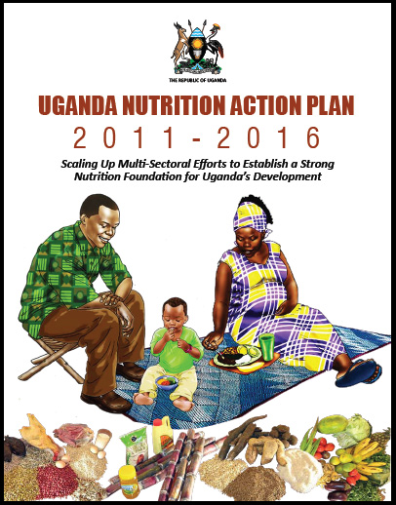
Uganda Nutrition Action Plan 2011–2016
Objectives:
  Improve access to and utilisation of MIYCN health-related services.
  Enhance consumption of diverse diets.
  Protect households from the impact of shocks and other vulnerabilities that affect nutritional status.
  Strengthen the policy, institutional framework, and capacity to effectively plan, implement, and monitor nutrition.
  Create awareness, maintain interest
  and commitment to improve support
  for nutrition.
Notes:
The Uganda Nutrition Action Plan is the national agenda providing multi-sectoral guidance on improving the nutrition outcomes within the first 1,000 days. The goal of the UNAP is to reduce malnutrition levels among women of reproductive age, infants, and young children from 2011 through 2016 and beyond.
It has five objectives:
Improve access and utilisation of maternal, infant, and young child nutrition health-related services.
Enhance consumption of diverse diets.
Protect households from the impact of shocks and other vulnerabilities that affect nutritional status.
Strengthen the policy, institutional framework, and capacity to effectively plan, implement, and monitor nutrition.
Create awareness, maintain interest and commitment to improve support for nutrition.

Slide 30
Local Government Development
Planning Guidelines 2014
Integrate key cross-cutting issues into government programmes and projects.
Key cross-cutting issues:
  Gender
  HIV/AIDS
  Environment
  Nutrition
  Climate change
  Human rights
  Social protection
  Child welfare
Notes:
Nutrition is a key issue cross cutting issue highlighted in the local development planning guidelines to be integrated into the planning frameworks in all sectors and government programs. This means nutrition should be included in the district development plans, sectoral work plans, and budgets.

Slide 31
National Nutrition Planning Guidelines 2015
Support identification, analysis, integration, monitoring, and evaluation of nutrition issues in national, sector, and local government development plans.
Guidance aligned to the local government planning process.
Mandates local governments to include nutrition in their development plans and develop multi-sectoral nutrition action plans.
Notes:
Because nutrition is mandated as a cross-cutting issue in the NDP II, it needs to be integrated into national, sector, and local government level plans. This is reiterated in the local government planning guidelines. The National Nutrition Planning Guidelines 2015 provide a standard process for integration of nutrition into plans at all levels. It emphasizes the requirements at local government level to include nutrition in their five-year development plans and to develop five-year multi-sectoral nutrition action plans. This will familiarise you with the requirements laid out in the National Nutrition Planning Guidelines as you through the process of developing your MSNAPs.

Slide 32
Uganda Multi-Sectoral Nutrition Coordination Framework
Policy Coordination Committee
Parliamentary Subcommittee on Nutrition
Policy Coordination
UNAP implementation Steering Committee
Technical Coordination
Multi-Sectoral Nutrition Technical Committee
Nutrition Secretariat
Office of the Prime Minister
Development Partners Nutrition Coordination Committee
Sector Nutrition Coordination Committee
District Nutrition Coordination Committee
Decentralised Coordination
Municipal Nutrition Coordination Committee
Town Council Nutrition Coordination Committee
Sub-County Nutrition Coordination Committee
Division Nutrition Coordination Committees
Notes:
The UNAP presents this national coordination framework for nutrition, with committees responsible for overseeing nutrition activities from national to LLG level.

Slide 33
NCC Mandate
NCCs provide technical advice to the technical planning committees and subsequently to the Council. The committees will also monitor and evaluate nutrition activities, carrying out reviews and providing technical advice to districts and lower local government levels. Nutrition focal persons will coordinate nutrition activities within their area of responsibility.
Notes:
With this conducive policy environment for implementation of nutrition interventions, there is urgent need to invest in action at local government level and put in place sustainable systems for programming. As a member of the NCC it is part of your responsibilities to ensure nutrition is included in all local government plans and to take a leading role in the development and approval of your MSNAP.
By the end of this you will have a deeper understanding of the nutrition planning process and have developed a draft of your MSNAP to take back to your district/LLG for finalisation and approval by your Council.

Slide 34
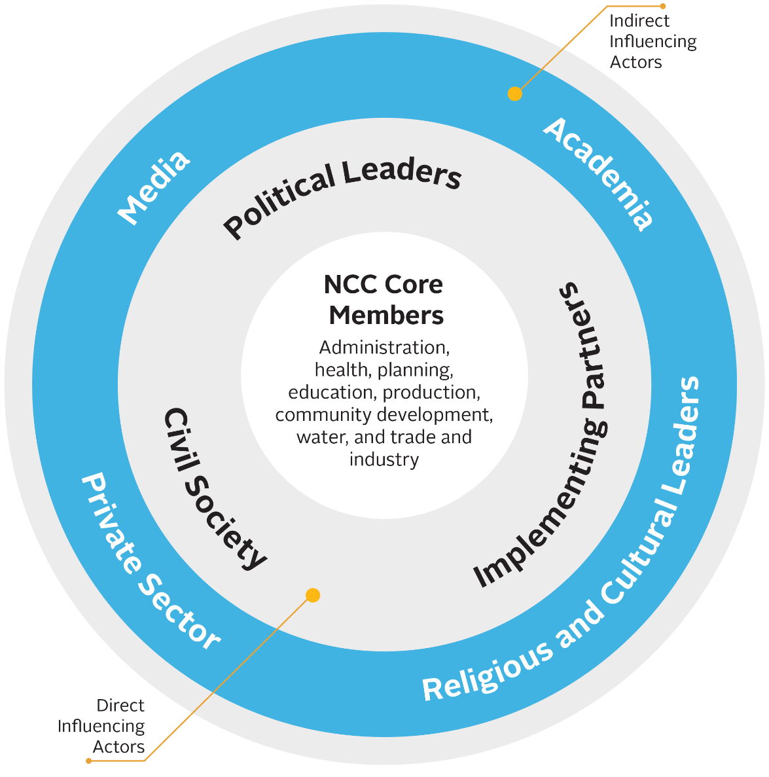
NCC Composition and Influencing Actors
Notes:
DNCC core membership should include government representatives from the administration, health, planning, education, production, community development, and water and environment sectors/departments.
Direct influencing actors include political leaders, civil society, and implementing partners. Because these actors have both financial and technical resources and political influence, they can be effective supporters of DNCC operations even though they are not part of the core DNCC membership. DNCCs should engage with them to advance shared goals that are appropriate for the local context, as these actors are well placed to mobilise nutrition resources and can contribute technical assistance in areas such as data collection.
DNCCs should also engage with indirect influencing actors such as academia, religious and cultural leaders, the media, and the private sector. Each of these actors has a sphere of influence in the community and access to platforms through which advocacy and behaviour change communication for nutrition can be done.
During planning and implementation, DNCCs should also keep the national context in mind, including both development partners and government sectors. Although many such actors do not directly engage with the DNCCs on a regular basis, they can influence decisions that impact DNCC operations through their work with influencing actors, such as implementing partners, at the district/LLG level.

Slide 35
NCC Roles and Responsibilities
Technical guidance
Coordination and partnership with nutrition stakeholders
Monitoring and reporting
Planning, budgeting, and resource mobilisation
Advocacy
Nutrition behaviour change communication and social mobilisation
Notes:
Technical guidance: NCCs provide nutrition technical guidance at all local government levels, including to departments, partners, technical planning committees, and councils to ensure proper nutrition planning and quality of service delivery. This also includes identification of capacity strengthening needs.
Coordination and partnership with nutrition stakeholders: The NCC provides a platform through which nutrition stakeholders from all departments can share information and build consensus on how best to address nutrition problems, use available resources, and harmonise the implementation of nutrition activities in the district/LLG. NCCs also have the responsibility to identify and build partnerships with nutrition stakeholders who can contribute to district/LLG nutrition goals and objectives.
Monitoring and reporting: NCCs conduct joint monitoring and support supervision visits to their lower local government NCCs, departments, and partners to provide oversight to activity implementation. NCCs are also responsible for submitting quarterly reports. Reporting requirements capture progress on nutrition governance activities and on the implementation of activities in the multi-sectoral nutrition action plan.
Planning, budgeting, and resource mobilisation: NCCs ensure integration and alignment of nutrition interventions in all local government development planning frameworks, including Development Plans, the MSNAP, annual work plans, and budgets. NCCs should also mobilise internal and external resources to address resource gaps (e.g., local revenues, partners, and through proposal development).
Advocacy: NCCs should conduct advocacy to raise nutrition awareness among their district/LLG leaders. NCCs should also identify and work with nutrition champions to support advocacy efforts.
Nutrition behaviour change communication (BCC) and social mobilisation: NCCs should utilise available platforms such as the media, community dialogue meetings (barazas), and community outreach to carry out behaviour change communication for nutrition. NCCs should also take the lead in ensuring that nutrition BCC messaging and social mobilisation efforts are harmonised across partners and lower local governments.

Slide 36
Planning for Nutrition
NCCs should ensure integration and alignment of nutrition interventions in all local government development planning frameworks, including the District Development Plan (DDP), the Multi-Sectoral Nutrition Action Plan (MSNAP), annual work plans, and budgets.
Notes:
By the end of this , your skills in this area should be strengthened.

