Slide 1
Multi-Sectoral Nutrition Action Planning Training Module
Unit 2: Nutrition Situation Analysis

Slide 2
Unit Purpose
Analyse the current nutrition situation in your district/LLG and identify the causes of malnutrition.

Slide 3
Unit Objectives
Understand the complexity of the nutrition situation in the district/LLG.
Identify how the various departments’ programmes are linked to the nutrition situation.
Identify nutrition stakeholders and their roles.
Identify the nutrition challenges and opportunities in the district/LLG.

Slide 4
Session 2.1
Understanding the Nutrition Situation

Slide 5
Before Starting to Plan…
What is the current state of nutrition leadership and governance in the district/LLG?
Which actors are involved and what are the main nutrition-related issues in the district/LLG?
Task: Create a visual summary (Rich Picture) of the current nutrition situation in the district/LLG.

Slide 6
Rich Picture – What Is It?
It is a drawing of a situation that helps us to understand the complexity of an entire situation. It helps us to think holistically.
It uses pictures, text, and symbols to illustrate the situation.
It helps us to see relationships and connections that we might otherwise miss.
It shows the complexity of the situation.

Slide 7
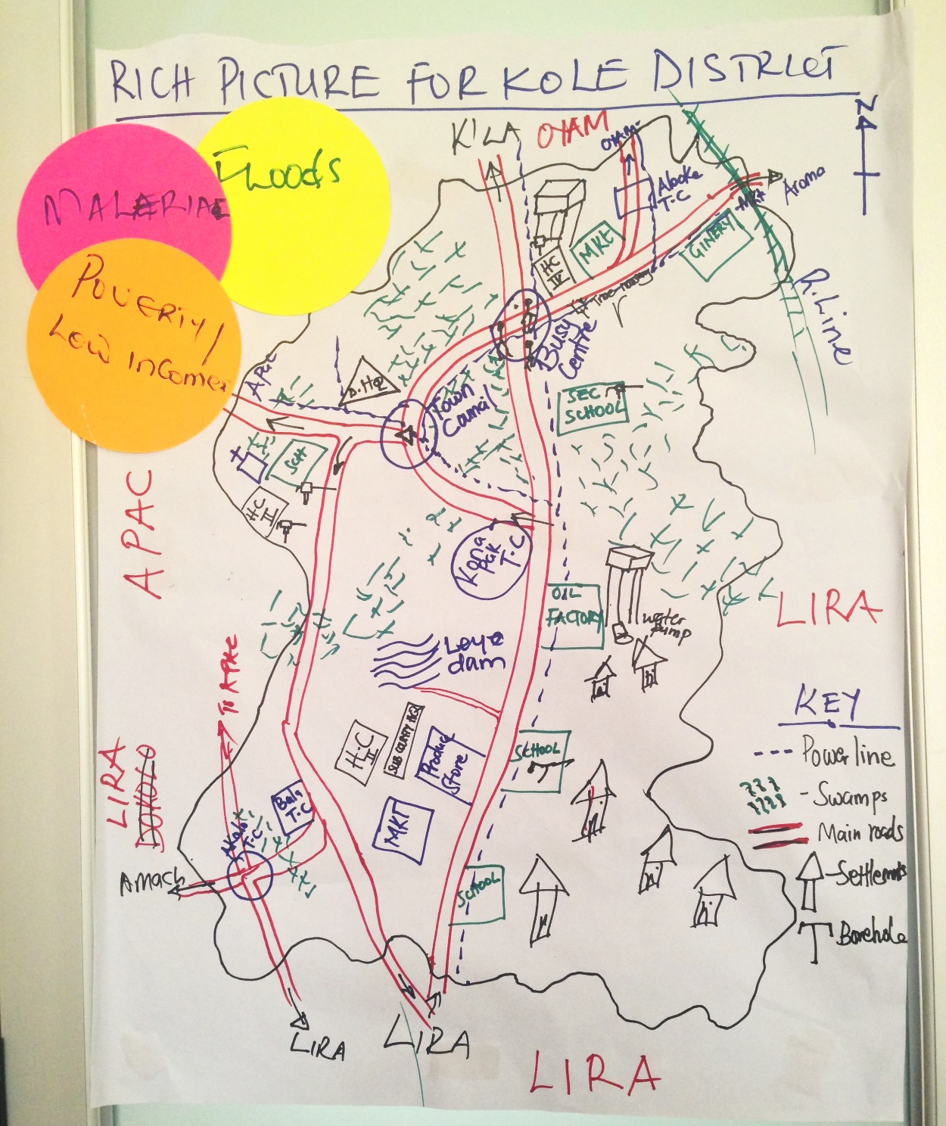

Slide 8
Rich Picture – Group Work
Each team will develop a Rich Picture that reflects the current nutrition situation in their district/LLG.
Please develop the Rich Picture by:
Drawing the district/LLG boundaries on the flip chart.
Drawing physical elements (rivers, buildings, roads, etc.).
Drawing the current nutrition situation and stakeholders (e.g., women growing crops; sick children in homes).
Drawing environmental, social, economic, political, and cultural features influencing the situation.

Slide 9
Reflection Questions
While drawing consider:
Who is most affected?
What are the causes of poor nutrition situation?
Who are the key stakeholders?
How do the causes of malnutrition link with/relate to the district/LLG?
How are the people and situations in the picture linked?
What stands out from the Rich Pictures, what are the three key challenges?
Write these challenges on cards and tape them to the Rich Picture.

Slide 10
Check!
Are all departments included?
Health
Education
Production
Community Development
Water
Trade and Industry
Planning
Administration

Slide 11
Session 2.2
Prioritising Nutrition Challenges by Lower Local Government
Nutrition Planning Workshop
11

Slide 12
Prioritising Challenges
The Rich Picture gives an overview of nutrition challenges.
To plan, we also need to know:
Where are the greatest challenges?
Are some LLGs affected more than others? Why?

Slide 13
Group Work: Traffic Light
Draw a map of the district/LLG on a flip chart, including LLG (e.g., LLG, parish, ward) boundaries.
Using the traffic light system, indicate on the map the nutrition situation in the LLGs.
The LLGs with a poor nutrition situation are coloured RED.
The LLGs with a moderate nutrition situation are coloured ORANGE.
The LLGs with a good nutrition situation are coloured GREEN.

Slide 14
Ranking and Reflection
On a separate flip chart, group the LLGs by ranking and add notes on the following:
Explain the immediate and root causes that contribute to the nutrition situation (good, moderate, poor).
Who is the most affected by the nutrition problems and why?
What actions are needed to improve the situation for these groups?
Remember you can use your district/LLG data to help you with this exercise.

Slide 15
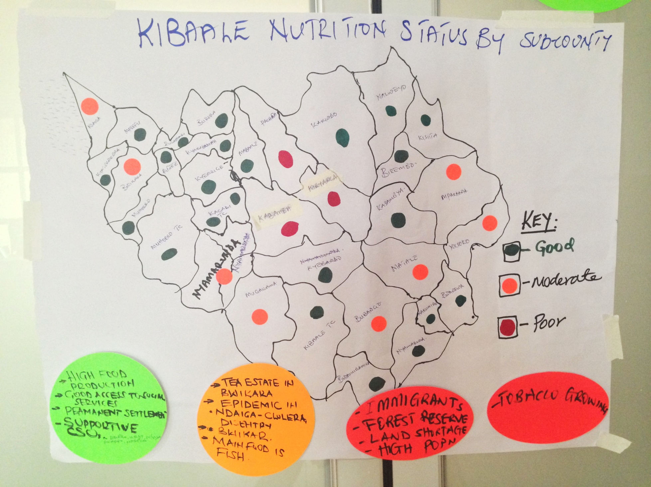

Slide 16
Session 2.3
Nutrition Timeline
16
16

Slide 17
Purpose of the Timeline
The Timeline enables teams to analyse the past and present undertakings in nutrition as well as the factors affecting implementation of nutrition activities.
This will enable districts/LLGs to recognise and appreciate factors responsible for the current nutrition situation, which can be used to inform future strategies.

Slide 18
Group Work
Using flip chart paper and markers, draw a timeline across several pages (about two meters in length).
Agree on an appropriate starting point for the timeline; aim to cover approximately five years.
Include any major historical events that may still be contributing to the current nutrition situation.

Slide 19
Group Work - continued
Discuss the following questions to help build the timeline:
What were the main events and what were the causes/factors responsible for what happened?
What went well, what challenges were faced, what were lessons learned, what are the opportunities/factors/challenges responsible for what happened?
How does each event link to/influence the current nutrition situation in the district/LLG?
Notes:
Facilitator may also add some other socio-economic examples that marked the nutrition history. For instance bad season → impact on nutrition status of the population. Or start of a gender programme → positive effects in terms of decreasing % teenage pregnancies.

Slide 20
Example Timeline
2012
2015
2016
DNCC Established and oriented
2010
Drought and poor harvest
IP starts integrated WASH and nutrition project
2013
Flooding
Cholera outbreak
District develops first MSNAP

Slide 21
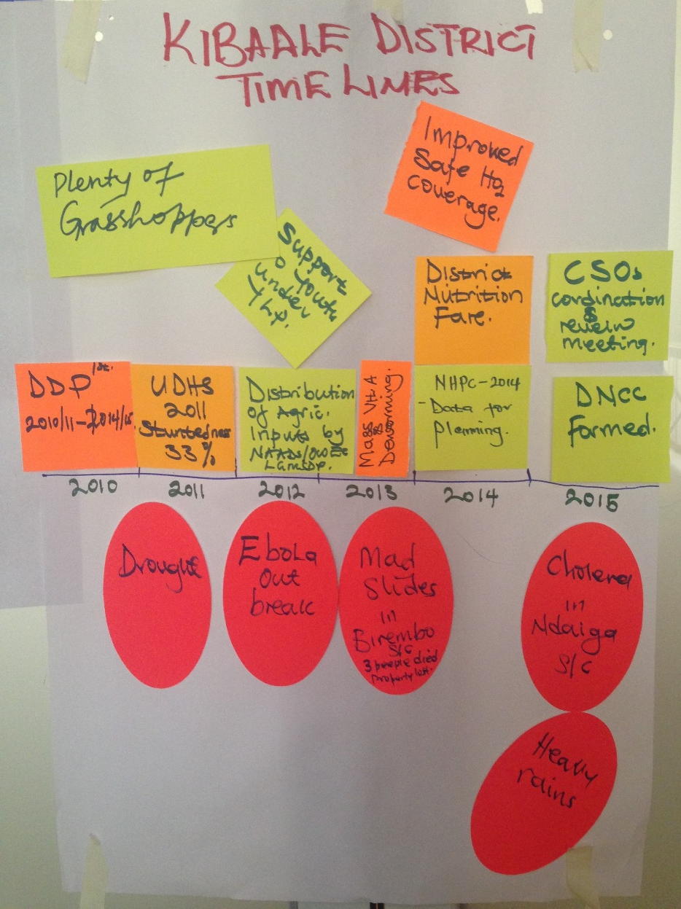
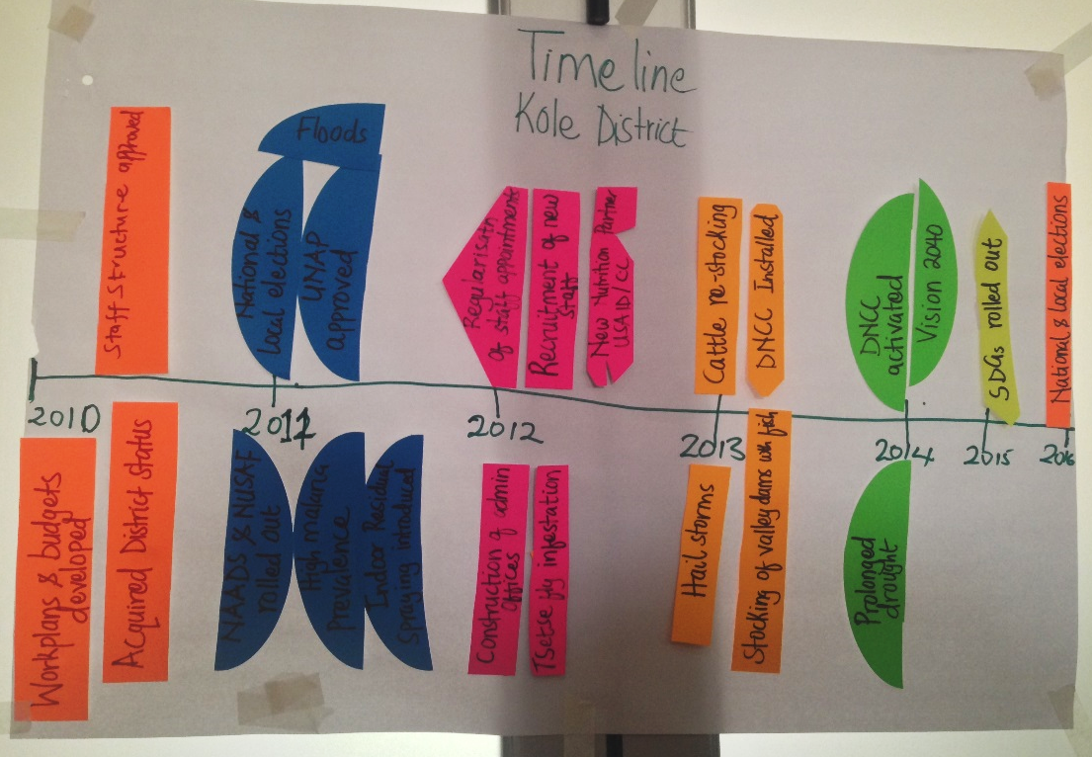

Slide 22
Session 2.4
Sharing the Nutrition Situation Analysis – Part 1
Nutrition Planning Workshop
22
22
22

Slide 23
Gallery Walk: Nutrition Situation
Gallery Walk: Display your Rich Picture, Traffic Light, and Timeline on the wall.
One team member stays with the flip charts to present and get feedback.
Other team members visit the other displays to get ideas and give feedback.
Discussion prompts:
What are the achievements and successes?
Are some of the causes of malnutrition the same as in your district/LLG?
Which lessons can you learn from other teams?

Slide 24
After the Sharing
Return to groups to share feedback and ideas received from other teams.
Make revisions as needed.
Begin working on the Introduction section of the MSNAP template, using what you’ve learned in these sessions.

Slide 25
Session 2.5
Nutrition Stakeholder Analysis
Nutrition Planning Workshop
Nutrition Planning Workshop
Nutrition Planning Workshop
Nutrition Planning Workshop
25
25
25
25

Slide 26
Definition: Stakeholder
A stakeholder is an organisation, group, or individual who has a direct or indirect interest in the nutrition issues in the district/LLG, and who affects or is affected positively or negatively by the implementation of nutrition activities and their outcomes.

Slide 27
Reasons for conducting a Stakeholder Analysis
To identify all people, groups, and institutions who might be affected by an activity or can affect its outcome.
To mobilise key stakeholders, build up common awareness, and create ownership.
To better target interventions and approaches, and identify local institutions and processes upon which to build.
To inform a strategy for participation.
To predict and/or manage conflicts.
To begin understanding the needs and interests of the key stakeholders.
To better understand the roles and responsibilities of those involved.

Slide 28
Analysis Steps
First identify all key stakeholders
Who are the key stakeholders that should be involved in the process of improving nutrition outcomes in the district/LLG?
Be specific—identify which organisation/ stakeholder?
Remember to include stakeholders from government departments, civil society organisations and partners, private sector, media, academia, religious institutions, and individuals like youth and mothers.
Include both current and potential stakeholders.

Slide 29
Steps - continued
Then for each stakeholder analyse the following:
Interest
What is the interest the stakeholder has in the envisioned nutrition changes?
What are the incentives that drive the stakeholder for this change?
Roles and responsibilities
What are the stakeholder’s roles and responsibilities related to nutrition?
Capacity
What is the current capacity of stakeholders to understand nutrition issues and to implement nutrition interventions? Capacity includes not only financial resources but also technical capacity, such as knowledge and skills.
Given level (none, limited, adequate, good) and an explanation.

Slide 30
Steps - continued
Operations
How do stakeholders operate on a day-to-day basis?
With whom do they interact and collaborate?
Where do you see very little or no collaboration?
Resources
What are the available resources and how can these resources be mobilised for nutrition?

Slide 31
Stakeholder Analysis Matrix Example
Name of organisation/ stakeholder | Intervention/ program area | Duration of project | Start date | Coverage | Target group and Estimated population | Implementation mode (complete all applicable columns) |  |  | Estimated annual support to District/ LLG
 |  |  |  |  |  | Tech-nical Assist-ance | Direct | In-kind
WASH Project | Water, sanitation, and hygiene | 2 years | May 2015 | Mbarara - Kakoba | Households with children under 2, 1,500 households |  | UGX 250,000 | Drilling of bore-holes UGX 500,000 | UGX 750,000

Slide 32
Session 2.6
Potentials, Opportunities, Challenges, and Constraints (POCC) Analysis
Nutrition Planning Workshop
Nutrition Planning Workshop
Nutrition Planning Workshop
Nutrition Planning Workshop
Nutrition Planning Workshop
32
32
32
32
32

Slide 33
Potentials, Opportunities, Challenges, and Constraints (POCC)
Potentials refer to internal factors, advantages, and resources that can enable the district/LLG to enhance its chances of achieving the selected goal and objectives.
Opportunities are the external factors (beyond the district/LLG) that positively influence development in the district/LLG to enhance its chances of achieving the selected goal and objectives.
Challenges are the external factors or obstacles (outside the district/LLG) that may hamper smooth development efforts.
Constraints are the disadvantages emanating from internal factors that hinder the district/LLG from achieving the selected development goal and objectives.
Notes:
Examples
Potentials: fertile soil, water sources, good functioning health services
Opportunities: low oil prices, national policies
Challenges: influx refugees, climate change, high food prices
Constraints: low education, rapid population growth, lack of land

Slide 34
POCC Analysis Matrix - Example
Potentials | Opportunities
Challenges | Constraints
Well-established mother’s groups could be used as a platform for sharing nutrition messages.
Private-sector investment in agriculture.
Unpredictable weather patterns.
Limited land available for farming by households.
Notes:
*click slides to take participants through an animated example*
Note to the facilitator: the National Nutrition Planning Guidelines mention the use of a SWOT (strengths, weaknesses, opportunities, and threats) analysis. However, in practice it has been found that the use of the POCC analysis is easier for districts/LLGs to align with the DDPs and other plans, since the Local Government Planning Guidelines propose the use of a POCC analysis for cross-cutting issues. Therefore, the POCC is what has been included for the purposes of this training.
Highlight that SWOT and POCC are simply slightly different approaches to the same type of analysis.

Slide 35
Group Work: POCC Analysis
Duplicate the POCC Analysis matrix on a flip chart.
Identify Potentials, Opportunities, Challenges, and Constraints in the district/LLG.
List at least four items under each category.
Think about all departments!
Be sure that each item included can be linked back to nutrition.
Refer back to your previous group work to help you identify issues to include in each category.

Slide 36
Session 2.7
Problem Tree
Nutrition Planning Workshop
Nutrition Planning Workshop
Nutrition Planning Workshop
Nutrition Planning Workshop
Nutrition Planning Workshop
Nutrition Planning Workshop
36
36
36
36
36
36

Slide 37
Identifying the Main Causes of Malnutrition: Problem Tree
In this session each team will identify the main nutrition problem facing the district/LLG.
Through this exercise, groups will identify the immediate, underlying, and basic/root causes of their main nutrition problem.

Slide 38
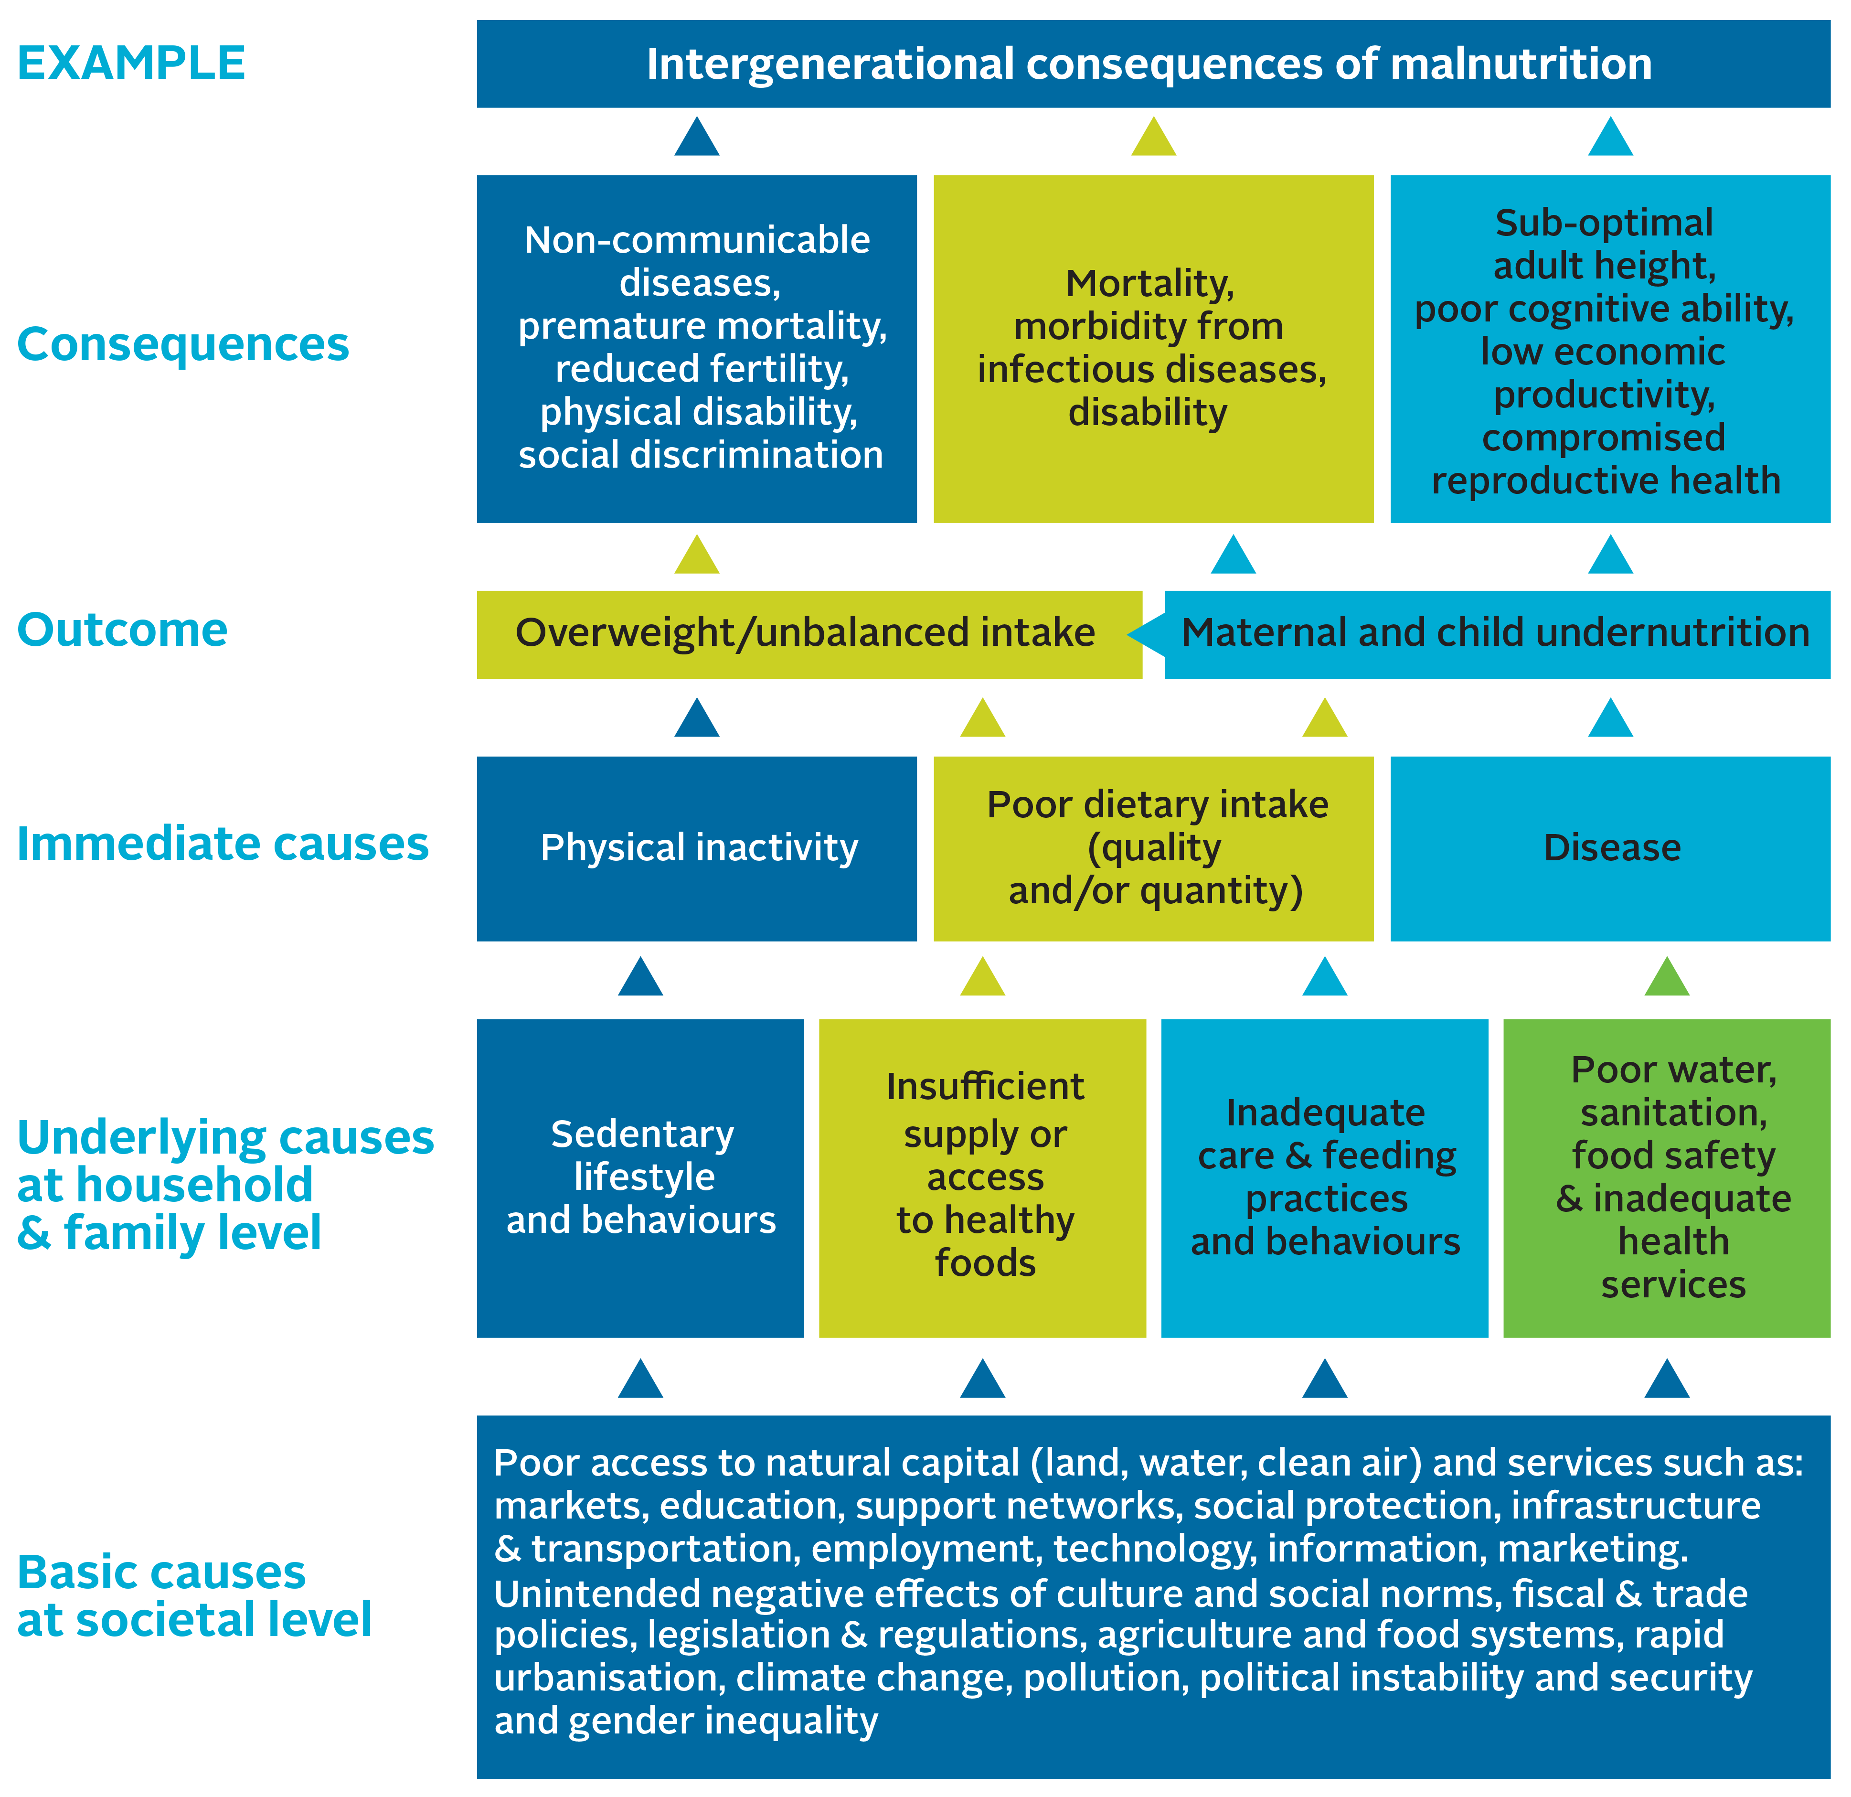
Remember the Causes of Malnutrition
Notes:
To achieve improvement in nutrition outcomes, the various causes of malnutrition must be tackled. There are three levels of causes of malnutrition: basic causes at the societal level, underlying causes at the household and family level, and immediate causes at the individual level.
Immediate causes can lead directly to malnutrition. The most obvious immediate cause is poor dietary intake. A person may not be getting enough required daily calories, or they may be consuming food that does not have the necessary micronutrients, which can lead to chronic malnutrition (stunting) and acute malnutrition (wasting) in children or specific micronutrient deficiency such as iron deficiency which contributes to anaemia in women and children. Extended and frequent illness/disease also can have an impact on the body’s ability to absorb required nutrients. An example of this is a young child who has frequent diarrhoea, which can result in acute malnutrition due to poor nutrient absorption. In addition, consumption of unhealthy foods (e.g., fatty or high calorie and nutrient poor food) and physical inactivity can also lead to malnutrition in the form of overweight or obesity, which can lead to diet-related non-communicable diseases such as diabetes and heart disease.
Immediate causes are exacerbated or caused by underlying causes of malnutrition. Inadequate dietary intake could be due to household food insecurity or poor child feeding practices, such as inadequate dietary diversity or early cessation of breastfeeding. Other inadequate care practices, such as failing to provide stimulation and other good early child development practices, can have negative impacts on cognitive development, which are further compounded by poor diet. Poor nutrition results in reduced immunity to infection, while infection results in the loss of appetite and reduces nutrient absorption, which can produce further weight loss and continued or increased levels of malnutrition. As this cycle repeats itself in a child, growth is compromised, the nutritional status worsens, and the risk of mortality continues to rise. Diseases can also be caused by poor food hygiene, (e.g., diarrhoea is often caused by exposure to faeces through poor handwashing practices). This, in turn, is linked to the environment, including issues of access to water and sanitation infrastructure. Poor water and sanitation infrastructure can contaminate food, leading to an increase in disease. Lack of access to health services, such as vaccinations, also contributes to disease. Lifestyle choices, such as sedentary behaviour, can lead to overweight and obesity, particularly if there is an imbalance in the number of calories consumed versus used. An appropriate diet based on one’s level of activity is recommended.
Finally, basic causes influence the underlying causes, and so can lead to malnutrition. At this level, all sectors are involved. Household food insecurity can be due to a lack of income, which can be the result of low levels of education, which restrict job opportunities and other income-generating opportunities. Educational disparity can lead to increases in gender-based violence, which can have an impact on a mother’s ability to properly care for her children; this may result in inadequate feeding practices or the inability to take children for health services. Educational disparity and available household resources also contribute to individuals making poor dietary choices--consuming a diet that is low in diversity, high in fat and sugar, and low in micronutrient content (e.g., soda, chips, biscuits). Political will can have an impact on the availability of services, including health, education, community development, and agricultural extension, to name a few. It also has an impact on the enabling environment for pro-nutrition policies, which can help expand service coverage and provide funding for necessary services.
As you unpack this framework, it becomes apparent that every sector has a role to play in improving nutrition.

Slide 39
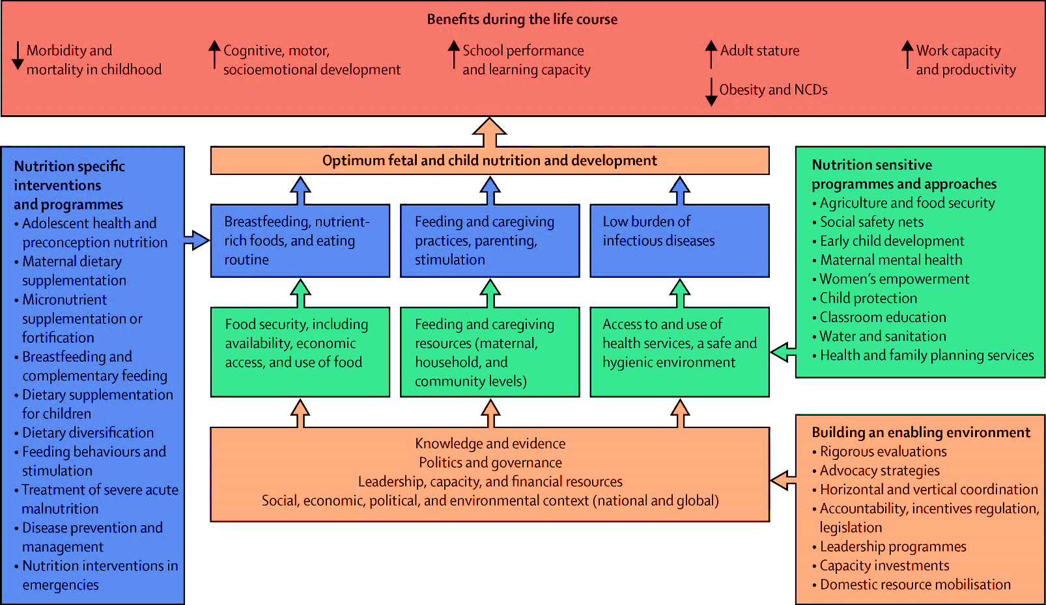
Conceptual Framework for Undernutrition
Source: Black et al. 2013. “Maternal and child undernutrition and overweight in low-income and middle-income countries.” The Lancet: 382.
Notes:
To address the immediate, basic, and underlying causes of malnutrition you need to conduct activities under three main objective areas:
Nutrition-specific, which address the immediate causes (the blue boxes)
Nutrition-sensitive, which address the underlying causes (the green boxes)
Nutrition governance, which address the basic causes (the orange boxes)

Slide 40
Steps to Make your Problem Tree
Write the main nutrition problem facing the district/LLG (e.g., stunting) at the top of a flip chart.
Identify the problems that are causing or contributing to your main nutrition problem, and write them on cards and place them below.
Brainstorm the causes of the next set of problems and write them on cards. Put only one problem per card. Place these cards under the corresponding problem to which they are contributing or causing.
Repeat this process until the root causes of the main nutrition problem are identified.

Slide 41
Use the following questions to help you identify the problems:
Are the economic, political, and socio-cultural dimensions of the problem considered?
Which causes are being addressed and which causes need more attention? Focus on causes that need more attention to uncover their root causes.
Refer to the UNICEF Causes of Malnutrition Framework and the Conceptual Framework for Undernutrition to ensure you have identified:
One problem that is nutrition-specific,
One problem that is nutrition-sensitive, and
One problem related to nutrition governance

Slide 42
Example of a Problem Tree
Why?
Stunting
What else?
What else?
Why?
Inadequate food intake
Why?
Frequent illness
Lack of data to monitor child growth outcomes
Why?
What else?
Household food insecurity
Why?
Poor food hygiene
Unsafe water
Quarterly reporting not completed
Why?
What else?
Why?
Poor harvest
Low income
Unsafe food storage
Inadequate knowledge about safe food preparation
Lack of boreholes
Poor stakeholder coordination
What else?
Why?
More reasons?
Notes:
Emphasise that participants need to think through all departments when identifying the causes of nutrition problems. Refer to the causes of malnutrition framework to help work through district/LLG-specific causes.

Slide 43
Check!
Are all departments included?
Health
Education
Production
Community Development
Water
Trade and Industry
Planning
Administration

Slide 44
Session 2.8
Sharing the Nutrition Situation Analysis – Part 2
Nutrition Planning Workshop
Nutrition Planning Workshop
Nutrition Planning Workshop
Nutrition Planning Workshop
Nutrition Planning Workshop
Nutrition Planning Workshop
Nutrition Planning Workshop
44
44
44
44
44
44
44

Slide 45
Sharing Results
Display on the wall the stakeholder matrix, POCC analysis, and problem tree.
Identify three areas where you think you can strengthen or improve your analysis.
Write these on cards and display with your work.
Visitors should provide suggestions to improve these areas.
One team member remains with the display to answer questions and receive feedback from other teams. Other team members visit other teams.

Slide 46
After the Sharing
Return to groups to share feedback received and ideas from other teams.
Make revisions as needed.

Slide 47
Update the MSNAP Template
Using the results of Unit 2, you can complete the Introduction and Implementation and Coordination sections of your MSNAP.

