Slide 1
Multi-Sectoral Nutrition Action Planning Training Module
Unit 6: Next Steps

Slide 2
Unit Purpose
Finish drafting the MSNAP and understand the next steps to have it approved and implemented.

Slide 3
Unit Objectives
Complete a draft MSNAP to bring back to the district/LLG for additional feedback.
Understand the next steps to finalise and approve MSNAPs.
Understand annual planning requirements, based on the approved MSNAP.

Slide 4
Session 6.1
Review Draft MSNAPs

Slide 5
Review of the MSNAPs
Decide who will be the two hosts staying at your table. These team members will present the MSNAP to visitors. Present your draft MSNAP template on a laptop. Arrange the table so that guests can sit and view the laptop.
Decide who from your team will go to the other district/LLG tables.
Hosts: Prepare your MSNAP presentation and be sure to present all key sections. Be clear on the parts where you request advice and suggestions from the guests. Be sure to note these suggestions to share with your team.

Slide 6
When Visiting Other Teams
Guests arrive and hosts present their MSNAP for 10 minutes.
Afterwards: Allow for 20 minutes of discussion.
Guests can give compliments and constructive feedback. Ask guests to check the logic of the Results Framework and completeness of the M&E Framework and budget.
Two rounds of presentation and sharing should be done so that each group receives feedback from two other teams.

Slide 7
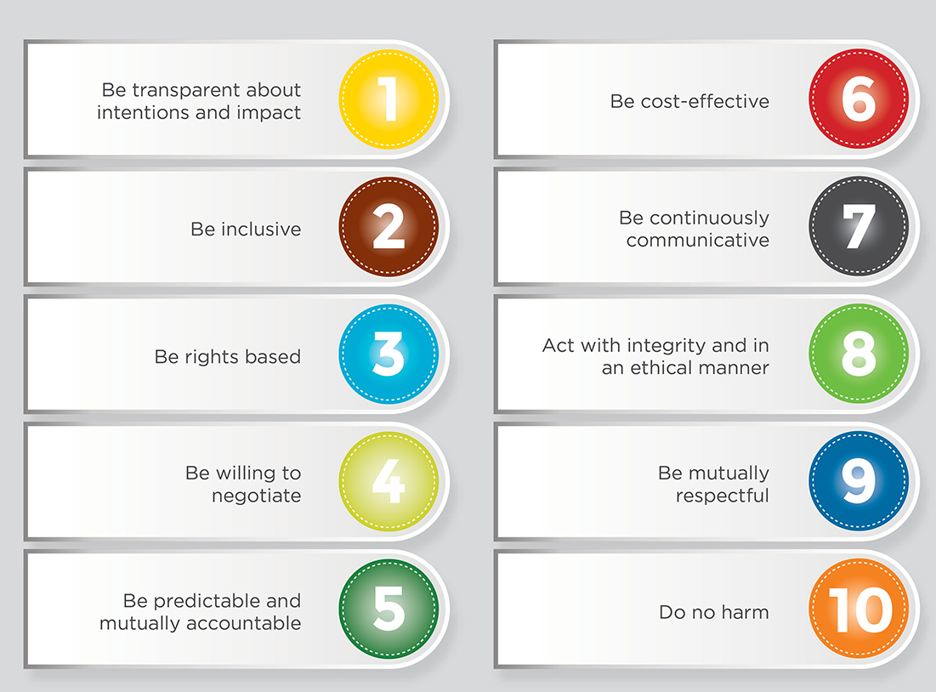
To Help with Your Review
Keep in mind the 10 Principles of Engagement that guide all SUN countries and refer to the checklist of criteria for good nutrition plans in Annex 1 of your Participant Handbook

Slide 8
Updating Draft MSNAPs
Team members return to groups.
Hosts present the suggestions they received.
Other members share the ideas they got from colleagues.
Incorporate necessary changes in your MSNAP template.

Slide 9
Next Steps
Session 6.2

Slide 10
Nutrition Planning Process
Notes:
As mentioned at the beginning of the week, the planning process is ongoing and does not end with drafting the MSNAP. Here are the major steps in the planning process. Note that ongoing advocacy and nutrition technical assistance and sensitisation are key ongoing processes.

Slide 11
Next Steps: Finalizing the Draft MSNAP
Form an MSNAP task force to support the finalisation and subsequent presentation of the MSNAP to relevant council committees for review.
Present the draft MSNAP to the Technical Planning Committee (TPC) and request department support to finalise.
With the departments:
Check that all departments are well represented in the plan.
Gather data and cost information you did not have access to this week.
Request technical support from implementing partners and collect feedback for improvements.
Present the completed, draft MSNAP to the TPC.

Slide 12
MSNAP Approval Process
Once the MSNAP is reviewed by the TPC, the TPC seeks approval by the Council, through the relevant sectoral committee.

Slide 13
After Approval
Implementation of the MSNAP requires:
Inclusion of activities in the annual work plan and budget.
Identification of resources.
Monitoring of and reporting on activities.
Your work as a NCC member does not end with the approval of the MSNAP!

Slide 14
Types of NCC Annual Plans
Annual Nutrition Coordination Work Plan
This plan details the NCC activities on an annual basis, based on the six NCC roles and responsibilities. These activities should align with the activities identified under the governance objective in your Results Framework.
Annual Multi-Sectoral Implementation Work Plan and Budget
This plan details the MSNAP activities, targets, and budgets on an annual basis. These activities should align with the activities identified under the nutrition-specific and nutrition-sensitive objectives in your Results Framework

Slide 15
Group Work: Your Next Steps
Now that you have a draft MSNAP, what next steps must you take?
Complete the matrix in your Participant Handbook and consider the following:
What additional information needs to be collected/confirmed in order to complete the MSNAP?
Who needs to review the draft MSNAP before it is submitted for approval?
Departments, TPC, CAO, partners?
What is the timeline to complete the draft MSNAP?
When should it be submitted to the Council for approval?
Who needs to be involved in the approval process?

Slide 16
Example
Next Steps/ Activities | Responsible | Timeline | Approach/ Methodology
Complete MSNAP Budget | District/LLG Planner | 2 weeks after MSNAP training (September 16, 2017) | Obtain input from each department on activity costs

Slide 17
Closing
Session 6.3

Slide 18
Revisiting Training Objectives
Were the training objectives met?
Develop a draft 5-year Multi-Sectoral Nutrition Action Plan (MSNAP) tailored to the district/LLG context.
Describe the nutrition situation within the district/LLG.
Develop a Multi-Sectoral Nutrition Results Framework and Monitoring and Evaluation Plan.
Estimate required resources for implementation of nutrition interventions.
Understand the process of MSNAP finalisation and approval by the appropriate Council.

Slide 19
Self-Assessment
At the start of the week you completed a self-assessment.
At the end of the week we would like to see how much you have learned and help you identify areas for further strengthening.
Please turn in your assessment to the facilitator after you complete it.
Be sure to include your name or initials on the assessment form.

Slide 20
Closing
Add the name, title, and organisation of the official closing the training, if appropriate.

